Slide 1
An unpublished Latin testament P. Carlsberg 671 recto + Pap. Berlin P. P 14470 b recto
Hilla Halla-aho
Act of the Scribe –project, University of Helsinki
PLATINUM-ERC, University of Naples
hilla.halla-aho@helsinki.fi

Slide 2
P. Carlsberg 671 + PSI inv. I 149 + Pap. Berlin P. P 14470 b recto
Fragments in Copenhagen, Florence and Berlin
Verso: demotic and hieratic writing from the Tebtunis temple library (magical spells, water)
Recto: Latin and Greek writing
2nd century AD (?)

Slide 3
P. Carlsberg 671
PSI inv. I 149
Photo courtesy of Carlsberg papyrus collection
Photo courtesy of Istituto papirologico ”G. Vitelli”

Slide 4
Pap. Berlin P. P 14470 b recto
-Joins with P. Carlsberg 671 frag A.
(Susanne Töpfer)
Photo courtesy of Ägyptisches Museum und Papyrussammlung, Berlin

Slide 5
P. Carlsberg 671
D
C
Fragment A: part of a Roman will.
Careless and irregular cursive hand.
Fragment B: Latin writing and a word in Greek.
The hand in fragment B resembles partly the hand in fragment A.
The traces of letters in fragments C and E possibly the same hand as fragment A.
E
B
A

Slide 6
PSI inv. I 149
D
C
E
A
Greek writing on fragment B and traces of Greek letters on fragment D
Traces of Latin letters in fragments C and A.
Same document or smaller pieces of papyri glued together for making larger manuscripts?
B

Slide 7
Roman testaments in the papyri
Migliardi Zingale, L. (1997³) I testamenti Romani nei papiri e nelle tavolette d’Egitto. Silloge di documenti dal I al IV secolo, Torino: Giappichelli.
→ 12 texts in Latin, 18 texts in Greek
Nowak, M. (2015) Wills in the Roman Empire. The Journal of juristic papyrology, Supplement XXIII. Warsaw: University of Warsaw and The Raphael Taubenschlag Foundation.
→ 13 texts in Latin, 21 texts in Greek
Latin wills on papyri are usually copies of originals on wax tablets
Greek texts are translations of Latin originals until the first half of the third century (Severus Alexander)

Slide 8
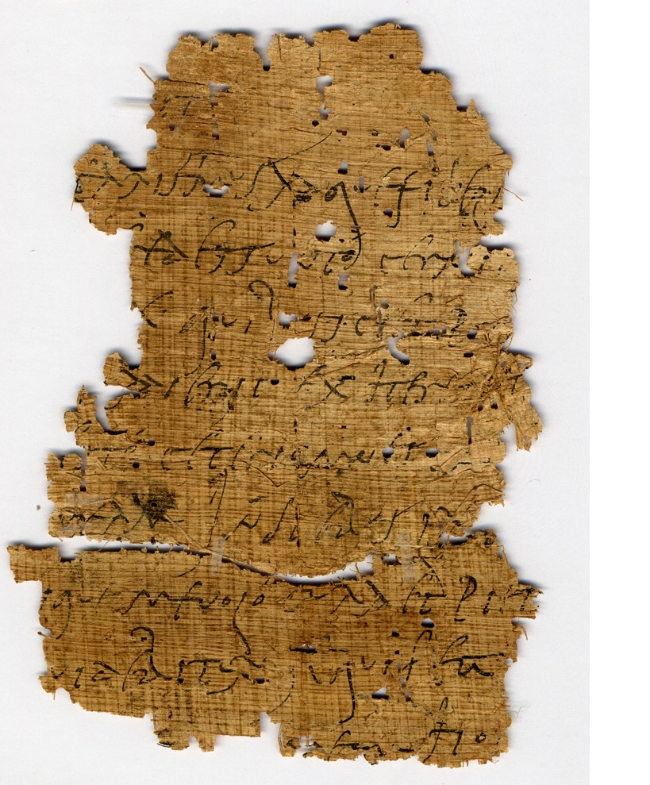
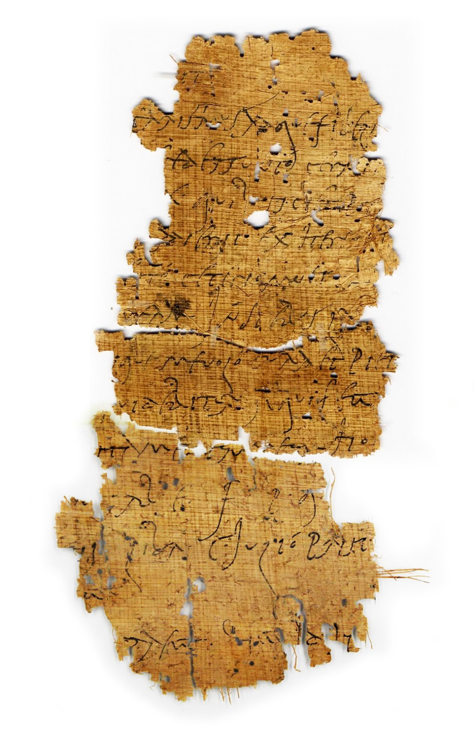
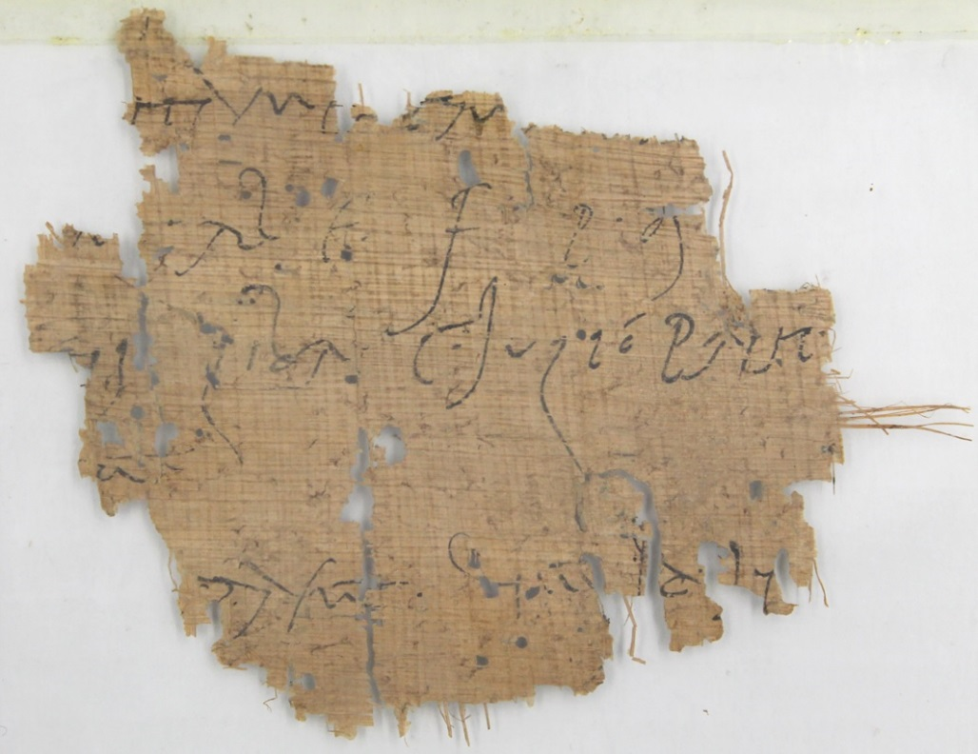
P. Carlsberg 671 + Pap. Berlin P. P 14470 b recto

Slide 9
P. Carlsberg 671, recto, fragment A + Pap. Berlin P. P 14470 b recto
1 [ testamentum fec]ịt
2 [ ]caris`si´mus atque fideli[ssimus mihi heres esto]
3 [ceteri omnes exh]ẹṛedes sunto cernịṭ[oque hereditatem meam]
4 [in diebus C pro]x(imis) quibụs scịet pọṭ[eritque testari quod ni ita]
5 [creuerit nequ]ẹ adierit exherẹṣ [es]t[o tum ]
6 [ mihi heres] esto ceteri omnes ẹx̣[heredes sunto cernitoque]
7 [hereditatem] ṃeam in diebus LX p̣[roximis ]
8 [ sepelir]ịque me uolo cura et pietạ[te ]
9 [ ]uidebiturq[u]ẹ qui feci[t?
10 [ ]ṭti me . ciuṃeụṃ ho . [ ]
11 [ d(olus) · ]ṃ(alus) · ab e(sto) · f(amiliam) · p(ecuniam) · q(ue) ·[t f c e f]
12 [ ] . · i libr(ipende) C · Iulió Prisc[o
13 [ ]u .
14 [ ] p̣ · aeciṭ · . . . . d

Slide 10
P. Carlsberg 671, recto, fragment A + Pap. Berlin P. P 14470 b
1 [ testamentum fec]ịt
2 [ ]caris`si´mus atque fideli[ssimus mihi heres esto]
3 [ceteri omnes exh]ẹṛedes sunto cernịṭ[oque hereditatem meam]
4 [in diebus C pro]x(imis) quibụs scịet pọṭ[eritque testari quod ni ita]
5 [creuerit nequ]ẹ adierit exherẹṣ [es]t[o tum ]
6 [ mihi heres] esto ceteri omnes ẹx̣[heredes sunto cernitoque]
7 [hereditatem] ṃeam in diebus LX p̣[roximis ]
8 [ sepelir]ịque me uolo cura et pietạ[te ]
9 [ ]uidebiturq[u]ẹ qui feci[t?
10 [ ]ṭti me . ciuṃeụṃ ho . [ ]
11 [ d(olus) · ]ṃ(alus) · ab e(sto) · f(amiliam) · p(ecuniam) · q(ue) ·[t f c e f]
12 [ ] . · i libr(ipende) C · Iulió Prisc[o
13 [ ]u .
14 [ ] p̣ · aeciṭ · . . . . d

Slide 11
PC671.2 ]caris`si´mus atque fideli[ssimus
P. Oxy. LII 3692 (ChLA XLVII 1424 = TM26514) [caris?]sima femina

Slide 12
P. Carlsberg 671, recto, fragment A + Pap. Berlin P. P 14470 b
1 [ testamentum fec]ịt
2 [ ]caris`si´mus atque fideli[ssimus mihi heres esto]
3 [ceteri omnes exh]ẹṛedes sunto cernịṭ[oque hereditatem meam]
4 [in diebus C pro]x(imis) quibụs scịet pọṭ[eritque testari quod ni ita]
5 [creuerit nequ]ẹ adierit exherẹṣ [es]t[o tum ]
6 [ mihi heres] esto ceteri omnes ẹx̣[heredes sunto cernitoque]
7 [hereditatem] ṃeam in diebus LX p̣[roximis ]
8 [ sepelir]ịque me uolo cura et pietạ[te ]
9 [ ]uidebiturq[u]ẹ qui feci[t?
10 [ ]ṭti me . ciuṃeụṃ ho . [ ]
11 [ d(olus) · ]ṃ(alus) · ab e(sto) · f(amiliam) · p(ecuniam) · q(ue) ·[t f c e f]
12 [ ] . · i libr(ipende) C · Iulió Prisc[o
13 [ ]u .
14 [ ] p̣ · aeciṭ · . . . . d

Slide 13
PC671.4-5 [quod ni ita creuerit nequ]ẹ adierit exherẹṣ [es]t[o
Gaius, inst. 2.165-166:
Cum ergo ita scriptum sit: heres TITIVS ESTO, adicere debemus: CERNITO QVE IN CENTVM DIEBVS PROXUMIS, QVIBVS SCIES POTERIS QVE. QVOD NI ITA CREVERIS, EXHERES ESTO. Et qui ita heres institutus est, si uelit heres esse, debebit intra diem cretionis cernere, id est haec uerba dicere: QVOD ME PVBLIVS MEVIVS TESTAMENTO SVO HEREDEM INSTITVIT, EAM HEREDITATEM ADEO CERNITO QVE.
R.S.O. Tomlin, Archaeologia Cambrensis 150 (2001), 143-156 (reprinted in Nowak 2015, 357) l. 12 adito ce[r]nito hereditatem meam; l. 18-19 [s]i aditum noluer[is exher]es esto

Slide 14
P. Carlsberg 671, recto, fragment A + Pap. Berlin P. P 14470 b
1 [ testamentum fec]ịt
2 [ ]caris`si´mus atque fideli[ssimus mihi heres esto]
3 [ceteri omnes exh]ẹṛedes sunto cernịṭ[oque hereditatem meam]
4 [in diebus C pro]x(imis) quibụs scịet pọṭ[eritque testari quod ni ita]
5 [creuerit nequ]ẹ adierit exherẹṣ [es]t[o tum ]
6 [ mihi heres] esto ceteri omnes ẹx̣[heredes sunto cernitoque]
7 [hereditatem] ṃeam in diebus LX p̣[roximis ]
8 [ sepelir]ịque me uolo cura et pietạ[te ]
9 [ ]uidebiturq[u]ẹ qui feci[t?
10 [ ]ṭti me . ciuṃeụṃ ho . [ ]
11 [ d(olus) · ]ṃ(alus) · ab e(sto) · f(amiliam) · p(ecuniam) · q(ue) ·[t f c e f]
12 [ ] . · i libr(ipende) C · Iulió Prisc[o
13 [ ]u .
14 [ ] p̣ · aeciṭ · . . . . d

Slide 15
PC671.8 sepelir]ịque me uolo cura et pietạ[te
BGU 1 326, 2, 1-2 (Chr. Mitt. 316 = FIRA III 50 = TM 9056; testament of the veteran C. Longinus Castor, 21. February 194 CE, Karanis?)
ἐκκο[μι]σθῆναι περιστ[αλ]ῆναί τε ἐμαυτὸ[ν] θέλω τῇ φροντίδι καὶ εὐσεβείᾳ τῶν [κ]ληρονόμων μου

Slide 16
P. Carlsberg 671, recto, fragment A + Pap. Berlin P. P 14470 b
1 [ testamentum fec]ịt
2 [ ]caris`si´mus atque fideli[ssimus mihi heres esto]
3 [ceteri omnes exh]ẹṛedes sunto cernịṭ[oque hereditatem meam]
4 [in diebus C pro]x(imis) quibụs scịet pọṭ[eritque testari quod ni ita]
5 [creuerit nequ]ẹ adierit exherẹṣ [es]t[o tum ]
6 [ mihi heres] esto ceteri omnes ẹx̣[heredes sunto cernitoque]
7 [hereditatem] ṃeam in diebus LX p̣[roximis ]
8 [ sepelir]ịque me uolo cura et pietạ[te ]
9 [ ]uidebiturq[u]ẹ qui feci[t?
10 [ ]ṭti me . ciuṃeụṃ ho . [ ]
11 [ d(olus) · ]ṃ(alus) · ab e(sto) · f(amiliam) · p(ecuniam) · q(ue) ·[t f c e f]
12 [ ] . · i libr(ipende) C · Iulió Prisc[o
13 [ ]u .
14 [ ] p̣ · aeciṭ · . . . . d

Slide 17
PC671.10 ho[c]?
→ ho[c testamento dolus] ṃ(alus) abe(sto)?
cf. huic testamen[to dolus malus abesto]
P. Yale inv. 1547 = ChLA IX 399
→ ho[c testamentum]?.
Cf. si quid post hoc testamentum (… scriptum sit)

Slide 18
P. Carlsberg 671, recto, fragment A + Pap. Berlin P. P 14470 b
1 [ testamentum fec]ịt
2 [ ]caris`si´mus atque fideli[ssimus mihi heres esto]
3 [ceteri omnes exh]ẹṛedes sunto cernịṭ[oque hereditatem meam]
4 [in diebus C pro]x(imis) quibụs scịet pọṭ[eritque testari quod ni ita]
5 [creuerit nequ]ẹ adierit exherẹṣ [es]t[o tum ]
6 [ mihi heres] esto ceteri omnes ẹx̣[heredes sunto cernitoque]
7 [hereditatem] ṃeam in diebus LX p̣[roximis ]
8 [ sepelir]ịque me uolo cura et pietạ[te ]
9 [ ]uidebiturq[u]ẹ qui feci[t?
10 [ ]ṭti me . ciuṃeụṃ ho . [ ]
11 [ d(olus) · ]ṃ(alus) · ab e(sto) · f(amiliam) · p(ecuniam) · q(ue) ·[t f c e f]
12 [ ] . · i libr(ipende) C · Iulió Prisc[o
13 [ ]u .
14 [ ] p̣ · aeciṭ · . . . . d

Slide 19
PC671.11-12 f(amiliam) · p(ecuniam) · q(ue) ·[t(estamenti) f(aciendi) c(ausa) e(mit) f(iduciarius X (sestertio) n(ummo)] · i libr(ipende) C · Iulió Prisc[o antestatus est Y]

Slide 20
P. Carlsberg 671, recto, fragment B
1 P̩ˌ . . LXỊ
2 . . . . ETH . . B
(vacat)
3 Ṣ . IMARE M
4 SE IN
5 EM I . . BS
(a symbol)
. σ . . επωτιαṆ

