Slide 1
Supporting upper secondary students’
online inquiry competencies
Liisa Ilomäki, University of Helsinki,
liisa.ilomaki@helsinki.fi
Elina Hämäläinen, University of Jyväskylä,
Eero Sormunen, Tampere University
CPH 2019 Conference on literacy, 5.8.2019 Copenhagen, Denmark
liisa.ilomaki@helsinki.fi

Slide 2
ARONI project, Academy of Finland https://blogs.sis.uta.fi/aroni/ Background of the study
Previous studies show that upper secondary students leave the school with insufficient and heterogeneous information competencies (Hautamäki et al., 2012; Kiili, 2012; Lundahl et al. 2010; OECD, 2010).
Existing teaching practices or models need to be updated for teaching relevant digital online literacy (Breakstone, McGrew, Smith, Ortega, & Wineburg, 2018). Also here thoughts of Byeong-Young Cho!
Our aim was to create a practical four-step intervention process following an inquiry process for teaching online inquiry skills and to investigate teachers’ and students’ experiences when using it. For this, we used both pedagogical, literacy and information science expertise.

Slide 3
Developing pedagogy for supporting students’ online inquiry skills
MAIN GOAL
SUBGOALS
To develop models and practices for teaching online inquiry skills
To develop instruments for evaluating students’ online inquiry skills and use them to evaluate current skills
To develop a model for teaching online inquiry skills and knowledge work competence as well as test it with teachers
To examine teachers’ current pedagogical practices in building students knowledge work competence
To examine students’ conceptions of knowledge and everyday online practices
Dia by Minna Lakkala & Liisa Ilomäki

Slide 4
Today the aim is to describe some results of the intervention study (2018-19).

Slide 5
The intervention approach: simulating real life processes of online inquiry
In general, we used the trialogical design principles as guidelines (Paavola, Lakkala, Muukkonen, Kosonen, & Karlgren 2011) and results of a previous sub study (Ilomäki, Lakkala, Muukkonen, Paavola, & Toom, submitted)
A collaborative object for students’ work was an “authentic”, contradictory health issue (e.g. sleeping pills). A few topics which the groups could choose one.
Working groups were based on students’ interest of the topic, work in groups was obligatory.
Work was organised using a collaborative writing template which followed the recommended phases of information processing.
A limited Google search engine in use
Reflective questions about the process and the outcomes after every phase (Agarwal & Roediger, 2018)
Teachers followed the together planned working schedule and they had all materials ready-made.
liisa.ilomaki@helsinki.fi

Slide 6
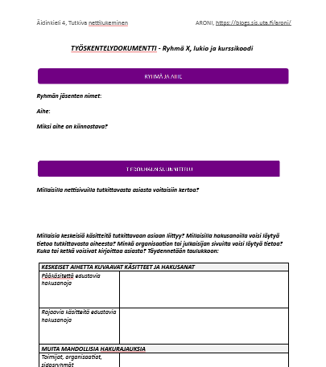
Organization of the intervention assignment
Working process
Web-based platform for sharing materials and links (OneNote)
Work document template for each group (Google doc)
Lesson 1: Searching
for relevant sources
Instructions for the assignment
For each phase/lesson:
Teaching material about online inquiry strategies
Working instructions
Links to work documents of the groups
Authors:
Topic:
Interests in the topic
Planning the search process
Examining the sources
Reflecting the process and outcomes
.....
Homework 1 (if necessary): Searching for sources
Lesson 2: Evaluating the credibility of sources
Homework 2 (if necessary): Evaluating / comparing sources
Lesson 3: Preparing a synthesis based on multiple sources
Homework 3 (if necessary): Finalizing the group report
Lesson 4: Presenting and discussing about the
syntheses
Dia by Minna Lakkala & Liisa Ilomäki
Notes:
(Agarwal & Roediger, 2018)

Slide 7
Teacher data of this sub-study
Teaching online inquiry and knowledge practices
Observations (5)
Diaries (9)
Interviews (5)
How the teacher applied the model
How the teacher applied the model Experiences about the model, suggestions for improvements
Experiences about the model, suggestions for improvements;
Self-reflection about pedagogy & own expertise,
Teacher collaboration
liisa.ilomaki@helsinki.fi

Slide 8
Student data of this sub-study
Learning online inquiry and knowledge practices
Individual (both test and control groups)
Collaborative knowledge practices (CKP) questionnaire
CKP Open questions
The process of the teaching model
Self-assessed learning of knowledge practices
Working group (only the test group)
Quality of working; self-reflection about working
Working documents

Slide 9
Some results of the intervention study
How did students evaluate learning of knowledge work practices during the intervention (test group) vs. no intervention (control group)?
How did students evaluate the experiences during the intervention (test group)?
How did teachers evaluate the experiences of the intervention?

Slide 10
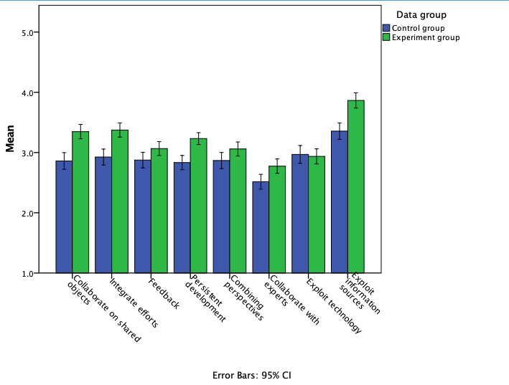
Students’ self-evaluated learning of knowledge work practices (CKP questionnaire)
Statistical significance of the difference <.000
Statistical significance of the difference <.05 or <.005

Slide 11
Experiences described by students
in free-text CKP answers (9 courses, 146 students; number of mentions in parenthesis)
Positive or impressive (183)
Online inquiry (88 / 48,1 %): Learnt critical ecaluation (49), Learnt to find sources (15), Learnt to use sources (12), Exploring sources (7), Making a synthesis (5)
Project task (57 / 31,1 %): Interesting and enjoyable (15), Different than usual (12), Learnt something new (10), Focussed exploration (4), Comprehensive (4), Interesting topics (3), Freedom of working (3), Appropriate challenge (3), Useful (3)
Collaboration (32 / 17,5 %): Working in the group (27), Different viewpoints (3), Learnt group work skills (2)
Organization (6 / 3,3 %): Well-structured (4), Material from researchers (2)
Challenging or disturbing (140)
Online inquiry (33 / 23,6 %): Challenges in evaluating sources (17), Challenges in finding sources (14), Challenges in making a synthesi (2)
Project task (55 / 39,3 %): Not interesting (19), Too long and laborious (16), Nothing new (9), Challenging (11)
Organization (30 / 21,4 %): Poor instructions and materials (16), Tight timetable (9), Unclear structure (5)
Collaboration (22 / 15,7 %): Challenges in group work (13), Uneven participation (9)
Dia by Minna Lakkala & Liisa Ilomäki
liisa.ilomaki@helsinki.fi

Slide 12
Teachers’ evaluations of the intervention in diary statements (9)
Statement | Totally agree | Somewhat agree | Neutral | Somewhat disagree | Totally disagree
The teaching entity worked well. | 2 | 7
Time for the assignments was sufficient. | 2 | 4 | 1 | 2
The assignments were on appropropriate level. | 4 | 3 | 2
Students were engaged in doing the assignments. | 2 | 5 | 1 | 1
The learning goals were realistic. | 5 | 4
Students learnt the skills of information search. | 2 | 7
Students learnt the skills of critical evaluation. | 2 | 7
Students learnt the skills of making synthesis. | 2 | 7
liisa.ilomaki@helsinki.fi

Slide 13
Teachers’ evaluations in the interviews (5): The most often mentioned (ATLAS.ti analysis)
Digital technology: students did not need any help
Positive project, all teachers will re-use this model, succeeded well, matched well in the course (Finnish language and literature, course named Influencing)
The assignment was good.
The materials were excellent: Information dias, Clear assignments, Working document good.
To be improved: the topics (now limited because of the study), guidance (more guidance needed, not skills to guide groups)
Too many groups

Slide 14
Making the synthesis and comparing references was difficult.
Students had difficulties in understanding various stakeholders (meaning to use different opinions).
Students pre-attitudes (“we know this information search”) was not true.
Teachers needed to guide students: Search words, Focusing the search, Evaluating the references
Students succeeded differently and the level of the outcomes varied. They especially learnt how to create search words and how to evaluate information or a reference.
Exceptions of the intervention plan: only the use of time.

Slide 15
Discussion and conclusions
In general, the intervention succeeded, based both on teacher and student data: the idea, the process and the teaching & learning materials.
Small adjustments needed, e.g. topics. Should the projects always respect also the content?
More emphasis on students’ engagement – how?
Self-reflection and presenting the results in groups (not teacher-led) were (too) new to teachers and to students.
Increased consciousness about the phases of online information search - also among teachers.
A more accurate and detailed analysis of the process needed, based on the both data.

Slide 16
References
Agarwal, P. K., & Roediger, H. L. (2018). Lessons for learning: How cognitive psychology informs classroom practice. Phi Delta Kappan, 100(4), 8–12. https://doi.org/10.1177/0031721718815666
Breakstone, J., McGrew, S., Smith, M., Ortega, T., & Wineburg, S. (2018). Why we need a new approach to teaching digital literacy. Phi Delta Kappan, 99(6), 27–32. https://doi.org/10.1177/0031721718762419
Hautamäki J., Säkkinen, T., Tenhunen, M-L., Ursin, J.,Vuorinen, J., Kamppi, P., & Knubb-Manninen, G. (2012). Lukion tuottamat jatkokoulutusvalmiudet korkeakoulutuksen näkökulmasta. [The competencies produced by upper secondary school for further education from the higher education point of view]. Jyväskylä: Koulutuksen arviointineuvosto.
Ilomäki, L., Lakkala, M., Muukkonen, H., Paavola, S., & Toom, A. The Nature of Knowledge Assignments in Finnish Upper Secondary Schools: Opportunities to acquire Knowledge Work Competence. Submitted.
Kiili, C. (2012). Online reading as an individual and social practice. (Jyväskylä studies in education, psychology and social research, 441). Jyväskylä, Finland: Jyväskylän yliopisto.
Lundahl, L., Erixon Arreman, I., Lundström, U., & Rönnberg, L. (2010). Setting things right? Swedish upper secondary school reform in a 40-year perspective. European Journal of Education, 45(1), 46–59.
Organisation for Economic Co-operation and Development. (2010). Inspired by technology, driven by pedagogy. A systemic approach to technology-based school innovations. Educational Research and Innovation. Paris: OECD Publishing.
Paavola, S., Lakkala, M., Muukkonen, H., Kosonen, K., & Karlgren, K. (2011). The roles and uses of design principles in a project on trialogical learning. Research in Learning Technology, 19(3), 233–246.
liisa.ilomaki@helsinki.fi

