Slide 1
Modal Devices in Kirundi A Corpus-driven Approach
Ferdinand MBERAMIHIGO
Université du Burundi
fmberamihigo@gmail.com

Slide 2
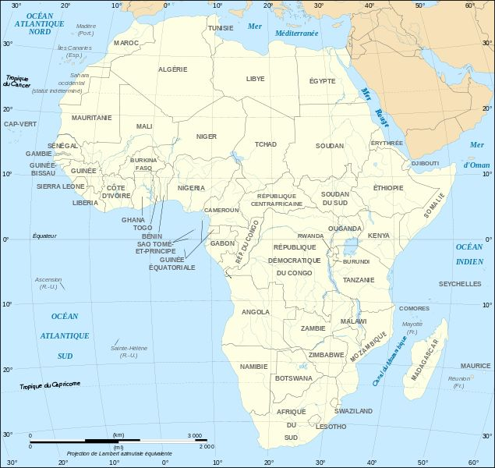

Slide 3
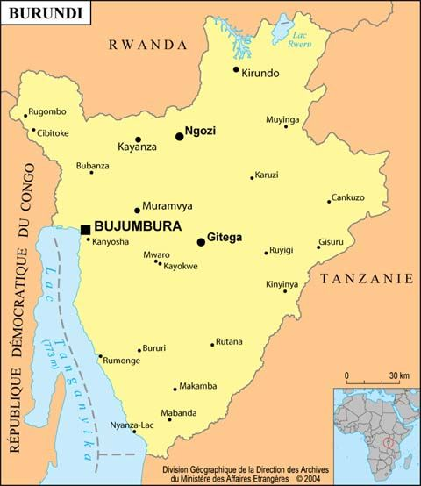
Notes:
Présente le contenu du slide suivant en montrant celui-ci. Dis aussi que des langues proches sont parlées dans les pays limitrophes, notamment le kinyarwanda au Rwanda.

Slide 4
A corpus-driven approach
Kirundi corpus
Tokens : 1.918.292
Types : 204.016
Period distribution: 9 decades (1920s-2010s; 1930s: empty)

Slide 5
Genre/Topic & Period

Slide 6
Theoretical framework
Van der Auwera & Plungian (1998):
Modality: Possibility and necessity
Nuyts (2004, 2005):
Dynamic:
Participant-inherent
Participant-imposed
Situational
Deontic
Epistemic

Slide 7
Focus
Four types of modal devices used in Kirundi language :
Affix
auxiliary verbs
epistemic adverbs

Slide 8
Modal affix: -oo-
Potential marker
traditionally labeled conditional/potential in Bantu
Located between SC and root.
The most widely used and has the largest semantic scope and the greatest number of modal values.
Therefore, it stands as the grammatical morpheme dedicated to the expression of modality in Kirundi.

Slide 9
Dynamic possibility
Participant-inherent Dynamic Possibility (P-In DyPo):
Uburundi naje nobutwara.
‘Burundi, I am also able to govern it’
(Mugororoka, News, 1970s)
u-bu-ruúndi na je n-oo-bu-twáar-a
AUG₁₄-NP₁₄-Burundi also me SC_{1sg}-MOD-OC₁₄-govern-PFV

Slide 10
Dynamic possibility (2)
Participant-imposed Dynamic Possibility (P-Im DyPo):
…ejo uraza kundamutsa, niho tworonka n'akanya ko kuganira.
‘…tomorrow, come and visit me, so that we can have at least some time to talk.’
(Rumarantimba, Drama, 1980s)
ejó u-ra-əz-a ku-n-ramuts-a ni ha-ó
tomorrow SC_{2sg}-HORT-come-IPF NP₁₅-OC_{1sg}-visit-IPF COP PP₁₆-PRCS
tu-oo-roonk-^{H}a n a-ka-ánya ka-ó
SC_{2pl}-MOD-get-REL.IPF at.least AUG₁₂-NP₁₂-time PP₁₂-CONN
ku-gáaniir-a
NP₁₅-talk-IPFV

Slide 11
Dynamic possibility (3)
Situational Dynamic Possibility (SiP):
Umuntu arashobora guhema umwotsi w’itabi awutumuriweko n’uwurinywa.
‘A person can breathe tobacco smoke when he is smoked out by someone who smokes.’
(USCRI_H_QuitSmoking, Health, 2000s)
u-mu-ntu a-ra-shóbor-a ku-heem-a u-mu-óotsi
AUG₁-NP₁-person SC₁-DISJ-can-IPFV NP₁₅-breathe-VF AUG₃-NP₃-smoke
u-a i-ø-taábi a^{H}-u-tuumuur-ir-u-ye-kó
PP₃-CONN AUG₅-NP₅-tobacco SC₁.CJC-OC₃-smoke.out-APPL-PASS-PFV-POSTF₁₇
na u-u-ri-nyó-a
by AUG₁-SC₁-OC₅-smoke-IPFV

Slide 12
Deontic possibility
Imana yabariye Adamu iti: “Urashobora kurya ivyamwa vyose uretse igiti kiri hagati mu murima”.
‘God said to Adam: « You can eat of all the fruits, except of the tree which is in the middle of the garden».’
(CU110308Umuro, Peace, 2010s)
i-N-máana i-á-bárir-ye Adaámu i-ti u-ra-shóbor-a
AUG₉-NP₉-God SC₉-PE-say-PFV Adam SC₉-QUOT SC_{2sg}-DISJ-can-IPFV
ku-rí-a i-bi-aámwa bi-óóse urétse i-ki-tí
NP₁₅-eat-IPFV AUG₈-NP₈-fruit PP₈-all except AUG₇-NP₇-tree
i-ki-tí ki-ri^{H} hagatí mu mu-rimá
AUG₇-NP₇-tree SC₇-be.REL in.the.middle LOC₁₈ NP₃-garden

Slide 13
Epistemic possibility
Iryo dini rero ryoba ryatangira izo nyigisho mu kinyegero kuko mu masengero yabo basa n'abatanga inyigisho nziza.
‘So this religion may have given these precepts in secret because in their churches they seemed to give good precepts.’
(Mushingantahe, Paix, 2000s)
i-ri-o ø-diní reeró ri-oo-bá-a ri^{H}-á-táang-ir-a
AUG₅-PP₅-DEMb NP₅-religion then SC₅-MOD-be-VF SC₅.CJC-PE-give-APPL-VF
i-zi-o N-yígiisho mu ki-nyegero kukó
AUG₁₀-PP₁₀-DEMb NP₁₀-precept LOC₁₈ NP₇-secret because
mu ma-sengero a-ábo ba-á-se-a na
LOC₁₈ NP₆-church PP₆-POSS₂ SC₂-HP-seeem-VF with
a-ba-á-táng-a i-n-yígiisho N-(z)iizá
AUG₂-PP₂-HP-give-IPFV AUG₁₀-NP₁₀-precept AP₁₀-good

Slide 14
Dynamic necessity
Participant-inherent Dynamic Necessity (P-In DyNe):
Dawe wo mw’ijuru arazi ko dukeneye kwambara n’ugufungura.
‘Our Father in Heaven knows that we need to dress and to eat.’
(Yaga, Religion, 1960s)
daawé u-ó mu i-ø-juru a-ra-ə́zi kó
our.father PP₁-CONN LOC₁₈ AUG₅-NP₅-heaven SC₁-DISJ-know that
tu-kener-^{H}ye ku-ambar-a nó u-ku-fuungur-a
SC_{1pl}-need-REL.PFV NP₁₅-dress-IPFV and AUG₁₅-NP₁₅-eat-IPFV

Slide 15
Dynamic necessity (2)
Participant-imposed Dynamic Necessity (P-Im DyNe)
Ibimazi vy’úmuryāngo ní ikīntu umuryāngo utegérezwa kwǎma ufíse kugíra ngo urōnké umugisha.
‘Family amulets are something a family must keep constantly so that it would have a blessing.’
(IntaraKama, Traditional Culture, 2010s)
i-bi-mazi bi-a u-mu-ryaango ni i-ki-ntu
AUG₈-NP₈-amulet PP₈-CONN AUG₃-NP₃-family COP AUG₇-NP₇-thing
u-mu-ryaango u-tégerezw-^{H}a ku-ám-a
AUG₃-PN₃-family SC₃-must-REL.IPFV NP₁₅-be.constantly-IPFV
u^{H}-fít-ye kugíra ngo u-roonk-^{H}e u-mu-gisha
SC₃-have-PFV so that SC_{2sg}-get-SBJF.PFV AUG₃-NP₃-chance

Slide 16
Dynamic necessity (3)
Situational Dynamic Possibility (SiP):
Ivyo bihe bitegerezwa gushikira na cane cane ikiremwa muntu kandi nta ko avyirinda kuko ni ntabanduka.
‘These times must happen especially to the human being and there is no way of eluding them because they are ineluctable.’
(CU100427, Peace, 2010s)
i-bi-o bi-he bi-tégerezw-a ku-shik-ir-a na
AUG₈-PP₈-DEMb NP₈-time SC₈-must-IPFV NP₁₅-happen-APPL-IPFV and
caanecáane i-ki-remwá mu-ntu kaándi nta ku-o
especially AUG₇-NP₇-being NP₁-human and COP.NEG PP₁₅-PRCS
a-bi-iriind-^{H}a kukó ni ntabaandúuka
SC₁-OC₈-elude-REL.IPFV because COP ineluctable

Slide 17
Deontic necessity
Ingene Bakwa. Umusore waho agomba kukwa umugore, abwirizwa kutanga inka zine canke zitanu, canke zitandatu.
‘How they pay dowry. A young man from there who desires a wife must give four, five or six cows.’
(Rusizira4603Akatangaza, News, 1940s)
ingéne ba-kó-^{H}a u-mu-sóre u-áaho
how SC₂-pay.dowry-REL.IPFV AUG₁-NP₁-young.man PP₁-POSS₁₆
a-goomb-^{H}a ku-kó-a u-mu-goré a-bwíirizw-a
SC₁-desire-REL.IPFV NP₁₅-pay.dowry-IPFV AUG₁-NP₁-wife AUG₁-must-IPFV
ku-táang-a i-N-ká zi-né caanké zi-taanu
PN₁₅-give-IPFV AUG₁₀-NP₁₀-cow PP₁₀-four or PP₁₀-five
caanké zi-taandátu
or PP₁₀-six

Slide 18
Epistemic necessity
Icara ndagusomye mbona umengo akazuba kaguciyeko, utegerezwa kuba unyotewe.
‘Sit down, let me share beer with you, I see that, apparently sun passed on you, you must be thirsty.’
(Umugumyabanga, Drama, 1990s)
icar-a N-ra-ku-som-i-^{H}e N-bón-a
sit.down-IPFV SC_{1sg}-DISJ-OC_{2sg}-drink-CAUS-SBJV.PSP SC_{1sg}-see-IPFV
umeengo a-ka-zuúba ka-a-ku-cí-ye-kó
apparently AUG₁₂-NP₁₂-sun SC₁₂-HP-OC_{2sg}-pass-PFV-POSTF₁₇
u-tégerezw-a ku-bá-a u^{H}-nyóoterw-ye
SC_{2sg}-must-IPFV NP₁₅-be-IPFV SC_{2sg}.CJC-be.thirsty-PFV

Slide 19
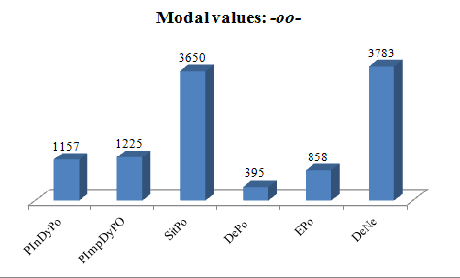
-oo-: the modal affix

Slide 20
Auxiliaries
Typical construction: followed by an infinitive (see slides 11,12).
Possibility: ‑shóbor‑ (be able), ‑shóbok‑ (be possible), ‑báash‑ (be able), ‑kúund‑ (be possible), ‑bón‑ (be able), ‑rekuriw‑ (be allowed) and ‑émerew‑ (be allowed); each of them covering a modal scope in its way.
Necessity: ‑tégerezw‑ (must), ‑bwíirizw‑ (must),
‑kener‑ (need), ‑riind‑ (need), ‑kwíir‑ (should),
‑béer‑ (be necessary) and ‑goomb‑ (must).

Slide 21
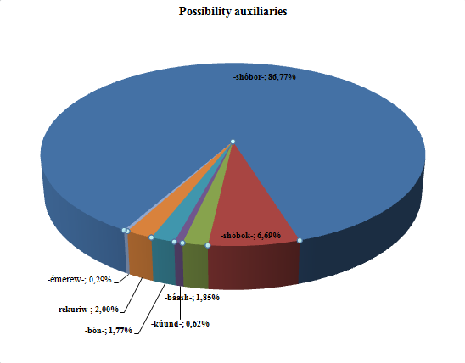
Possibility auxiliaries

Slide 22
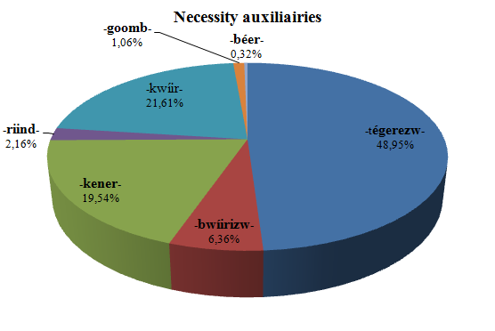
Necessity auxiliaries

Slide 23
Epistemic adverbs
Epistemic adverbs (14)
Six expressing possibility: ngirango, umeengo, nkeeka, kuumburé, kurúubu, ubóna (‘maybe’)
One expressing necessity (certainty): kokó (‘certainly’)
One epistemic (umeengo ) overlapping to evidentiality (15) [Mberamihigo & al. forthcoming).

Slide 24
Overlap to evidetiality: umeengo
Yinjiranye n’umukobwa, kandi umengo ni Janine!
‘He entered with a lady, and apparently it is Jeanine!’
(Nyerek’akaranga, Drama, 1970s)
a-ínjir-an-ye na u-mu-koóbwa kaándi
SC₁-enter-ASSOC-PFV with AUG₁-NP₁-lady and
umeengo ni janiíne
apparently COP Jeanine

Slide 25
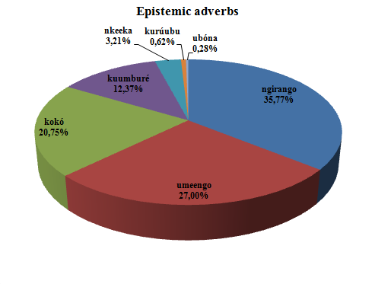
Epistemic adverbs: Statistic overview

Slide 26
Conclusion
A set of modal markers
With different scopes
Grammaticalized to different extents.
Some structures typical of the expression of modality.

Slide 27
References
de Haan, Ferdinand. 2006. Typological Approaches to Modality. In W. Frawley, E. Eschenroeder, S. Mills & T. Nguyen (eds.), The Expression of Modality. Berlin; New York: Mouton de Gruyter. 27-69.
Mberamihigo, Ferdinand. 2014. L’expression de la modalité en kirundi. Exploitation d’un corpus électronique. Bruxelles: Université libre de Bruxelles, thèse de doctorat.
Mberamihigo, Ferdinand , Gilles-Maurice de Schryver & Koen Bostoen. forthcoming. Entre verbe et adverbe: Grammaticalisation et dégrammaticalisation du marqueur épistémique umeengo/umeenga en kirundi (bantou, JD62). JALL
Nuyts, Jan & J. van der Auwera (eds.). 2015. The Oxford Handbook of Mood and Modality. Oxford: Oxford University Press.
van der Auwera, Johan & Valentin A. Plungian. 1998. Modality's semantic map. Linguistic Typology 2: 79-124.

