Slide 1
Upholding Excellence: Nurturing Ethical Conduct and Integrity in funded research projects
Senior Science Adviser Päivi Kolu
Research Council of Finland

Slide 2
Overview
Research Council of Finland
What the Research Council of Finland does and how we work?
What are our science policy objectives in decision-making?
What is the feedback from our reviewers?
Research ethics and Research integrity
Why nurturing research ethics & integrity matters?
How to nurture ethical research and research integrity?

Slide 3
What the Research Council of Finland does
WE PROMOTE
WE SUPPORT
WE STRENGTHEN
high-quality and ethically sustainable scientific research
research impact and scientific renewal
application of research results and research knowledge
international opportunities for research cooperation
multidisciplinary and novel research approaches
internationalisation and appeal of research environments
national and international research infrastructure activities

Slide 4
Year 2022 in figures
Applications
Review reports
Research funding granted
Funding processing costs of total funding allocated
3 920
9 740
17%
€468 million
2,3 %
of applicants were granted funding*
Each year, our funding contributes to some 3,000 people’s work (FTEs) at different research organisations.
Ongoing in 2022
10
Finnish Flagships
1070
Academy Projects
13
Academy Programmes
13
Strategic Research Council (SRC) Programmes
23
Finnish Centres of Excellence
* Average for autumn 2021 call, including applications for Academy Project, Academy Research Fellow, Postdoctoral Researcher and Clinical Researcher funding

Slide 5
How we work
International peer review is our key tool for identifying the most promising research projects to fund.
The decision-makers are members of the Finnish scientific community, that is, distinguished professors or researchers in their fields. Research Council of Finland officials do not make any funding decisions.
Political decision-makers do not participate in the Research Counsil’s review process or decision-making.
Applicant submits an application in our online services
A science adviser processes the application
An international panel of experts reviews the application
A decision-making body makes the funding decision based on the panel review and science policy guidelines
The project starts

Slide 6
Science policy objectives taken into account in decision-making
Promoting the internationality of research
Renewal of science and research
Advancing the research careers of early-career researchers and women
Promoting multi- and interdisciplinary research
Responsible science: good scientific practice, equality and nondiscrimination, open science, sustainable development
Impact beyond academia
In addition to the Research Council's science policy objectives, the decision-making bodies have their own criteria and policies on funding https://www.aka.fi/en/about-us/decision-making-bodies/research-councils/

Slide 7
https://coara.eu/
‘Publish or perish’ and metrics have led us into a blind alley. Let’s start recognizing the full breadth of value created by researchers.
Marc Schiltz, President of Science Europe

Slide 8
We follow the principles of responsible assessment
The Research Council of Finland is comitted to the Declaration on Research Assessment (DORA), and the international Agreement on Reforming Research Assessment (CoARA) and the national recommendation on responsible researcher evaluation in Finland.
Reviewers are asked to:
Consider the content and quality of publications, rather than their number or venue of publication, or the impact of the journals in which they were published
Consider the value and impact of all research outputs, not only publications
Be sensitive to legitimate delays in publication and personal factors or other types of leave, part-time work and disabilities that may have affected the applicant’s record of outputs
Take into account the applicant’s career stage throughout the review
Base the review mainly on a qualitative peer review of the research plan
Research ethics
Disqualification
Open access
Equality and nondiscrimination
Confidentiality
Sustainable development

Slide 9
Feedback from reviewers
”More emphasis should be put on the (societal, economical etc.) impact –section”
“The frame and objectives should be more precise, hypotheses should be better described.”
”Implementation plan should be better described.”
”Lack of proper theoretical background / support”
”Mobility plan was unconnected to the research plan.”
”More attention to methodological detail.”
”Many proposals lacked preliminary data”
”Some proposals were over-ambitious and thus lacked feasibility”
”Power calculations, justification for animal experiments missing”

Slide 10
What can I do?
Competencies may include:
National and international collaboration and mobility
Cross-sectoral collaboration
Sharing of data
Establishing a research team and other academic leadership experience
Supervision and teaching experience
Various expert positions
Most important research funding awards
If you plan to apply:
Read the call objectives and review questions carefully
Think open-mindedly of your merits and skills
Be optimistic but realistic
If you are not eligible yet but plan to apply later:
Think open-mindedly how to gain merits and skills
Make a career plan, talk to your seniors/mentor
If you are a senior researcher, supervisor or research manager:
Support the younger!
Give an example but remember that everyone has their own career path
Help a promising researcher over a gap
Create procedures to systematically give career support

Slide 11
Overview
Research Council of Finland
What the Research Council of Finland does and how we work?
What are our science policy objectives in decision-making?
What is the feedback from our reviewers?
Research ethics and Research integrity
Why nurturing research ethics & integrity matters?
How to nurture ethical research and research integrity?

Slide 12
Research Ethics is an evaluation criterion
Principles:
Researchers must always describe the ethical issues related to their research
Research ethics issues may relate to the research topic, methods and practices, or the research data. These issues include ethical governance procedures, informed consent, anonymity of subjects and withdrawal from research. In addition, they concern research permits granted and pending.
If the research project involves ethical issues such as the processing of personal data, the use of laboratory animals or dual-use products, the applicant must explain in sufficient detail how these have been taken into account
Researchers must demonstrate that they do not intend to apply research practices abroad that are considered unethical in Finland and Europe
Guidelines:
Relevant legislation
The guidelines of the Finnish National Board on Research Integrity (TENK)
ALLEA’s (All European Academies) European Code of Conduct for Research Integrity when engaging in international collaboration and applying for EU funding
Finnish ethical guidelines also apply to Finnish researchers working abroad!

Slide 13
Research Integrity, Research Ethics, and Research Governance – aspects on achieving a positive research culture
Research ethics
research behaviour from the perspective of moral principles
aim is to protect the research object as well as the wider society and to minimse harmful effects on them
field-specific regulations (e.g. Ethical Principles for Medical Research Involving Human Subjects)
Research integrity
research behaviour from the perspective of professional standards
aim is to provide researchers with a framework for carrying out their work following good scientific practices
protected in all disciplines with the same guidelines (E.g. Finnish Code of Conduct for Research Integrity)
RESEARCH governance
research behaviour from the perspective of legal and policy requirements
Specific laws, regulations and approvals (e.g. Law on the protection of animals used for scientific or educational purposes)

Slide 14
Research integrity principles and practices:
Necessary research permits have been acquired and the preliminary ethical review has been conducted.
Reliability
Honesty
Respect
Accountability
Fairness
Care
Methods conform to scientific criteria and are ethically sustainable.
Results are communicated and reported in an open and responsible fashion.
Other researchers’ work is respected by citing appropriately, and by giving the credit they deserve.
Relevant commitments are announced and reported when publishing.

Slide 15
Why nurturing research ethics & integrity matters?
Build society’s trust in research
Create a healthy research environment
Support cooperation
Contribute to high-quality research
Hypercompetitiveness
Publication pressure
Intensive use of metrics in evaluation
Poor training and supervision
Financial interests
Things undermining research ethics & integrity
Research ethics and integrity
Research ethics & integrity promote

Slide 16
How common is research miscounduct?
A meta-analysis of surveys asking scientists about their experiences of misconduct:
Over the years, the rate of admitting declined significantly in self-reports, but not in non-self-reports!
Admitted to have fabricated, falsified or modified data
Admitted other questionable research practices
Observed fabrication, falsification or modification of data by colleagues
Observed other questionable practices by colleagues
Fanelli D (2009) How Many Scientists Fabricate and Falsify Research? A Systematic Review and Meta-Analysis of Survey Data. PLoS ONE 4(5): e5738. https://doi.org/10.1371/journal.pone.0005738

Slide 17
Some ethical questions raised by review panels
“Points about ethics are usually well dealt with. However,…”
“…two proposals were very similar. It seemed that some parts of the proposals were copied from each other raising concerns with regard to good scientific practice, and also raised concerns, regarding the independence of the junior applicant.”
“often too little or too generic information is provided by the applicants.”
“Several applications did not include mouse numbers for their studies nor power calculations. It is rather unethical to initiate underpowered studies.”
“Several proposals survey vulnerable communities and such proposals should provide much more details on how ethical issues concerning obtaining and storing their survey data, are dealt with.”
“In vivo animal experiments will be performed outside the EU in accordance with local legislation and licensing procedures. The panel considered whether the animal experiment permit practice and approved working methods are the same as in the EU/Finland….and who owns the patents.”
“…the researcher seems to have published more than one paper per week. We wonder how this relates to fair authorship guidelines.”
“The involvement of local researchers in projects carried out abroad to support local capacity building.”

Slide 18
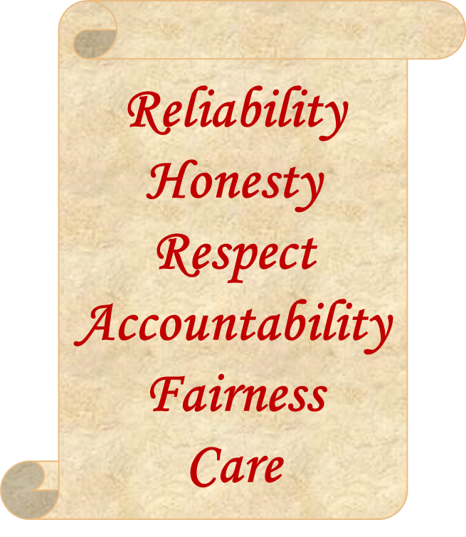
How to nurture ethical research and research integrity?
Familiarize yourself with ethical & research integrity guidelines
Participate actively in training
Offer/ask for supervision and mentoring
Take time to reflect; most ethical questions are not ones of right and wrong
Get to know your organisation’s research integrity adviser(s)
Discuss and agree an understanding among all collaborators about their roles and responsibilities throughout the research cycle, from study design to implementation and publication
Discuss and agree among all authors who will be included, who is corresponding author, what is the order and who are acknowledged in a publication
Lead by example! Good research environment is everybody’s responsibility

Slide 19
Guidelines on research ethics and responsible research conduct:
Finnish guidelines by TENK:
Finnish Code of Conduct for Research Integrity and Procedures for Handling Alleged Violations of Research Integrity in Finland
Ethical principles of research with human participants and ethical review in the human sciences in Finland (PDF)
Agreeing on authorship. Recommendation for research publications (PDF)
European guidelines by ALLEA:
European Code of Conduct Revised Edition 2023 (PDF, allea.org)
Medical research involving human subjects:
WMA Declaration of Helsinki – Ethical Principles for Medical Research Involving Human Subjects – WMA – The World Medical Association
Equitable research partnerships:
Global Code of Conduct for Research in Resource-Poor Settings (PDF, globalcodeofconduct.org)

Slide 20
Nature 570, 5 (2019), Doi: https://doi.org/10.1038/d41586-019-01727-0
“Conducting research with integrity, honesty and accuracy is something to which every scientist should proudly aspire. And research integrity is not a virtue that is either present or absent: it is a capacity that can be enhanced. It requires ongoing training for both early-career researchers and more senior faculty members, as well as the reworking of perverse incentives, and rewarding researchers for important but unglamorous contributions. Every conversation or course in research integrity is an opportunity to grow.”

