Slide 1
Energy vulnerability in energy transition: who, why and how?
20.11.2020
Tuija Kajoskoski & Senja Laakso, University of Helsinki

Slide 2
From energy poverty to energy vulnerability
Traditional definitions of energy poverty based on the combination of three factors: low income, energy inefficient dwellings and appliances, and high energy costs
In Finland, the Ministry of Environment defines energy poverty as the household's difficulty in maintaining or satisfying basic needs due to energy costs
The concept of energy vulnerability expands the dominant techno-economic analysis to social, political and structural dimensions of vulnerability to energy inequality
Recognizing that vulnerability is highly context-specific & relates to a wide array of issues such as challenges with health, social relations, social isolation, occupational status, housing characteristics, income, the energy market and regulation etc.
Acknowledging that people can also move between being and not being vulnerable
Complementing statistical analyses with everyday experiences

Slide 3
energy transition and Vulnerability
The on-going energy transition causes new vulnerabilities, such as…
Difficulties in participating in energy saving or efficiency measures
Difficulties with access to low-carbon energy sources, smart energy or online services, or electric mobility
Difficulties in maintaining or satisfying (situational, household specific) basic needs due to energy costs
Experiences of injustice, experiences of deprivation in relation to others
→ Energy transition creates obvious social benefits, such as reduced emissions and wider access to renewable energy sources, but to ensure a just and fair transition vulnerable groups need to be given explicit attention

Slide 4
Energy vulnerability and the “freedom to choose”
"What is the freedom to choose a car if there is no alternative? That is a forced disguised freedom. Instead, those who have been free to choose have often chosen to spend their money on things other than owning a car." Minister of Transport and Communication Timo Harakka, speech at Transport and Communications forum on 3.3.2020 (timoharakka.fi/liikenteen-ja-viestinnan-suunnat-2020-luvulla/)
Is energy vulnerability a situation where more energy is consumed than would be desirable, e.g. because of long distances, even though there is a way to “afford” it?
Is it energy vulnerability that social participation “forces” car ownership, or that intellectual resources are spent on planning car trips so that they need to be done as little as possible?

Slide 5
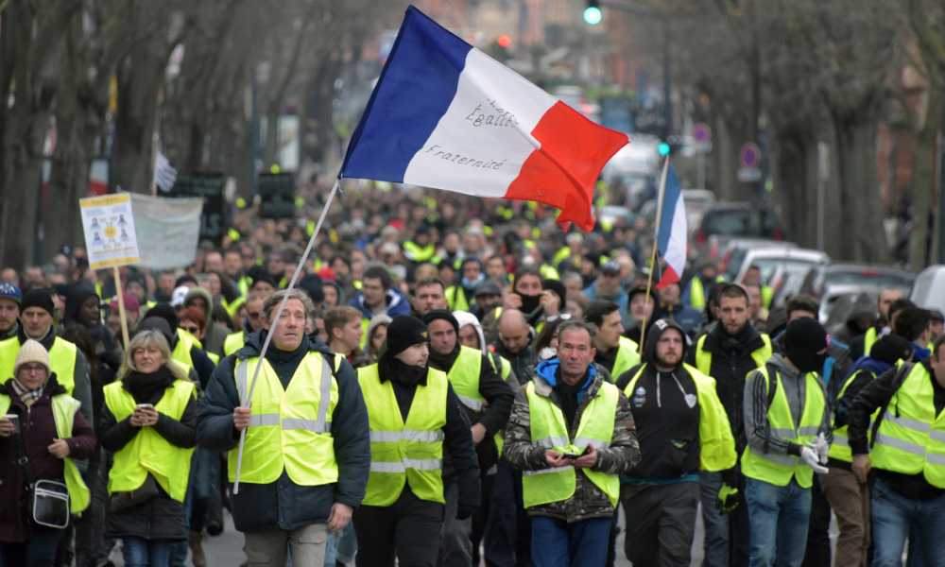
Energy vulnerability and participation in decision making
Is the experience of inclusion and exclusion on energy issues energy vulnerability?
Experiences of injustice related to energy, its price and availability?
Opportunities to participate in decision making on energy issues and the right to be heard?

Slide 6
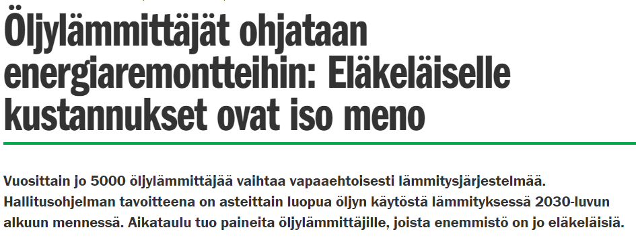
Energy vulnerability and participation in transition
Is inability to participate in renewable energy programs or utilise subsidies energy vulnerability?
Are the feelings of exclusion from transition and unwillingly living an environmentally unfriendly life style energy vulnerability?
(Rakennusmaailma 11.12.2019)
(YLE 17.9.2020)

Slide 7
Conclusions & questions
Energy transition creates winners and losers → vulnerable groups require specific attention
Who are vulnerable in (the context of Finnish) energy transition?
Why are they vulnerable?
How is vulnerability constructed by peoples’ life situations?
Thank you!
Tuija Kajoskoski (tuija.kajoskoski@helsinki.fi), Senja Laakso (senja.laakso@helsinki.fi)
ENCIT: Citizens, everyday life and tensions in the energy transition https://blogs.helsinki.fi/citizens-energy-transition/

