Slide 1
Schooling the Future: Beyond a Binary of an Ethics of Probabilities and an ethics of possibilities
Professor Bob Lingard, Australian Catholic University, University of Helsinki, Anticipated and Alternative Futures of Education Lecture, 17/11/2022.

Slide 2
Preface
Nancy Fraser (2022). Cannibal Capitalism. Preface, p. xiii and p. xv.
Epilogue: Impact of COVID demonstrates entanglements of issues at this moment: ‘capital’s inherent drive to cannibalize nature’; evisceration of public power; weakened state capacities re social reproduction (essential workers); growth in inequalities, gendered, raced and classed.
Nancy Fraser (2013). Fortunes of Feminism. Verso.

Slide 3
Creating the future in education policy: where to start?
Lingard (2022), Multiple temporalities in critical policy sociology in education. Critical Studies in Education. 62,3: 338-353.
Facer (2021): ideas of the future, desire for better futures implicit in policy reforms.
Sriprakash (2022): reparative justice linking past, present and future cf UNESCO repair injustices to transform the future.
Appadurai (2013, p.3): in terms of designing the future ‘it is vital to build a picture of the historical present’.
Foucault’s ‘history of the present’.

Slide 4
Big argument
Post-war policy settlement: Keynesian,1945-1970s, social democratic education policy settlement, national focus.
From 1970s through to present: Post-Keynesian, neo-liberal settlement (despite GFC, Covid and climate emergency), neo-liberal education policy settlement, new practices of statecraft and governance, global/national focus.
Unsettling of that settlement: new nationalisms, growing inequality, precarity, challenges to democracy, climate emergency, Covid, post-truth etc.; (UNESCO (2021), Reimagining our Futures Together: A New Social Contract for Education).
Need a new education policy settlement; gesture towards

Slide 5
structure of presentation
Introduction: preface, then the argument
Part 1: Changing global/national relations, new nationalisms:
i. growth in inequality ii. challenges to democracy iii. climate emergency challenge.
Part 2: Digital disruption:
i. ‘surveillance capitalism’, ‘data colonisation’, ‘metric society’, ‘deep mediatisation’ ii governance of schooling iii. schools, teachers, students iv. accountability.
Part 3: Gesturing towards elements of a new education policy settlement.
Conclusion: moving beyond the tensions between an ‘ethics of probability’ and an ‘ethics of possibility’, working with and across the imbrications of human and machine cognition in ‘synthetic governance’ in education, prefigurative & reparative futures.

Slide 6
Part 1
Changing global/national relations and new (ethno)nationalisms

Slide 7
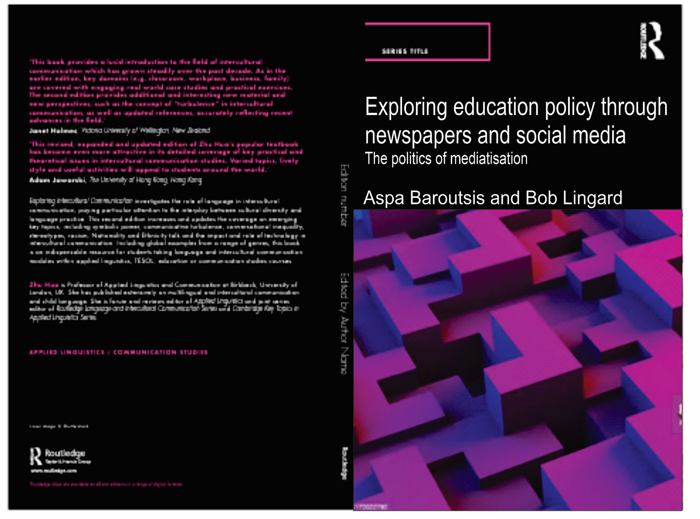

Slide 8
Changing spatialities, changing global/national relations
Prior to the end of the Cold War: education policy the sole prerogative of the nation and sub-national political units.
Globalization then challenged that reality: e.g. impact of OECD’s PISA, UN’s MDGs and SDGs.
Spatial turn: new spatialities associated with globalization: global field, rescaling, the topological, world society, cultural flows/scapes, policy transfer, policy mobilities.
Globalization challenged ‘methodological nationalism’; rise of ‘methodological globalism’.
Current political moment, changing global/national relations: rise of new nationalisms, ethno-nationalisms (e.g. USA: Trump’s America First and anti-multilateralism; UK: Johnson’s Brexit and anti-multilateralism; Europe, anti EU and anti migration sentients).
Beyond binary of methodological nationalism and methodological globalism: see the (re)constitution of changing local/national/global relations as part of the evolving work of the state within nations – ‘statecraft’ – ‘scalecraft’ (Papanastasiou, 2019) and ‘spacecraft’ (Savage, Gregorio and Lingard, 2022).

Slide 9
Place of education policy production prior to end of Cold War
Prior to end of the Cold War: comparative education, policy studies in education, education research took the nation as the unit of analysis; all assumed society, the social and political (including policy developments) were homologous with the nation; education policy (mass literacy and mass numeracy) central to the construction of the ‘imagined community’ which is the nation (Anderson, 1991).
In that context: education policy and education seen as exclusive function of the nation-state, ‘devised, directed and enacted’ by the nation-state (Clarke, 2019).

Slide 10
Education policy as national prerogative
Theory: various sociological and policy studies approaches; ‘methodological nationalism’: premises: society equated with nation-state societies (also sub-national and local); nation states and their governments central to social science/education research; assumes humanity divided into limited number of nations with boundaries (borders) with other nations (Beck, 2007, Theory, Culture and Society, 24: pp.7-8).
Globalization: challenges to ‘methodological nationalism’.

Slide 11
Globalization and impact on education policy production
In immediate wake of End of Cold War: much hubristic thinking and theorising: Appadurai (1996) emergence of a ‘postnational’ world, almost the end of the nation-state; The End of History and the Last Man, Fukuyama (1992), almost the end of history as liberal democracy/market capitalism seen as the end point historically for all nations, post-ideological world.
Globalization: challenged the nation-state as tightly bordered and bounded e.g. Appadurai’s flows/scapes across borders’ – ethnoscapes, financescapes, mediascapes ideascapes; in education, Carney (2009) and Ball (2008) ‘policyscapes’ (work of OECD, UNESCO etc); emergent global economy, supranational EU, new regionalisms, emergent global policy fields. Challenge to methodological nationalism.
Reality: nation-state has remained important, but now works in different/multiple ways and imbricated in inter alia supranational political organizations (EU), international organisations, new regionalisms, global policy fields, and a rescaled state.

Slide 12
Globalization and education policy
Since new millennium at least, national polices in education in many nations affected by binding chains of transnational framings (European, regional and global), affecting the national/sub-national, local and policy actors.
Dominant policy discourses: human capital theory (education to ensure a competitive national economy) and national education policies to ensure: economic growth, innovation, sustainability and social cohesion. Focus on learning. Discursive policy convergence, but always ‘path dependent’ manifestations of these transnational and global discourses.
With impact of the global, there are: ‘new domains and dynamics of policy, in particular those associated with processes of globalization, regionalization and Europeanization’, which have ‘unsettled the assumed unities of place, people and policy associated with methodological nationalism’ (Clarke, 2019, p.v).
Clarke (2019, p.v): ‘there has been a risk of substituting a methodological globalism…, projecting a flat world of policy travel and transfer’ .

Slide 13
Rise of new nationalisms and ethnonationalism: impact on education policy & production
Now right wing populist opposition to neo-liberal globalization; rise of new nationalisms – ethno-nationalisms – Brexit, Johnson UK election, Trump, America First, anti-globalization forces across Europe and around the world, rise of far right parties (e.g. Alternative for Deutschland, One Nation; Hungary); global flows/global bumps (Appadurai, 2013), friction.
Left critiques of growing inequalities within and between nations as welfare states weakened (Thomas Piketty (2013) Capital in the Twenty-First Century); Mike Savage (2021). The Return of Inequality. Harvard University Press. Nancy Fraser (2022). Cannibal Capitalism. Verso).
Jamie Peck and Nik Theodore (2015, p. xv), ‘Policymaking imaginaries have been ‘debordered’, … even if the achievement of policy outcomes remains a stubbornly localized, context-specific process’; mobility/fixity.

Slide 14
Challenges to the hyper globalization/flat world thesis
The rise of religion/populism and of nationalism/ethno-nationalism v the global
Russia’s choice not to join the West/Russia’s war on Ukraine
USA’s seeming abnegation of role as global superpower
Rise of China and global ambitions
Changing global/national imbrications - now ‘polymorphic nature of borders’
Impact of COVID 19; climate emergency
‘contemporary borders between the national and the international have many forms and vary sector by sector’ (Crowley, Stewart, Kay and Head, 2021, p.95; Chapter 5).

Slide 15
Growth in inequality
Significance of Mike Savage’s (2021). The Return of Inequality.
Argues documentation and acknowledgement of growing inequalities – the 1% - and its dangers – opens up possibilities.
Significance of Thomas Piketty’s (2014). Capital in the Twenty-First Century.
Significance of Nancy Fraser’s (2022). Cannibal Capitalism.
Significance of Richard Wilkinson and Kate Pickett’s (2010). The Spirit Level.

Slide 16
Savage (2021): The return of inequality.
‘This targeting of ‘the 1%’ was powerful because it made inequality concrete’ (Savage, p.5) cf Gini Coefficient (0-1).
Savage asks: ‘Why has inequality caught the attention of powerful and wealthy elites…?’,rather than those affected by the depredations of such inequality (pp.13-14) ?
Inequality a focus of the World Economic Forum, ‘rising income and wealth disparity is rated … as the most important trend in determining global developments over the next ten years’ (p.15) (2014): social instability; Oxfam 2017 briefing: ‘left unchecked, growing inequality threatens to pull our society apart’ (p.15); Inequality the focus not equality.
Globally: richest 1% own 43.4% of the world’s wealth; low/stagnant wage growth and rising inflation/cost of living pressures (Rowe, 2021).

Slide 17
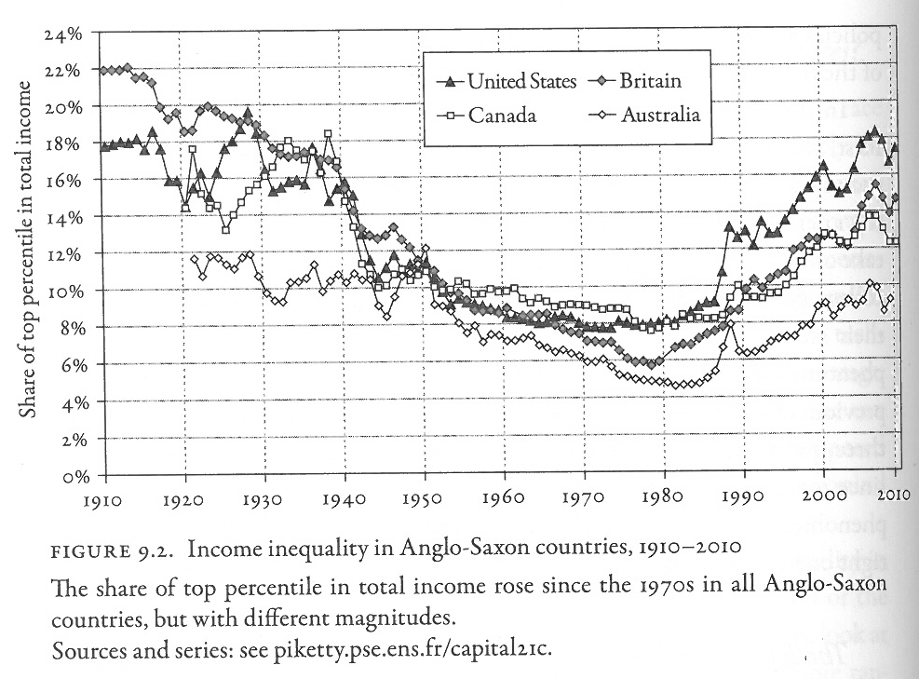

Slide 18
Wilkinson and Pickett (2010): The Spirit level.
Sub-title of book: ‘Why Equality is better for Everyone’. Basic position: rich nations have reached a level of affluence that no longer ensures gains in health, happiness or wellbeing (cf poor nations).
The way forward for rich nations: reducing the gap between rich and poor, reducing the amount of income inequality, poverty has effects but the extent of income inequality in a nation also has a strong and independent effect: ‘The evidence shows that reducing inequality is the best way of improving the quality of the social environment, and so the real quality of life, for all of us’ (p.29).
Re schooling: if a nation wants higher levels of achievement amongst all students: ‘it must address the underlying inequality which creates a steeper social gradient in educational achievement’ (p.30). (macro policy settings of more redistributive policies or more equal wage structure or combination). Policy implications? School funding.

Slide 19
Challenges to democracy
Kundani, H. (2020). The future of democracy in Europe: Technology and the evolution of representation. London: Chatham House.
Bergsen, P., Downey, L., Krahe, M., Kundnani, H., Moschella and Slobodian, Q. (2022). The economic basis of democracy in Europe: Structural economic change, inequality and the depoliticization of economic policymaking. London: Chatham House.
Appadurai, A. (2006). Fear of small numbers. Duke University Press.

Slide 20
Challenges to democracy
Kindani (2021): speaks of contemporary crises in liberal democracies in Europe/EU: rise of populism; ‘democratic deconsolidation’ - democratic authoritarianism (e.g., Hungary and Poland).
Bergsen et al. (2022): argument multiple threats to democracy in Europe/EU, beyond populism: structure of economies; growth of inequality (+ political inequality); depoliticization of economic policy making in EU – technocratic form of economic governance hidden from democratic participation and input.

Slide 21
Challenges to democracy
Impact of globalization of the economy on the working of democratic nation-states.
Appadurai (2006): in context of globalization of the economy, some loss of economic sovereignty (impact in small nations) and ethnos the one domain over which they have full autonomy; context of rise of new nationalism, ethno-nationalisms.
In education: economization of education policy, human capital framings, also national policy moves.

Slide 22
Climate emergency

Slide 23
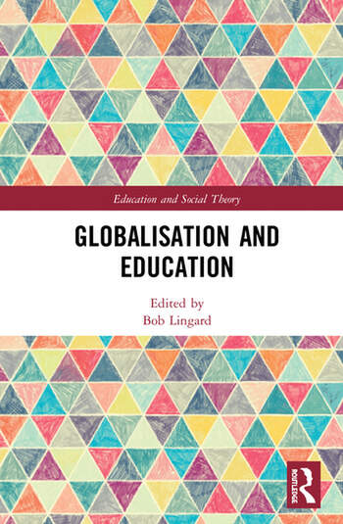

Slide 24
Part 2
Datafication and digitalisation: emerging modes of governance of schooling

Slide 25
The changing social: Datafication and digitalisation
Power (1997): ‘audit society’.
Thrift (2005): ‘knowing capitalism’.
Mau (2019): ‘metric society’; quantification of the social.
Zuboff (2019): ‘age of surveillance capitalism’; rendering of experience as data.
Couldry and Mejias (2019): data colonizing human life for capitalism.
Individuals constituted/reconstituted as constellations of data points over time; school systems, new modes of data-based governance.

Slide 26
What is datafication? What is digitalisation?
Datafication refers to the rendering of various aspects of experience as data – education policy, schooling, teachers, teachers’ work, students, the life of students.
Philosophical issues: can/ought all experience be rendered as data (Zuboff, 2019).
Digitalisation - conversion of data into digital form: enables machine learning, AI, big data, the work of algorithms.
Digital data infrastructures, enable new modes of governance; involvement of for-profit EdTech and philanthropies.
New professionals: data scientists cf statisticians etc.

Slide 27
What is changing re datafication?
Ever enhancing computational capacities.
Work of schooling systems now heavily datafied and digitalised.
Two significant moves: 1. Potential move from collection of discrete sets of data to collection of continuous real-time data. 2. Much greater volume of data now collected: a move from sample to census data.
Development of socio-technical data infrastructures enabling interoperability of data.
AI: combination of big data sets, enhanced computational capacity and machine learning algorithms (Gulson, 2022).
Requires change in our understandings of the human and the social, of schooling and teachers, demands shifts in ontoepistemological assumptions (de Freitas et al., 2016).

Slide 28
Emerging societal structure
Simultaneity of Foucault’s disciplinary society, the panopticon of control through test-based modes of accountability; and
Deleuze’s control society, continuous assessments, move from discrete to continuous data collection, move from sample to census data, big data.

Slide 29
Datafied schooling systems
Data Infrastructures
Datafied bodies
Datafied modes of governance

Slide 30
Data infrastructures
Data infrastructures: socio-technical assemblages of people, computing, software/hardware.
Mass datafication of schooling and digitalisation of that data.
Processes of data infrastructuring enable new types of datafied knowledge and new types of professionals.
Underpinning logic: data flows in multiple directions.

Slide 31
Data infrastructures
Globalization – creation of global data infrastructures.
Constitutive nature of infrastructures.
Consider how school performance, student learning and teachers’ work are captured and translated.

Slide 32
Datafied bodies
Significant site of datafication of education: bodies – human bodies, professional bodies, bodies of data.
Site of surveillance shifts from human bodies to bodies of data; new ways of discipling and controlling teachers.
Remaking of teachers in the image of data.

Slide 33
Datafied bodies
Disciplining of teachers.
Teachers’ bodies sites of intervention; classroom no longer the space of the professional teacher, but potentially the fishbowl that exposes them to constant observation and auditing.
Compliance-based teacher accountability.
A teacher’s body of data – new site of inspectorial gaze; dataveillance, liquid surveillance.
In schooling: ‘Doublethink of data’ (Hardy and Lewis, 2017)

Slide 34
Datafied modes of governance
Long history, governing through numbers, statistics as ‘state numbers’, Rose(1999), society known through statistics; AI extends this through access to big data, census data & algorithms.
Data infrastructures and bodies of data enabled datafied modes of digital governance.
Anticipatory and synthetic governance (human and machine governance), algorithms, big data, AI (Gulson et al., 2022).
BUT, governance not solely through numbers, big data etc, but also through example, reviews, comparison, expertise etc.

Slide 35
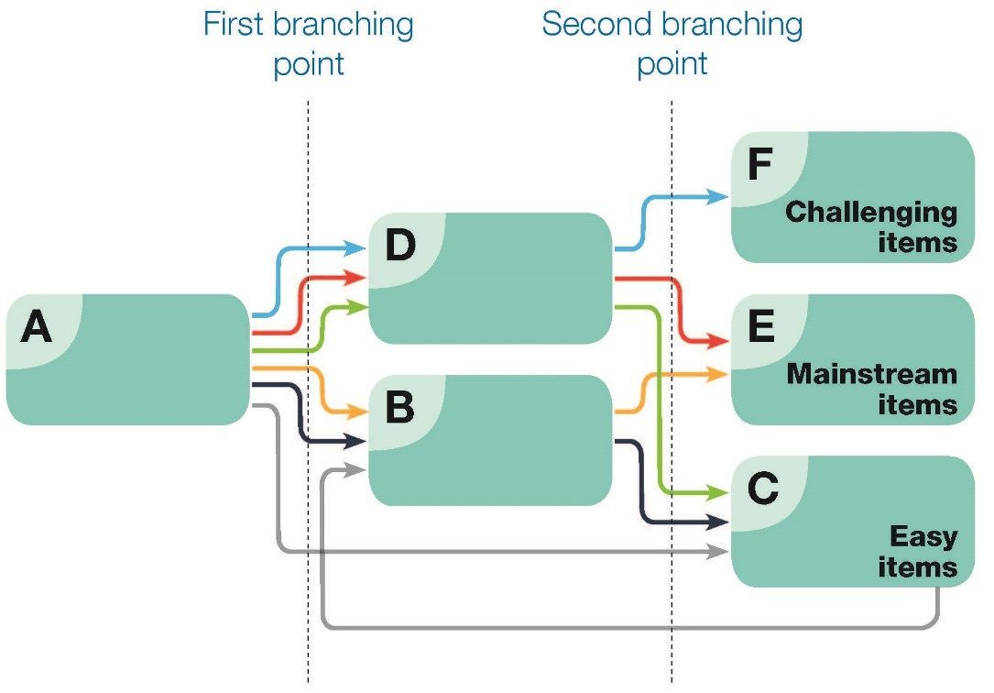

Slide 38
Intellectual resources
S. Lewis, J. Holloway and B. Lingard, The datafication of education: Evolving and emerging developments. In Fazal Rizvi, Bob Lingard and Risto Rinne (Eds.) (2022) Reimagining Globalization and Education. New York: Routledge.

Slide 39
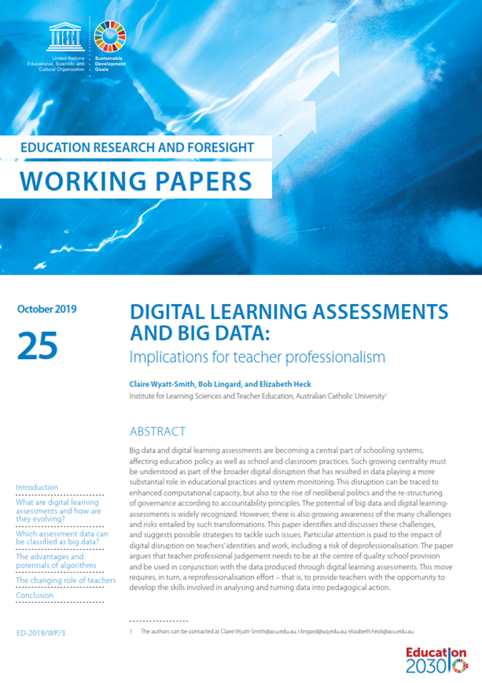
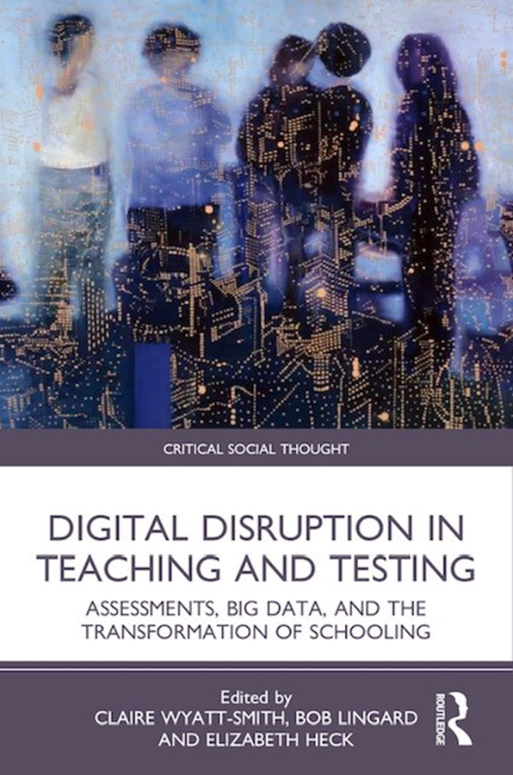
Wyatt-Smith, C., Lingard, B., & Heck, E. (2019). Digital learning assessments and big data: Implications for teacher professionalism. Education Research and Foresight, Working Papers, 25, 1-23.
Wyatt-Smith, C., Lingard, B., & Heck, E. (Eds). (2021). Digital Disruption in Teaching and Testing Assessments, Big Data, and the Transformation of Schooling. Routledge.

Slide 40
Part 3
Gesturing towards elements of a new education policy settlement

Slide 41
Elements of a new education policy settlement
Inequality (broadly) and in and through schooling; Chmielewski (2019), increasing SES impact on performance on PISA: Need for redistributive funding to schools serving poor students, reparative futures/healing (Facer, 2021; Sriprakash, 2022).
Teachers: support, pay, conditions of work, reprofessionalise re data and digitalisation; new digital technologies and assessment.
Curriculum (citizenship - cosmopolitan nationalism, climate change, scientific citizenship, criticality, democratic as prefigurative, reparative curricula and pedagogies etc).
Climate emergency: schools as prefigurative.

Slide 42
Reconceptualising Accountability
Bob Lingard, Aspa Baroutsis and Sam Sellar (2021).Enriching educational accountabilities through collaborative public conversations: Conceptual and methodological insights from the Learning Commission approach. Journal of Educational Change. 22, 4: 565-587.
‘An ethics of possibility’; prefigurative – practising the world we aspire to.

Slide 43
New mode of accountability: The PEtRA Project
Backdrop: need for alternative to PBA/SAWA; accept the necessity of accountability, but redefine – ‘rich’, ‘intelligent’ accountabilities.
Accept two meanings of accountability: being held to account and giving an account; top-down gaze v giving voice to many and bottom-up; accountability about answerability, need for multiple modes and directions of answerability (Ranson, 2003, 2012, 2018).
Accepted that current dominant mode of PBA uses comparison as central to its functioning; comparison as a contemporary mode of governance.
Here we started from Isabelle Stengers’ (2010, 2011) argument that to be ethical ‘comparison must not be unilateral, and, especially, must not be conducted in the language of just one of the partners’, otherwise such comparisons are unethical.
Raises the question of who controls the field of judgement in schooling (Ball, 2006).
Through research with schools, principals, teachers, students, communities, policymakers create a reconceptualised mode of results-oriented governance. We worked with the research and concepts developed by Oxford geographer, Sarah Whatmore (2009) and the idea of ‘competency groups’ and wide definition of ‘expertise’ cf Moll’s concept of ‘community funds of knowledge’.

Slide 44
Pursuing equity through rich accountabilities (PETRA)
Research project funded by Australian Research Council (ARC) and Queensland Government for 5 years as a Linkage Project (8 schools in regional Queensland).
Partner, The Queensland Ministry of Education, specifically, the Director-General of Education: she wanted an alternative mode of PBA/SAWA, not the top-down, test-based mode (NAPLAN) because of narrowing/reductive effects of PBA; Director of Research in state department a partner in the research.
NAPLAN introduced by a federal Labor government in 2010; at time of support/partnership for PETRA research by D-G, a federal conservative government and building of opposition to NAPLAN used for PBA. Labor states mounted research projects as ammunition for arguing against NAPLAN.
Goal of research: contribute to the construction/conceptualisation of a richer mode of educational accountability developed through collaborative research with schools, teachers, students, communities and the department of education; broad definitions of outcomes beyond just test results.
5 stages of the research: 1. case studies of 8 schools; 2. collaborative development of community–based curriculum projects in schools. 3. creation of a Learning Commission, based on Whatmore’s competency groups to canvas community views of the purposes/achievements of schools; use of data to develop rich accounts of school practices and community contributions. 5. development of new accountability concept.

Slide 45
Petra: The learning Commission
A competency group: membership – community groups, Indigenous person, department director of research, local media person, local government politician, chaired by retired local secondary school principal. Research team as secretariat.
Called for and took community submissions and submissions from principals, teachers, students.
Activity framed by questions: What do communities want from schools and how would we know they were achieving these expectations?
Important that we had built trust and reciprocity with school principals, teachers, students and communities over the 5 years.
One important outcome was support for reciprocal accountabilities between schools and their communities.
Another was support for what Linda Darling-Hammond (2010) called ‘opportunity to learn standards’, that is an upward accountability gaze on the policy makers.
Overwhelming rejection of the idea that NAPLAN results by themselves were an adequate mode of accountability and concern that this mode was reductive of the much broader and important work of teachers and schools; loss of idea of schools working together, PBA put schools in competition with each other, MySchool website.

Slide 46
Making accountability multilateral & multidirectional around a broad conception of outcomes
Government(s)
Form of accountability:
Who accounts and how?
Being held to account & giving an account.
Department
Top-down
Vertical:
Bottom-up
‘Opportunity to learn standards’
Region
Students
Communities
School
School
Families
Employers
Horizontal

Slide 47
In/Conclusion

Slide 48
Creating the future
‘Refusing to deal with numbers rarely serves the interests of the least well-off’ (Piketty, 2014, p.577).
Beyond the tensions between an ‘ethics of probability’ and an ‘ethics of possibility’ (Appadurai, 2013, p.295); pluralise.
Working across and with the imbrications of human and machine cognition in ‘synthetic governance’ (Gulson, Sellar and Taylor Webb, 2022), across ‘human habitus’ and ‘machine habitus’ (Airoldi, 2022).

Slide 49
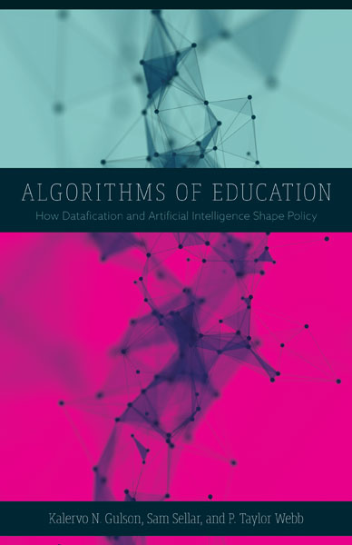
Cover image

Slide 50
Appadurai’s (2013) two ethics in anticipating the future
Contrasts an ‘ethics of possibility’ with an ‘ethics of probability’: very useful binary, but….
‘By the ethics of possibility, I mean those ways of thinking, feeling, and acting that increase the horizons of hope, that expand the field of imagination, that produce greater equity in what I have called the capacity to aspire, and that widen the field of informed, creative and critical citizenship’ (p. 295).
‘By the ethics of probability, I mean those ways of thinking, feeling, and acting that flow out of what Ian Hacking called the ‘avalanche of numbers’, or what Michel Foucault saw as the capillary dangers of modern regimes of diagnosis, counting and accounting’ (p .295).
UNESCO’s (2021). Futures of Education cf OECD’s (2021). Future of Education and Skills 2030 (ethics of possibilities v ethics of probabilities); Robertson (2022).
Necessity to move beyond the binary.

Slide 51
Working with both Probabilities and Possibilities
Work together or across an ethics of probability and ethics of possibility/possibilities.
Numbers and data helpful.
BUT, does probability assume continuity between the past and the present and the future? Data collected in the past, certain assumptions built in re race, class and gender.
So need human involvement, conversations, dialogue, BUT what about AI and synthetic governance, working across/together human cognition and machine cognition?

Slide 52
A synthetic politics: Co-learning, human and Machine cognition
‘A synthetic politics begins from the premise that there is no outside of algorithmic decision-making and automated thinking. We must think with and through our imbrications with other modes of cognition as a kind of ‘co-learning’ with automated systems’ (p.144).
‘Education is a site in which we can remain open to the uncertainties, risks and possibilities of synthetic governance’ (p.144).
Kalervo N. Gulson, Sam Sellar and P. Taylor Webb (2022). Algorithms of education: How datafication and artificial intelligence shape policy. University of Minnesota Press.

Slide 53
What is synthetic governance and what are its possibilities?
Control societies – ‘a political rationality of prediction in education policy and governance’ (Gulson et al., 2022, p. 132).
‘…this rationality can be understood as synthetic governance, an amalgamation of human classifications, rationalities, values, and calculative practices on the one hand, and new algorithms, data infrastructures, and AI on the other’ (Ibid., p.132)
Combining human and machine cognition; beyond path dependence.

Slide 54
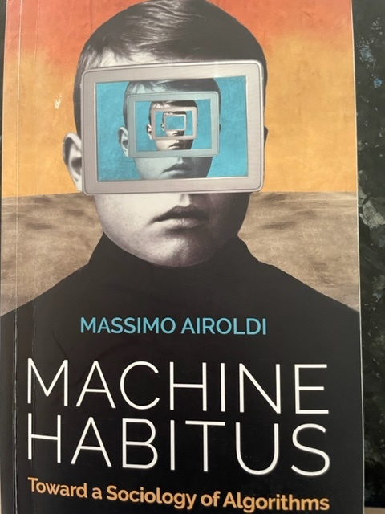

Slide 55
Another way of thinking about SG: Machine habitus
‘…unexplored theoretical landscapes, where two main kinds of agents – humans and machine learning systems – and their cultural ‘black boxes’ – habitus and machine habitus – jointly make society, while being made by it’ (Airoldi, 2022, p.30).
‘Machine habitus can be defined as the set of cultural dispositions and propensities encoded in a machine learning system through data-driven socialization processes’ (Airoldi, 2022, p.113).

Slide 56
New technologies: beyond ‘apocalyptic critics’ and ‘acritical enthusiasts’ (Airoldi, 2022, p.154)
‘The socio-economic fields surrounding technology matter, especially if the technology in question attempts to learn the arbitrary, discriminatory and, certainly, biased cultural codes guiding human behaviour solely for the sake of profit and social control’. (Airoldi, 2022, pp.154-155)
‘When used differently, artificial intelligence systems and learning machines can become amazing tools for solving socially relevant problems, cultivating social relations, preserving local cultures, reducing social inequalities and improving the life of communities’. (Airoldi, 2022, p. 155)

Slide 58
Facer (2021): Ideas of the future in education
What might education be like in the future?
Education as a preparation for the future.
Education about futures.
Liberating education from futures.
Reparative futures (see Sriprakash, 2022).

Slide 59
How do we get from here to there?
‘…the future is not a blank space for the inscription of technocratic enlightenment or for nature’s long-term oscillations, but a space for democratic design that must begin with the recognition that the future is a cultural fact’ (Appadurai, 2013, p. 299).

Slide 60
Thank you
Robert.Lingard@acu.edu.au
r.lingard@uq.edu.au

Slide 61
References
Airoldi, M. (2022). Machine habitus: Toward a sociology of algorithms. Polity.
Appadurai, A. (2006). Fear of small numbers. Duke University Press.
Appadurai, A. (2013). The future as cultural fact. Verso.
Ball, S. J. (2006) Education Policy and Social Class, London, Routledge.
Bartlett, L. and Vavrus, F. (2019). Rethinking the concept of ‘context in comparative research. In Gorur, R. et al., (Eds.). Comparative methodology in the era of big data and global networks. New York: Routledge.
Bergsen, P., Downey, L., Krahe, M., Kundnani, H., Moschella and Slobodian, Q. (2022). The economic basis of democracy in Europe: Structural economic change, inequality and the depoliticization of economic policymaking. London: Chatham House.
Bonnor, C., Kidson, P., Piccoli, A., Sahlberg , P and Wilson, R. (2021). Structural Failure: Why Australia Keeps Falling Short of Our Educational Goals. University of NSW Gonski Institute for Education.
Couldry, N. and Mejias, U. (2019). The costs of connection: How data is colonizing human life and appropriating it for capitalism. Stanford University Press.
Facer, K. (2021). Futures of Education: Learning to Become. UNESCO.
Fraser, N. (2022). Cannibal capitalism. Verso.

Slide 62
References contd.
Fraser, N. (2013). Fortunes of feminism. Verso.
Gulson, K., Sellar, S. and Webb, T. (2022). The algorithms of education. University of Minnesota Press.
Lingard, B. (Ed.) (2021). Globalisation and education. Routledge.
Mau, S. (2019). The metric society: On the quantification of the social. Polity.
Piketty, T. (2014). Capital in the Twenty-First Century. Belknap Press of Harvard University Press.
Ranson, S. (2018). Education and democratic participation. Routledge.
Rappleye, J. and Komatsu, H. (2020). Towards (comparative) educational research for a finite future. Comparative Education. 56, 2: 190-217.
Rizvi, F., Lingard, B. and Rinne, R. (Eds.) (2022). Reimagining globalization and education. Routledge.
Robertson, S. (2022). Guardians of the future: International organisations, anticipatory governance and education. Global Society. 36, 2: 188-205.
Savage, G., Gregorio, E. and Lingard, B. (2022). Practices of statecraft and the reassembling of political boundaries: The contested nature of national schooling reform in the Australian federation.. Policy Studies. 43, 5: 962-983. DOI: 10.1080/01442872.2021.1885640

Slide 63
References contd.
Savage, M. (2021). The Return of Inequality. Harvard University Press.
Sriprakash, A. (2022). Reparations: Theorising just futures for education. Discourse: Studies in the Cultural Politics of Education. DOI: 10.1080/01596306.2022.2144141
Stengers, I. (2010). Cosmopolitics 1. University of Minnesota Press.
Stengers, I. (2011). Comparison as a matter of concern. Common Knowledge. 17, 1: 48-63.
Wetsch, M. (2009). YouTube and you: Experiences of self-awareness in the context collapse of the recording cam. Explorations in Media Ecology. 8, 2: 99-114.
Whatmore, S. (2009). Mapping knowledge controversies: Science, democracy and the redistribution of expertise. Progress in Human Geography. 33, 5: 587-58.
Wyatt-Smith, C., Lingard, B. and Heck, E. (2019). Digital learning assessments and big data: Implications for teacher professionalism. Education Research and Foresight Working Paper 25, UNESCO.
Wyatt-Smith, C., Lingard, B. and Heck, E. (Eds.) (2021). Digital disruption in teaching and testing: Assessments, big data, and the transformation of schooling. Routledge.
Zuboff, S. (2-19). The age of surveillance capitalism: The fight for a human future at the new frontier of power. Public Affairs.

