Slide 1
The Ewenic expansion in Siberia
SLE 56 Athens
Juha Janhunen
asiemajeure@yahoo.com
asiemajeure@yandex.ru
ILS RAS, St. Petersburg

Slide 3
Two extremes
Jurchen-Manchu
imperial language of the Jin (1115-1234) and Qing (1616-1911)
official language of “China” during the Qing (1644-1911)
written language since 1120 (Jurchen) / 1599 (Manchu)
speaker population decreased from millions to max 10 000 (Sibe)
Ewenki-Ewen
the most widespread language(s) in North Asia / Siberia
covering a territory of c. 5-6 million km²
historical speaker population never more than max 50 000
today rapidly declining and seriously endangered

Slide 4
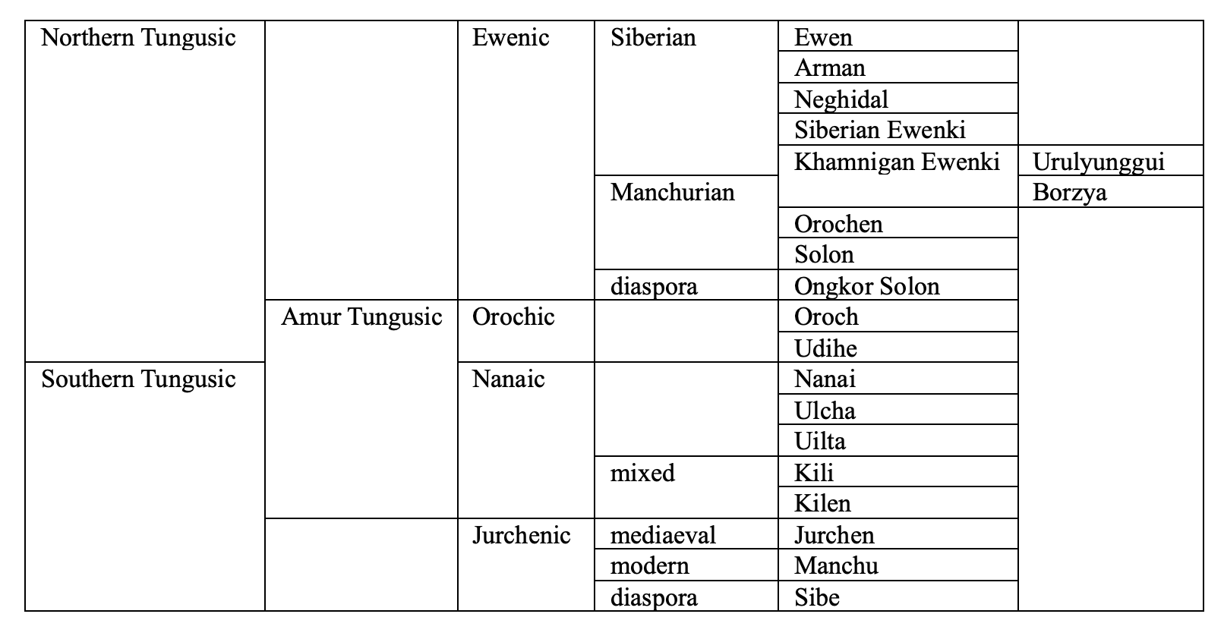
Taxonomy

Slide 5
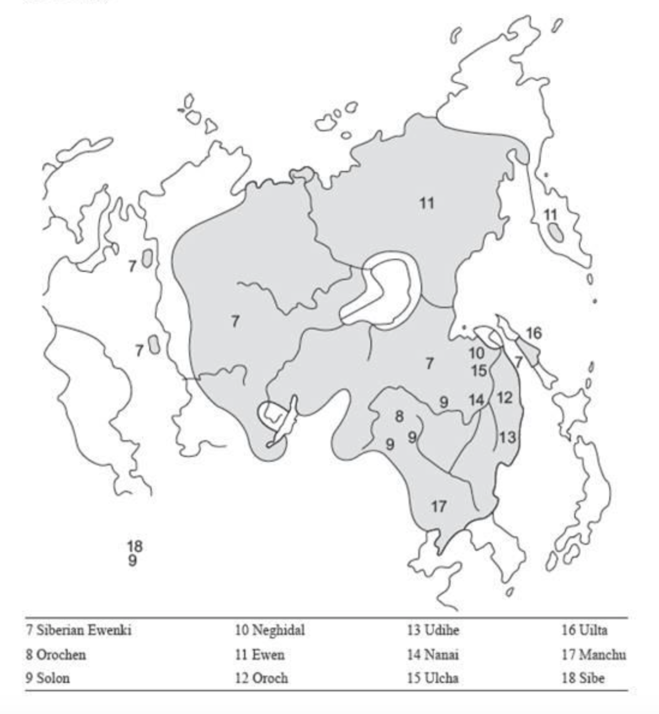
Distribution

Slide 6
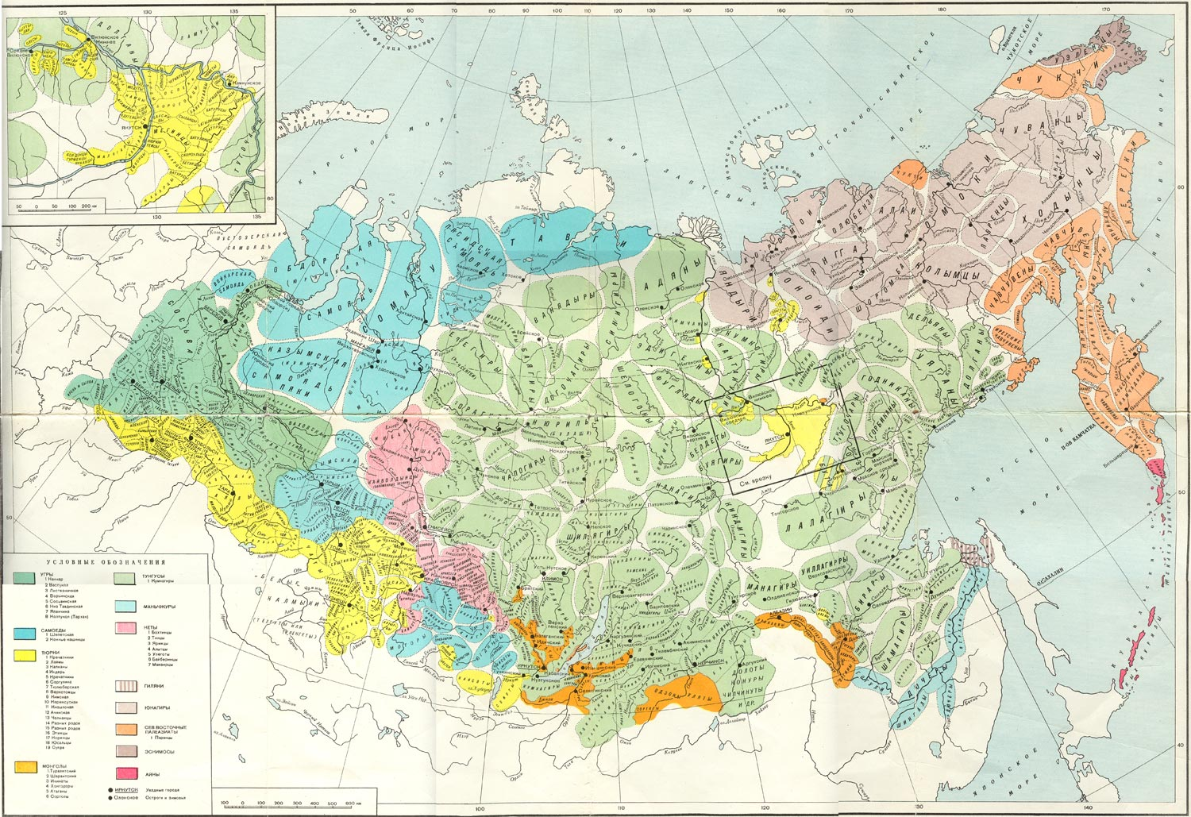
17th to 18th cc.
Б. О. Долгих 1960

Slide 7
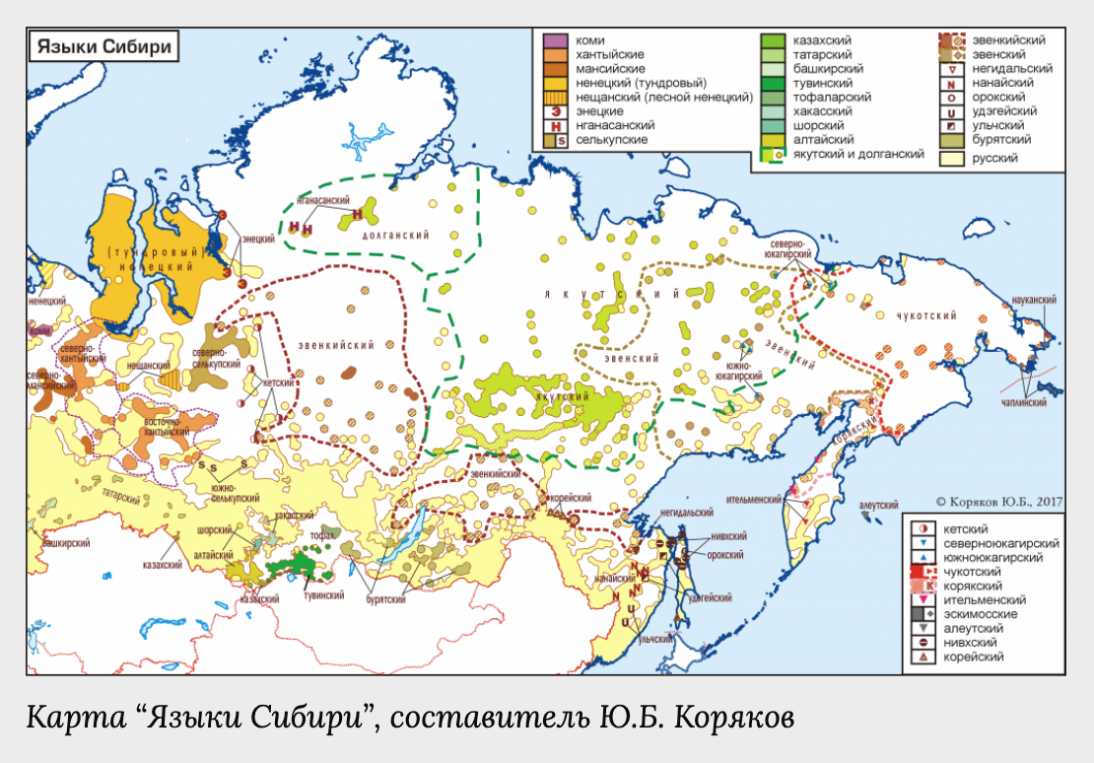
21st c.

Slide 8
Reasons of regression
14th- cc. Expansion of Yakut
- to the Middle Lena
- to Taimyr: Dolgan
16th- cc. Expansion of Russian
- across the Yenisei
- to the Pacific coast
- in Transbaikalia

Slide 9
Stages of expansion
19th c. Kamchatka, Sakhalin
17th-18th cc. Kolyma, Anadyr, Taimyr
15th-17th cc. Yenisei, Angara, Tunguska
11th-14th cc. Lena basin, Baikal region
-10th c. Middle Amur, Zeya

Slide 10
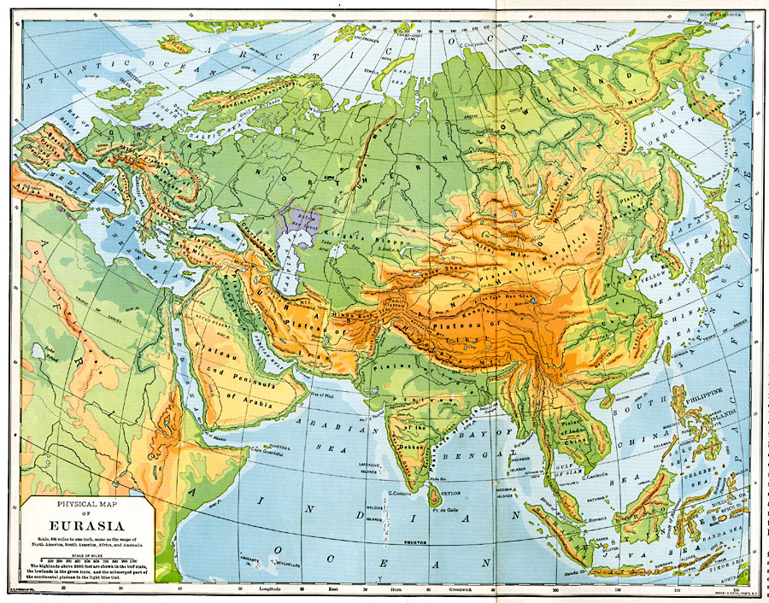
Proto-Tungusic

Slide 11
Proto-Ewenic

Slide 12
Neighbouring languages
N Taimyr Nganasan
NW Katanga Nenets, Enets
W Sym Selkup, Khanty
SW Tunguska Ket, Kott
C Lena Yakut
S Baikalia Buryat
SE Dauria Khamnigan Mongol
E Amur Ghilyak
NE Okhotsk Yukaghir, Koryak

Slide 13
Language shift from Ewenic
N Taimyr
NW Katanga
W Sym
SW Tunguska
C Lena Yakut
S Baikalia Buryat
SE Dauria Khamnigan Mongol
E Amur
NE Okhotsk

Slide 14
Language shift to Ewenic
N Taimyr
NW Katanga
W Sym
SW Tunguska
C Lena
S Baikalia
SE Dauria
E Amur Ghilyak
NE Okhotsk Yukaghir

Slide 15
Regional groups
Western Ewenki Ob-Yenisei
Southern Ewenki Baikalia
Northern Ewenki Arctic
Eastern Ewenki Okhotsk
Ewen NE Siberia

Slide 16
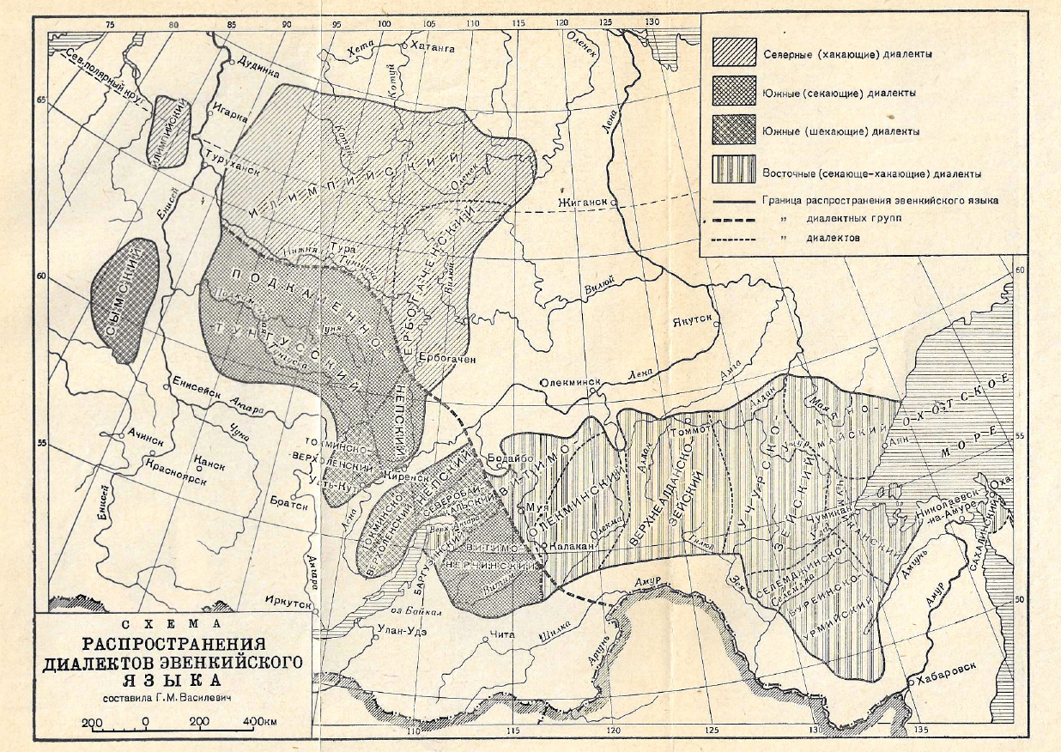
Ewenki
Vasilevich 1958

Slide 17
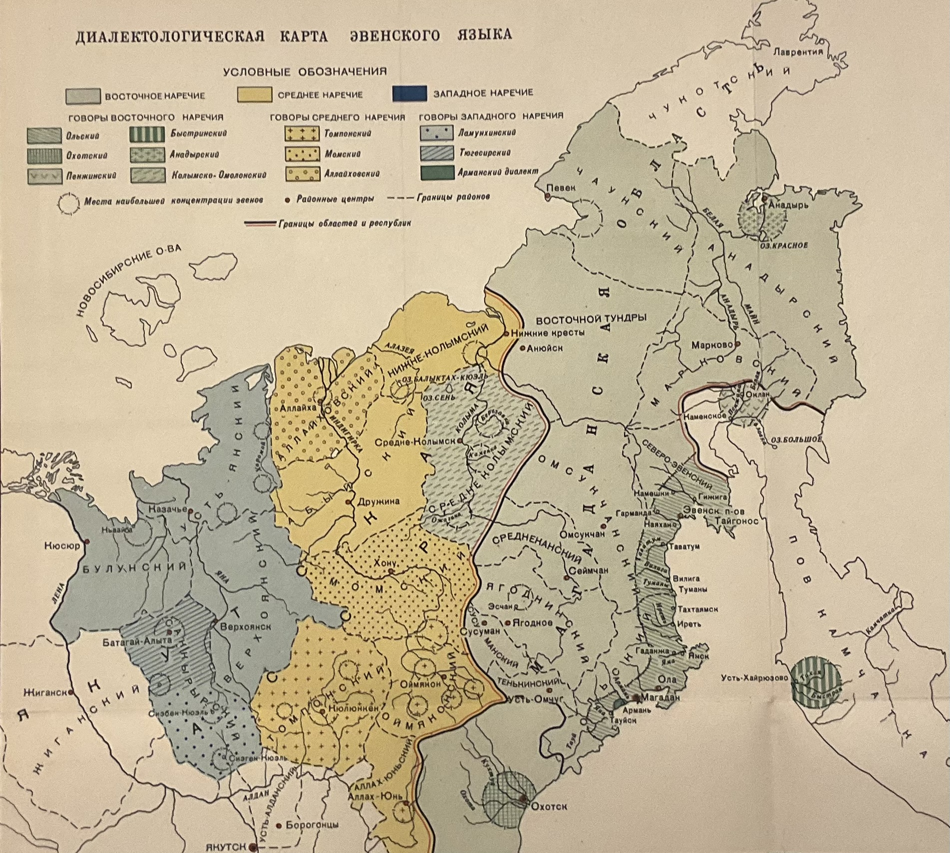
Ewen
Novikova 1960

Slide 18
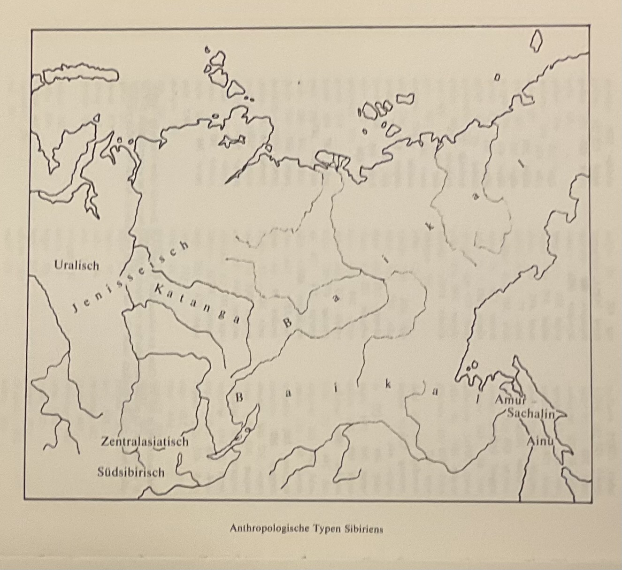
Doerfer 1985

Slide 19
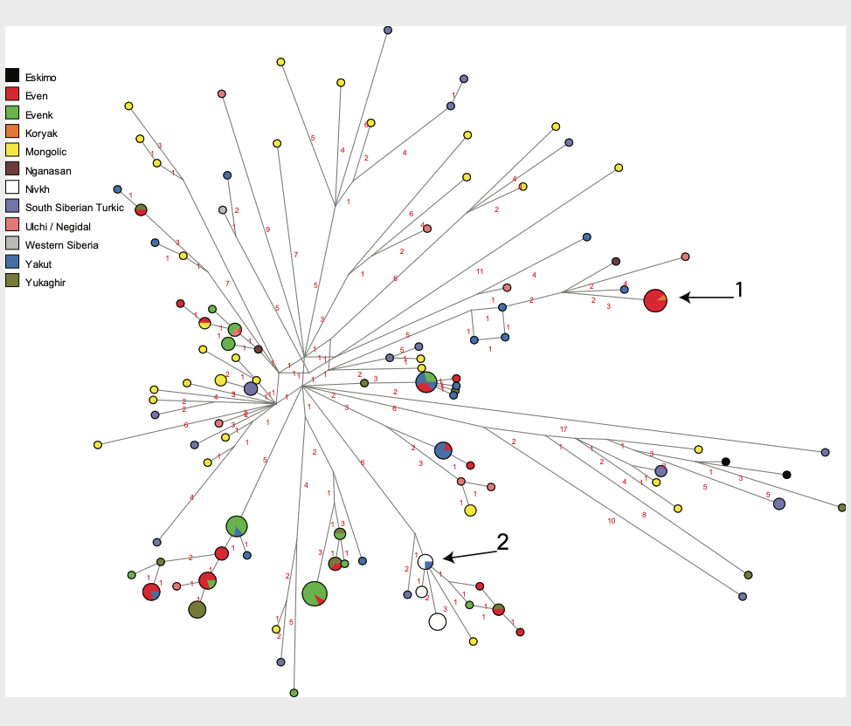

Slide 20
Specific features
Rapid expansion over wide area
Dating: 1000–1500–1900 AZ
Average annual expansion: 5000 km²
Using S/N and E/W rivers as routes
Covering an unknown number of languages
By absorption and assimilation
With few traces of substratal influence

Slide 21
A substratal areal feature?
[s] > [h] > Ø #_V V_V
F Nenets +
N Ewenki + (+)
Ewen + (+)
E Ewenki +
Udihe +
Buryat + +
Yakut Ø +

Slide 22
Underlying mechanisms
PUSH factors
Demographic edge? – larger population base?
Cultural edge? – new technologies? Reindeer herding?
Political edge? – higher social organization?
PULL FACTORS
Epidemics? – population decrease in target areas?
Wars? – political disunity among target populations?
PHYSICAL CONTEXT
Movements along E/W tributaries of major S/N rivers

Slide 23
Unsolved questions
Which and how many languages were replaced?
- Kolymic (Yukaghir: Odul and Wadul)
- Para-Samoyedic?
- Para-Uralic?
- Para-Amuric?
- other Palaeosiberian
Did the Ewenic expansion have predecessors?

Slide 24
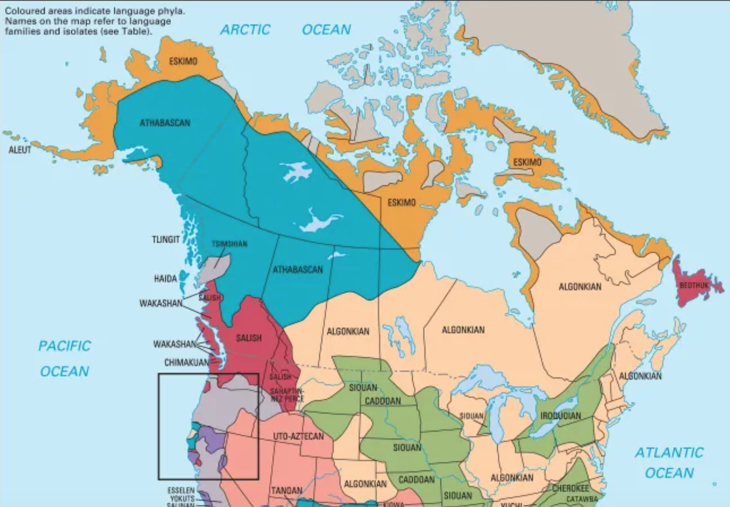
Cf. North America
Voegelin & Voegelin 1966

Slide 25
εὐχαριστῶ

