Slide 1
Rapid linguistic change in Tundra Yukaghir and language contact
Dejan Matić; matic@uni-muenster.de
Irina Nikolaeva; in3@soas.ac.uk
University of Münster

Slide 2
Introduction

Slide 3
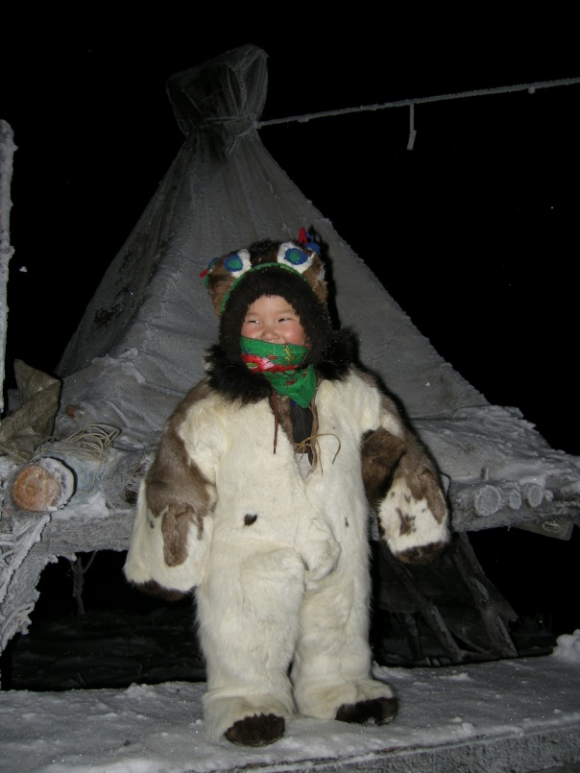
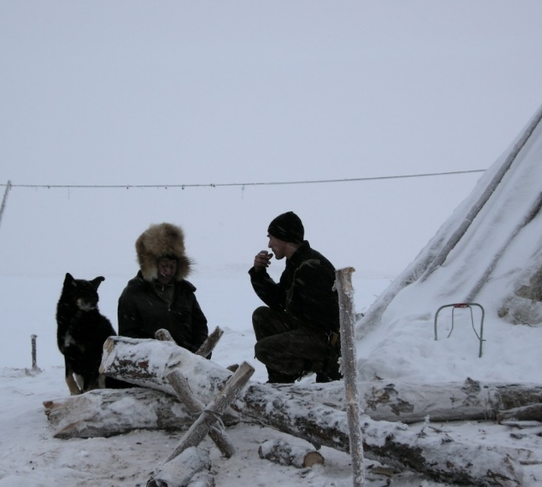
Tundra Yukaghir (TY)
Together with Kolyma Yukaghir, one of the two remaining Yukaghiric languages, forms a small language family.
Is currently spoken by 30-40 fluent speakers in the Lower Kolyma region (villages of Andryushkino, Kolymskoe, Chersky + Yakutsk).
Map: Pupynina & Aralova (2021: 3)

Slide 4
Language contact
In contact with Even (Tungusic), Chukchi (Chukotko-Kamchatkan), and Sakha (Turkic) since the 18th century.
Gradually intensifying contact with Sakha, especially since the advent of the Soviets in the 1930s.
Nowadays, Sakha (along with Russian) is the major language of the Lower Kolyma region and the major means of everyday communication.

Slide 5
Rapid linguistic change
TY has undergone a number of transformations in the course of only three generations during the 20th and 21st centuries.
Most changes are a product of extreme language contact, mostly with Russian and Sakha, as well as with the resulting incipient language death.
The changes range from lexicon and phonology, all the way to morphological categories and syntactic structure.
Focus of this talk
- morphosyntactic changes caused by the contact with Sakha
- one case study in detail (DOM)
- sociolinguistic context

Slide 6
Three stages of documentation of TY
Early Modern TY
- late 19th/early 20th century, speakers born before 1880s
Jochelson 1900, 1905; archival materials
Middle Modern TY
- mid 20th century, speakers born before 1940s
Krejnovič 1958, 1982; Maslova 2001, 2003; Kurilov 2001, 2005, 2006; Kurilov & Odé 2012
Late Modern TY
- early 21st century, speakers born after 1940s
- narrative fielddata - Cecilia Odé 2004-2014, Dejan Matić 2008-2013, Maria Pupynina 2022; elicitation data (in presence and online) - 2011-present

Slide 7
Recent contact-induced changes in TY

Slide 8
Lexicon and phonology
Modern TY displays some amount of lexical and morphological borrowings from Sakha, e.g. sular ‘bridle’, badiwa:- ‘to make disturbing noise’, kulubə ‘fur stockings’, araj ‘suddenly; once’, the verbalizer -la-.
Frequent code-switching between TY and Sakha (Kurilova 2020)
There are a number of recent phonological and phonetic changes, such as the realisation of the TY [œ] as [ø] (Odé 2012), introduction of [ɯ] in some words, and the occasional occurrence of voiced obstruents in the word-initial position, likely to be caused by the influence of Sakha.

Slide 9
Morphosyntax
The transfer of grammatical meaning from Sakha and, in most cases, also replicating the formal make-up of the original Sakha patterns.
New grammatical categories, absent from Early Modern TY and from related Kolyma Yukaghir.
Mostly evaluative and modal categories, but also patterns of informational structuring and discourse strategies.
In all cases cited below, there is good evidence that the direction of copying is Sakha > TY, not the other way round.

Slide 10
Morphosyntax
Necessitative
TY: -oːlmorau (prospective nominalization) + -ń(ə)- (proprietive) + subject marker
Aːwaː-j-oːlmorau-ńə-ŋi.
sleep.INCH-0-prosp.NMLZ-propr-intr.3pl
‘They had to sleep.’ (TY2012)
Sakha: -Iaχ (future participle) + -Laːχ (proprietive) + subject marker
Bier-bit tïl-gïn en tolor-uoχ-ta:χ-χïn.
give-PST.PTCP word-ACC.POSS.2SG 2SG fulfil-FUT.PTCP-PROPR-2SG
‘You must keep the word you gave.’ (Ubrjatova 1982: 330)

Slide 11
Morphosyntax
Impersonal necessitative
TY: -oːlmorau (prospective nominalization) + copula
Pojo:l a:wə-j-o:lmorau-k.
a.lot sleep-0-PROSP.NMLZ-COP
‘One should sleep a lot.’
Sakha: -Iaχ (future participle) + copula
ïjït-ïaχ ba:r.
ask-FUT.PTCP there.is
‘One should ask.’ (Slepcov 1972: 56)

Slide 12
Morphosyntax
Future imperative (2nd person)
TY: -təγənəŋ < the future form of the converb which expresses future-related and irrealis dependent situations
Egoːjeː met-u-l tilemǝ ma:-ŋi-tǝγǝnǝŋ.
tomorrow 1SG-0-NOM at.the.same.time wait-PL-FUT.IMP
‘Please wait for me tomorrow at the same time.’
Sakha: -A:r, cf. -A:rI the converb with comparable functions (see Pakendorf 2007)

Slide 13
Morphosyntax
Nominal pejorative
TY: the possessive construction - genitive noun + the bound pejorative word mutil
köde-n~mutil [man-GEN~PEJ] ‘good-for-nothing man’
Sakha: the possessive construction - noun + duom-POSS.3SG
kihi duom-a [man PEJ-POSS.3SG] ‘good-for-nothing man’

Slide 14
Morphosyntax
Verbal pejorative (‘pretense construction’)
TY: the genitive form of the action nominal + aux. muti- ‘pretend’ + subject marker
Tude-l a:wə-n muti-j.
3SG-NOM sleep-GEN(NMLZ) AUX-INTR.3SG
‘He is pretending to sleep.’
Sakha: SS converb + aux. duomna:- ‘pretend’ + subject marker
Oŋor-on duomnaː!
do-SEQ.SS.CVB AUX(IMP.2SG)
‘Do something like that!’

Slide 15
Morphosyntax
Contrastive/referential switch/topicalizing particles
TY: (ŋ)oldə and (ŋ)oldəγənə, grammaticalized converbs of the copula verb ‘be’
ta-ŋ keipə-pul ŋoldə eːruː-l-ŋiń kewei-nun-ŋi.
that-attr man-pl DP hunt-nmlz-dat go-hab-intr.3pl
[The women would prepare firewood] ‘and the men would go hunting.’ (TY2010)
Sakha: buollar and buollaγïna, grammaticalized converbs of the copula verb ‘be’
en buollaγïna tapta:-bak-kïn.
2SG DP love-NEG-2SG
[My grandmother loves me] ‘and/but you don’t.’ (Ubrjatova 1983: 473)

Slide 16
Case study: DOM

Slide 17
DOM
DOM in TY is extremely complex; it is affected by
- discourse prominence
- the morphosyntactic and semantic type of the object NP
- the person features of the subject and the object.
This results in the choice between six different case forms.
We focus on the form of the accusative case in ‘neutral sentence constructions’, the most frequent and functionally unmarked sentence type. The accusative is required on the object when the subject is 3rd person; otherwise the object stands in the nominative.
The accusative occurs in two different morphological forms, the long form (in -γənə) and the short form (in -lə).

Slide 18
Early and Middle Modern TY
The choice between the long and the short form depends on the structural properties of the object NP.
NPs in TY fall into two morphosyntactic classes which we conventionally label strong and weak, partly following the tradition stemming from Milsark (1974) and de Hoop (1995).
Strong NPs comprise
possessive NPs
NPs headed by personal names
NPs containing an attributive modifier
All other NPs are weak. NB: demonstratives and other determiners play no role in determining the status of an NP as strong or weak (Matić 2019).

Slide 19
Early and Middle Modern TY
Strong and weak NPs differ in a number of morphosyntactic behaviours, e.g. compatibility with the contrastive-individuating suffix -ŋ, the choice of the predicative form, etc. (Matić 2018, 2019).
The strong/weak distinction also affects the choice of the accusative form, the strong from vs. the short form.
Strong unmodified objects (possessives and proper names) take the accusative in the long form. This constraint has an exceptionless categorical status.
Strong modified objects can take both forms, but the long form is much more frequent.
Weak objects mostly take the short form, but the long form is also possible.

Slide 20
Early and Middle Modern TY
Object NP | Long accusative (-γənə) | Short accusative (-lə)
strong unmodified (possessives, names) | 100% | 0%
strong modified | 71% | 29%
weak | 5% | 95%

Slide 21
Early and Middle Modern TY
strong object NP (possessive)
[Qaičeː-təgə aruː-də-γənə] mə=möri-naː-m.
bear-AUG language-3POSS-ACC AFF=hear-INCH-TR.3SG
‘She began to understand the bear’s language.’ (Kurilov 2005: 396)
weak object NP
[Paipə-lə] laujə-γə kereː-s-ŋaː.
woman-ACC water-LOC descend-CAUS-TR.3PL
‘They threw the woman into the water.’ (Kurilov 2005: 370)

Slide 22
Early and Middle Modern TY
The referential status of the object NP in terms of specificity is not a relevant factor.
We will understand specificity as an intensional property (Fodor & Sag 1982, and much subsequent work): Specific NPs refer to particulars or sets of particulars in the world, whereas non-specific NPs have an existential reading and denote a property, without aiming at any particulars.
Non-specific NPs:
- narrowly defined non-specific items which trigger existential effects in opaque contexts
- generics
- non-discourse referents, i.e. NPs which denote a type of quality rather than an entity.

Slide 23
Early and Middle Modern TY
Non-specific objects take long or short accusative, depending on whether they are strong or weak.
strong (modified)
[Lajemu-i köde-γənə] mə=puń-nun-u-m.
stay.behind-S.PTCP man-ACC AFF=kill-HAB-0-TR.3SG
‘He used to kill people that stayed behind.’ (Kurilov 2005: 398)
weak
[Talau-lə] nime-ŋiń tono-rələk puń-nun-u-m.
reindeer-ACC house-DAT drive-SS.ANT.CVB kill-HAB-0-TR.3SG
‘He used to drive reindeer home and kill them.’ (Kurilov 2005: 128)

Slide 24
Late Modern TY
Strong unmodified NPs work in the same way (possessives and personal names).
Changes are observed for
- weak objects: the increase in the use of the long form (15% against earlier 5%)
- strong modified objects: the increase in the use of the short form (69% against earlier 29%)
The distinction seems to have been reinterpreted as a purely semantic one: the short form mostly combines with non-specific objects, while the long form is the first choice for specific objects.

Slide 25
Late Modern TY
Short form with non-specific objects
- The object in the example below does not denote a specific group of individuals but rather a kind of humans, the lazy type.
- This requires the choice of the short accusative both for a weak NP and a strong modified NP.
(In the past, the Yukaghirs used to work hard, though some were quite lazy. Asked if these were tolerated by others, the speaker replies:)
[Ta-ŋ čiː-lə], [eleŋńə-i čiː-lə] waːji lögiteː-nun-ŋaː.
that-ATTR people-ACC lazy-S.PTCP people-ACC again feed-HAB-TR.3PL
‘They would also feed those people, the lazy people.’ (TY2009)

Slide 26
Late Modern TY
Conversely, the long form is required when the object is intended to pick out a specific referent or a set of referents, irrespective of its status as strong or weak.
(There is a little knife,)
[aduŋ ind´eːnubə neme tite čoγojə-γənə] teńi kudereː-nun-ŋaː.
this sewing what like knife-ACC here put-HAB-TR.3PL
‘and they put this knife for sewing and similar stuff here.’ (TY2009)
Larisa man-i met-i-ń [malaqaːj-γənə] ularsï-bït.
L. say-INTR.3SG 1SG-0-DAT fur.hat-ACC borrow.Y-PST.PTCP.Y(3SG)
‘Larisa told me that she had borrowed a fur hat.’ (TY2010)

Slide 27
Late Modern TY
Elicitation data: The long form is ungrammatical if the object NP is generic or quality-like.
*Leweimə joːrpurə talau-γənə puń-nun-ŋaː.
in.summer tundra reindeer-ACC kill-HAB-TR.3PL
intended reading: ‘They used to kill reindeer in the tundra in summer.’
*Amaː čiŋičədiń nonγə-γənə lau-nun-u-m.
father in.night tobacco-ACC drink-HAB-0-TR.3SG
intended reading: ‘Father used to smoke (lit. “drink tobacco”) all night.’

Slide 28
Early/Middle Modern TY vs. Late Modern TY
Non-specific objects in the corpus
 | Short accusative (-lə) | Long accusative (-γənə)
Early/Middle Modern TY | 57% | 43%
Late Modern TY | 93% | 7%

Slide 29
Late Modern TY
Additional quirk: If an object can be construed as semantically partitive, it normally takes the long form, irrespective of its specificity or its morphosyntactic status as weak or strong (this accounts for non-specific objects with -γənə in the corpus).
This is often the case with restrictive modifiers which imply that the denotation of the NP belongs to a set (in this instance, ‘big dog’ implies that that there are also smaller dogs, so that big dogs are part of the set of dogs of different sizes.)
non-specific partitive object
Keipə [čama laːmə-γənə] waŋči-nu-m […]
man big dog-ACC search-PROG-TR.3SG
‘A man was looking for a big dog (sc. to buy),’ (but he didn’t buy anything).

Slide 30
Summary of the change
In Early/Middle Modern TY, the distribution of the accusative markers is a function of the morphosyntactic class to which the object NP belongs.
In Late Modern TY, this has not changed for strong unmodified NPs.
However, there has been a change in the factors determining the choice of the accusative form for weak objects and strong modified objects.
To take the long accusative, they have to be either specific or partitive.
Conversely, the precondition for the use of the short accusative is the lack of specificity or partitivity.

Slide 31
Sakha
Sakha, like most Turkic languages, has a DOM system in which object can be encoded by the nominative or the accusative in -(n)I. Various accounts of this system (overview in Pakendorf 2007: 142ff.)
We follow Vinokurova (2005: 195ff., 322ff.), Baker & Vinokurova (2010), Pakendorf (2007: 142) and others in taking specificity to be the major factor.
The accusative is used for specific objects.
The nominative is used for non-specific objects, including
- non-specific indefinites
- generics
- quality-denoting NPs

Slide 32
Sakha
specific
Üle-tin I hin dien mede:l-i ïl-bït-ïm.
work-GEN for SUB medal-ACC take-PST.PTCP-POSS.1SG
‘I received a medal for my work.’ (Pakendorf 2007: 143)
non-specific
Biːr eder uol üle kördüː-r.
one young boy work.NOM search-PRS(3SG)
‘A young boy is looking for work.’ (https://m.vk.com/wall-241920_2284)
Kïːs oγo taptïː-r.
girl child.NOM love-PRS(3SG)
‘The girl loves children.’ (https://vk.com/wall-68471778?offset=1700)

Slide 33
Sakha
Partitive readings tend to trigger the use of the accusative, so work together with specificity.
This is especially patent with quantified NPs, since a quantifiable amount of a substance or entities implies a superset to which the substance/entities belong, and modified objects if the modifier is construable as implying a superordinate set.
If the modifier is not meant to imply the existence of a superset, the nominative can also be used.

Slide 34
Sakha
non-partitive
Ulaχan ït kördüː-r.
big dog.NOM search-PRS(3SG)
‘He is looking for a big dog.’
partitive
Ulaχan ït-ï kördüː-r.
big dog-ACC search-PRS(3SG)
‘He is looking for a dog that is big (not small or medium-sized).’

Slide 35
Sakha vs. TY
object NP | Early/Middle Modern TY | Late Modern TY | Sakha
strong (possessive, names) | long | long | ACC
strong modified specific | long | long | ACC
weak specific | short | long | ACC
strong modified non-specific | long | short | NOM
weak non-specific | short | short | NOM

Slide 36
Sakha vs. TY
The conditions on the choice of the accusative form in Modern TY changed from structural (morphosyntactic class of NP) to purely semantic (specificity/partitivity).
We propose that the cause of the change was to match Sakha.
The long form of the TY accusative was interpreted as being functionally equivalent to the Sakha accusative, and the short form was interpreted as being functionally equivalent to the Sakha nominative.
The already existing identity of some of the distributional criteria (possessives and proper names had already patterned identically) might have facilitated the process of grammatical replication.

Slide 37
Discussion

Slide 38
Sakha and TY in the 20th/21st centuries
Traditionally, trade relations between the Sakha and the Yukaghirs; small number of intermarriages; some Yukaghirs spending winters close to the Sakha settlements
> some bilingualism, mostly Yukaghir men speaking Sakha (Pupynina & Aralova 2021)
Since 1930s, all inhabitants of the Lower Kolyma region organised in reindeer herding collective farms (kolkhoz)
> the Sakha increasingly speak TY (language of the reindeer herding, intermarriages)
Since 1940s, Sakha is becoming the dominant language, and in 1950s, after the settlement of the Lower Kolyma people in the village of Andryushkino, the primary language in the boarding school
> the Yukaghirs begin speaking Sakha as the primary language, gradually restricting TY to a small number of contexts

Slide 39
Sociolinguistic context and rapid change
Sociolinguistically rather atypical situation between 1930s and late 1950s, with both:
- symmetric small-scale bilingualism of the indigenous type (the Yukaghirs speaking Sakha and the Sakha speaking TY in the collective farms; the Sakha were put into the situation to learn the non-dominant language)
- assymetric bilingualism with Sakha as the socially dominant language, having prestige in administration and schools (the Yukaghirs increasingly using the socially dominant Sakha in everyday village life)
The simple dichotomy of borrowing vs. substratum (as in Thomason & Kaufman 1987; van Coetzem 1988) or the trichotomy of L1-, L1/L2- or L2-oriented change (as in Muysken 2000, 2010, 2013) are not sufficient to describe possible scenarios of language contact – if they are taken to be mutually exclusive.

Slide 40
Sociolinguistic context and rapid change
Types of multilingualism
symmetric
Sakha
TY
asymmetric
Possible agency in the transfer process
- Sakha speakers using TY in collective farm contexts (L1 > L2)
- TY speakers using Sakha in collective farms and in the village (L2 > L1)
These two possibilities existed in parallel and may have reinforced each other: the pressure to adapt the linguistic system of TY was intense enough to warrant changes coming from both L1 and L2 speakers.

Slide 41
Sociolinguistic context and rapid change
Most instances of structural copying are already traceable at that time, i.e. in the speech of the people born after 1900s or 1910s (Middle Modern TY).
However, the change in the functioning of DOM appears to be a more recent development, noticeable only in the languages of the speakers born in the 1950s and later.
It falls in the time when Sakha became fully dominant as the language of communication in all functional domains.
There were no more L1 Sakha speakers who spoke TY. The agency of change in this case lies with TY speakers alone, who copied the pattern of the dominant language into their L1.

