Slide 1
Sirenikski’s Place on the Eskaleut Language Family Tree
Anna Berge
University of Alaska Fairbanks, Alaska Native Language Center
SLE 2023, Athens, August 29-September 1, 2023

Slide 2
Sirenikski
A small language with numerous unique characteristics within the EA language family
Long-term, pervasive language contact with Central Siberian Yupik (CSY) and Chukchi; known contact effects include (most famously) the borrowing of particles, coordinators, and some stress patterns
Territorially squeezed out by CSY and Chukchi from at least the 18th century (Krupnik 1991); restricted to a few villages on the southern Chukotkan Peninsula
1st documented in the 1890’s, when it was already endangered and had already exhibited extensive contact effects
Bi/multi-lingualism, intermarriage, and shift to dominant languages in 20th century
Last speaker died in 1997

Slide 3
EA language family Distribution of Languages around Bering Sea

Slide 4
the question
The placement of Sirenikski on the EA language family tree is unresolved
Assumption (since at least Marsh and Swadesh 1951) that Yupik and Inuit branches separated ca 2000 BP. There are two main positions regarding Sirenikski
Sirenikski separated early from other Yupik and Inuit languages to create a 3rd, distinct branch.
it is the sole representative of that branch
it is a conservative, relic language
it may never have been spoken in Alaska
Sirenikski separated early from Yupik specifically, and it is a Yupik language

Slide 5
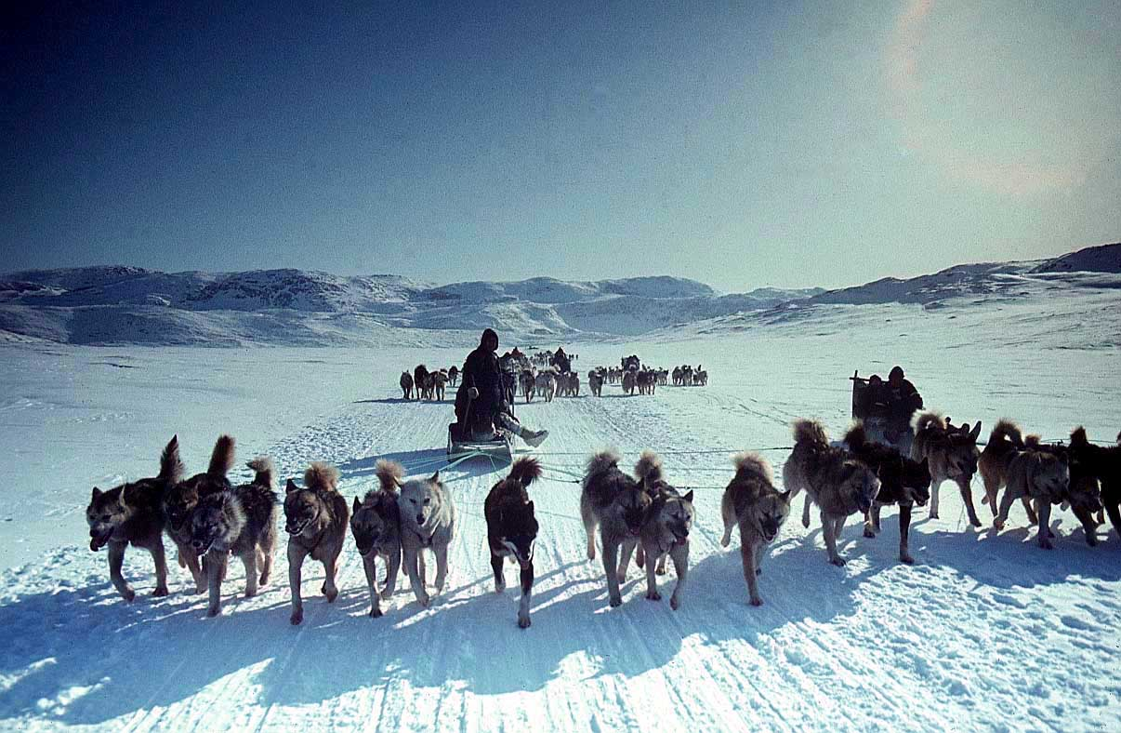
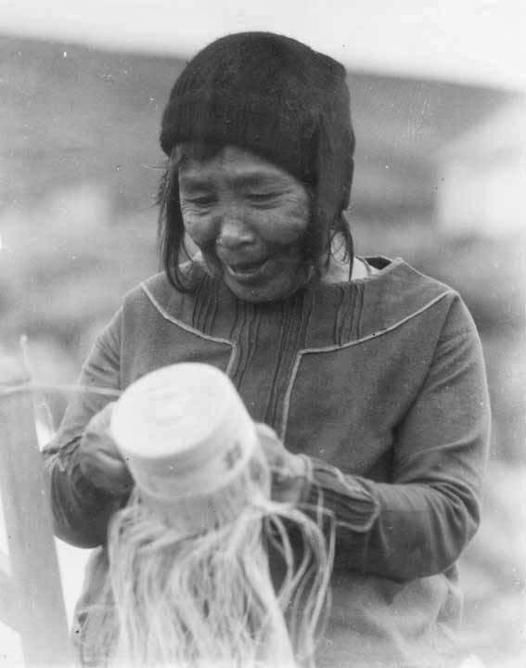
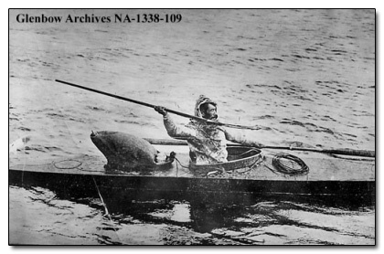
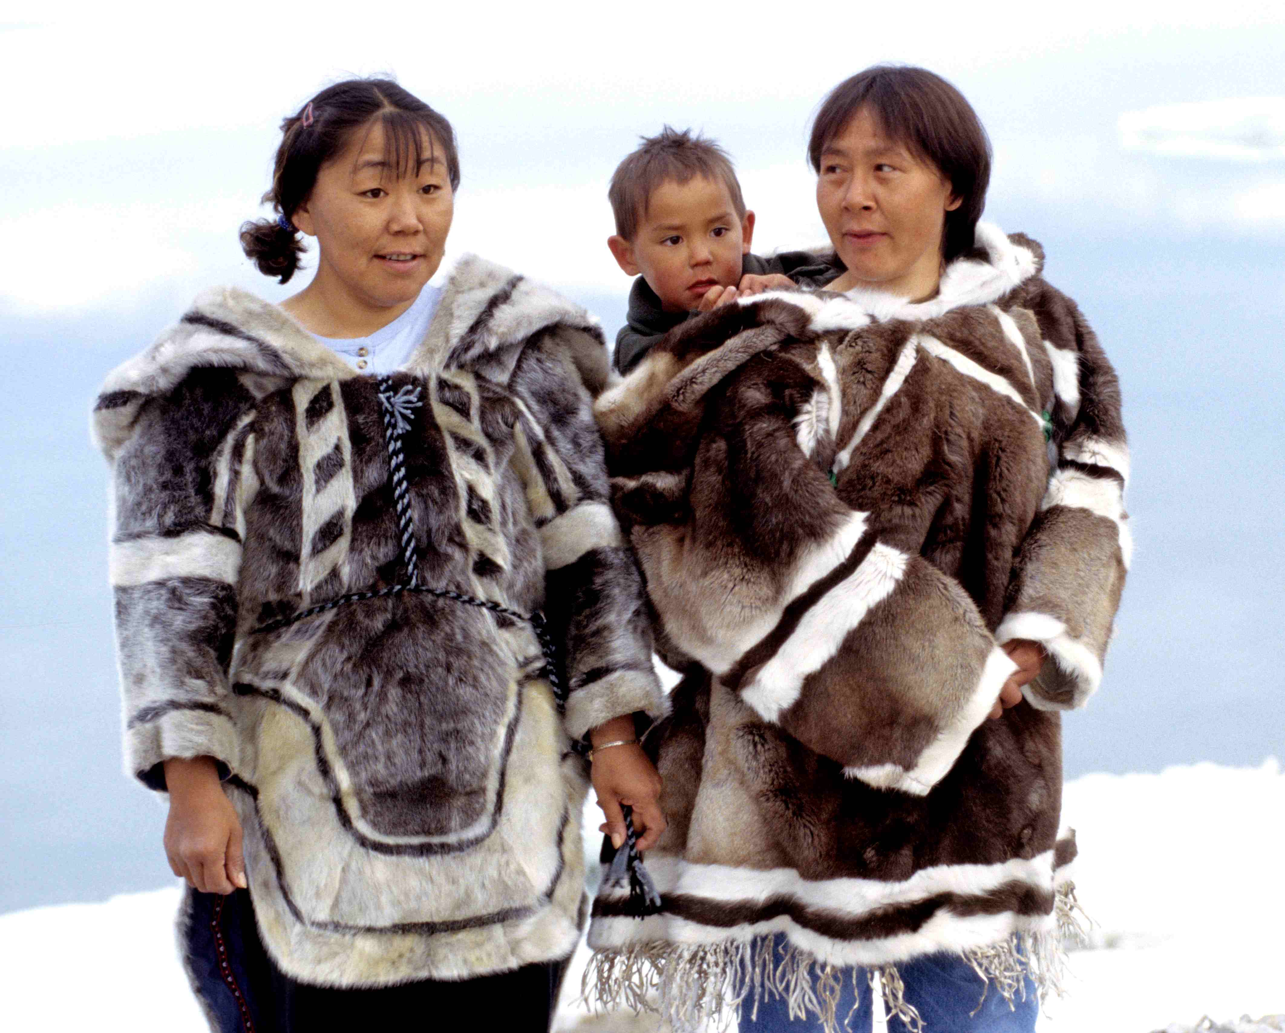
ESKALEUT LANGUAGES: 1st Scenario
Proto-Eskaleut
ca. 4000 BP??
Proto-Aleut I Proto-Yupik/Inuit
ca. 3500 BP ca. 3000-2500 BP
Proto-Sirenikski
ca. 2500BP?
Proto-Yupik
ca. 2000 BP
Proto-Aleut II
ca. 1000 BP
Proto-Inuit
ca. 1000-800 BP
Sirenikski
-1997
Unangam Tunuu
CSY
CAY
Inuit
Nauk
Alutiiq
Notes:
Common consensus (through much of 20th c) that
EA languages developed in isolation, especially UT
Estimates of divergence based on lexicon and phonology
UT diverged perhaps as much as 4500 yrs ago, based on divergence and linguistic isolation
Probably closer to 3000 yrs ago, and language reflects periods of post-split contact with Eskimo and with other languages
Sirenikski is an unknown: is it a separate language branch? Or part of Yupik?
Yupik diverged about 2000 yrs ago; but its spread is a result of Thule migrations about 800 yrs ago
Inuit diverged into different dialects within the past 800-600 yrs

Slide 6
ESKALEUT LANGUAGES: 2nd scenario
Proto-Eskaleut
ca. 4000 BP??
Proto-Aleut I Proto-Yupik/Inuit
ca. 3500 BP ca. 3000-2500 BP
Proto-Yupik
ca. 2000 BP
Proto-Aleut II
ca. 1000 BP
Proto-Inuit
ca. 1000-800 BP
Sirenikski
-1997
Unangam Tunuu
CSY
CAY
Inuit
Nauk
Alutiiq
Notes:
Common consensus (through much of 20th c) that
EA languages developed in isolation, especially UT
Estimates of divergence based on lexicon and phonology
UT diverged perhaps as much as 4500 yrs ago, based on divergence and linguistic isolation
Probably closer to 3000 yrs ago, and language reflects periods of post-split contact with Eskimo and with other languages
Sirenikski is an unknown: is it a separate language branch? Or part of Yupik?
Yupik diverged about 2000 yrs ago; but its spread is a result of Thule migrations about 800 yrs ago
Inuit diverged into different dialects within the past 800-600 yrs

Slide 7
The problem
Since the 1980’s, the dominant position has been that Sirenikski is a separate, 3rd branch of PEA, and a conservative, relic language
New advances in our knowledge have not been incorporated into the resolution of this question
It is my aim to address this

Slide 8
Sirenikski as a separate branch
Proponents: Krauss (1985), Vakhtin and Golovko (1987), Fortescue et al. (2010)
Linguistic evidence most commonly cited in support of Sirenikski distinctiveness
Lexical divergence
Sirenikski retention of intervocalic velar and uvular fricatives
Uniqueness of Sirenikski prosody
Phonological features shared with Yupik in some cases and Inuit in others
(More minor differences cited: lack of dual number, lack of distinction between ablative and instrumental cases)

Slide 9
Sirenikski as a separate branch
Lexical divergence between Sirenikski and the rest of the PE branch of the language family suggests an early separation
This determination is still based on Menovshchikov (1964) and Vakhtin and Golovko (1987), based on a comparison of Swadesh-list vocabulary
The publication of the Comparative Eskimo Dictionary (1994, 2010) has made an enormous amount of comparative data available, and a careful examination thereof shows that the divergence is not all that great:
PE → | Sirenikski | PE → | CSY
*caluɣ- ‘dry, to be dried out’ | saluɣtə ‘dry, to be dried out’ | *kinəʁ- ‘drip dry’ | kinəʁ- ‘dry’

Slide 10
Sirenikski as a separate branch
PE is thought to have been originally (C)VC(C)V(C)
PE had a process of intervocalic lenition (stop → voiced fricative)
One defining feature of Sirenikski has been its retention of intervocalic fricatives, progressively lost in other Y/I languages
PE | Sirenikski | Siberian Yupik | Alaskan Yupik | Inuit
*aðuɣ ‘blood’ | acəɣ | aakʷ | auk | auk
*ataʁuciʁ ‘one’ | atəʁəsəχ | ataasiq | atauciq | atausiq,\ GRI ataasiq
The loss of intervocalic fricatives in other Yupik and Inuit languages had the following effects:
Sirenikski | → | Yupik | Inuit
no long vowels or diphthongs |  | long vowels or diphthongs | long vowels or diphthongs
(Sirenikski has 2 prosodic systems) |  | rhythmic stress, with modifications based on syllable shape | consonant gemination, no rhythmic stress

Slide 11
Sirenikski as a separate branch
How distinctive is Sirenikski syllable structure?
Retention of intervocalic fricatives is found in other languages/dialects
They reappear as geminates in non-singular forms of Inuit (Kaplan 1985)
PE | Sirenikski | CSY | CAY | SPI | Other Inuit
*kuðəɣ ‘river’ | kucəx | kiikʷ |  | kuuk, kuɽɣit (pl) | NAI kuuk, kuɽɽii (pl)
*ciðəɣ- ‘cut open’ | sicəɣ- ‘to cut up’ | əsəɣ- ‘to cut fish’ | cəɣ-, səɣ- ‘to cut fish’ | siik ‘to cut lengthwise’ | siik ‘disembowel, cut down middle’ GRI siiɣ-
*iðəʁ- ‘hide’ | iceʁ- | iir- | iir- | SPI, NAI iɽiq- | WCI, ECI iyiq- GRI iʃiʁ-

Slide 12
Sirenikski as a separate branch
How distinctive is Sirenikski syllable structure?
No satisfactory study of when other languages retain intervocalic consonants
No study of when Sirenikski does not retain intervocalic consonants
PE | Sirenikski |  | CAY |  |  | SPI | Other Inuit
*nevi(C)aʁ ‘girl’ | naχsəraχ ‘little girl’ naχsəχ ‘woman’ |  | nəviaχcaq ‘girl, young woman of marriageable age’ |  |  | niaqsiaq | NAI niviaqsiaq ECI, GRI niviarsiaq
(earlier sources assume this is a cognate; Fortescue et al. 2010 suggest a borrowing from Chukchi ŋəəɣəsqət ‘woman;’ either way, the reconstruction or borrowing is irregular)
*aqaɣcuɣ- ‘lull baby to sleep’ |  | əχsəχ- |  | CSY aχsuɣ- (CAY aaqucuŋuq ‘doll’) |  |  | WCI aχχuq- GRI aqassuɣ-

Slide 13
Sirenikski as a separate branch
How distinctive is Sirenikski syllable structure?
No study of the conditions under which Sirenikski breaks up inherited clusters:
Sirenikski does not have VV’s except in borrowed words, but its retention of intervocalic consonants and PE syllable structure is not unique, and something else seems to be going on
PE | Sirenikski | Yupik | Western Inuit | Eastern Inuit
*aʁviʁ- ‘cross over’ | aʁvəqaχ ‘strait’ | aʁviʁ- | aʁviqtaq ‘go in and out’ | aʁviq- ‘go visiing’
*aqilʁuʁ ‘something soft’ | aqələɬəʁaχ | NSY aqilʁuq ‘swamp’ CAY aqəlʁuχtə- ‘be gelatinous’ | aqilʁuq | GRI aqiʁɬuq

Slide 14
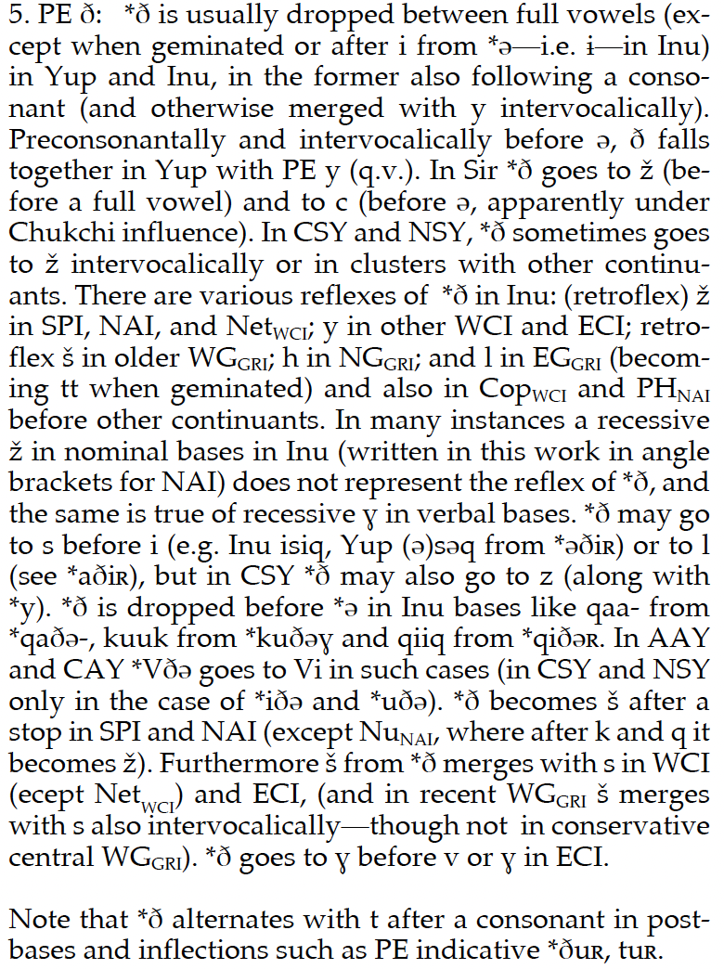
The perception of consonant ‘retention’ is partially a result of our incomplete understanding of the sound changes that have taken place
(cf. Fortescue et al. 2010:xvii)
PE *ð | usually | sometimes
Y, I | dropped | → s or l/__i
CSY |  | ʝ z/__i
CAY, Alu CSY |  | Vðə →Vi uðə, iðə→Vi
Sir | ʝ /__V c/__ə
etc.
Are they part of the same processes?

Slide 15
Sirenikski as a separate branch
Unique prosodic system within Y/I/S languages: Sirenikski shows evidence of two prosodic systems (Krauss 1985)
Most common = stress on the 2nd syllable, regardless of the shape of the syllable, and thereafter on every other syllable:
a small number of words have stress on the 1st-syllable; most are borrowed, either borrowed lexical items from Chukchi or English, or borrowed prosody from Chaplinski CSY
ki-pə́ɫ-xi-ná-qa-ʁə́-ɫə-mə́ŋ ‘alternatingly’
Sirenikski | Borrowed from
kə́-mə-njə́r-’a ‘a hollow of hand’ | Chukchi mənɣ ‘hand’
í-vən-rú-ta ‘outboard motor’ | English ‘Evinrude’ | (cf. CSY i-və́n-run)
ká-məx-tə́-qəχ-tə́-ʁa ‘he puts boots on’ | CSY prosodic borrowing | káam-ʁa-qaa ‘he puts boots on’

Slide 16
Sirenikski as a separate branch
Sirenikski stress continued
Earlier, native, initial syllable stress system, with no evidence of rhythmic stress (Krauss 1985)
explains the pervasiveness of reduced vowels in all but the initial syllable
explains stressed schwas; original full vowels reappear in inflected forms
evidence from earlier sources:
absolutive = citation form | inflected form
jaqəχ arm.abs.sg ‘arm’ | jaqu-n arm-2sg.pos/pl.posm ‘your arms’
naxsəχ woman.abs.sg ‘woman’ | naxsaɣ-nəŋ woman-inst.sg ‘to the woman’
Gondatti (1895) → | Menovshchikov (1964)
sákəka ‘my father-in-law’ | sákə, sakə́ka ‘my father-in-law’

Slide 17
Sirenikski as a separate branch
How unique is the Sirenikski prosodic system?
Inconsistent vowel reduction; Rasmussen (1994) suggests retention of full vowels where the proto-language had geminates, although this does not fully explain the full vowels, as he himself admits
PE | Sirenikski | CSY | Inuit
*qəŋaʁ ‘nose’ | qəŋəχ | qəŋaq | qiŋaq
*cuqqaʁ ‘baleen’ | suqaχ | suqaq | suqaq
*iyaquʁ ‘wing’ | jaqəχ, jaquj (pl) ‘arm’ | jaquq | isaʁuq, isaqqut (pl) ‘wing, bone’

Slide 18
Sirenikski as a separate branch
How unique is the Sirenikski prosodic system?
Full non-initial vowels in morphologically complex words (like other Yupik languages, there appears to be separate inherent stress assignment for roots, derivational affixes, and inflectional affixes)
Vowel reduction is not as pervasive as reported.
Sirenikski has an inherited prosodic system that reflects the results of changes to the PE syllabic system, like Yupik
Nuk-ŋə-lŋu-ki sister-cop-neg.part-1pl ‘We had no sisters.’ (Menovshchikov 1964:169)
Uɣnəʁə-valaʁ-təqəχ-tə-χ (from uɣ-nə- ‘be.hot-neg’) be.cold-very-prs-ind-3sg ‘He is very cold.’

Slide 19
Sirenikski as a separate branch
How unique is the Sirenikski prosodic system?
Vowel reduction in Sirenikski looks suspiciously like Chukchi schwa epenthesis
Sirenikski has had intensive language contact with Chukchi for the last few hundred years
Chukchi has a pattern of epenthetic schwas determined by the needs of syllabification; it does not allow CCC’s and certain CC’s.
Sirenikiski vowel reduction is a different process, but the result is the same: CVC(C)V structure, with disfavored CC’s separated by schwas.
ɣət you(sg).abs | ŋewʔen-e wife-erg | peɣsiŋ-u be.worried-equ | nə-ɬɣə-rkəni-ɣət 1sg.s/a-consider-1pfv-2sg.o
‘Your wife is worried about you.’ (Dunn 1999)
cf. Chukchi mənɣ ‘hand’ → Sirenikski kəmənjər’a ‘a hollow of hand’
cf. PE *aqilʁuʁ ‘something soft’ → Sirenikski aqələɬəʁaχ

Slide 20
sirenikski as a separate branch
There are even apparent instances of schwa epenthesis in Sirenikski; -nkuɣ is probably borrowed from CSY
CSY also sometimes has schwas where even Sirenikski does not:
Is there a good reason to assume that Sirenikski originally had a stress system completely different from all other EA languages, and maintained it for 2500 years?
PE | Sirenikski | Yupik | W. Inuit | E. Inuit
*-nkuɣ (du) *-nkut (pl) ‘and partner’ | -nəkux -nəkut | -nkuk -nkut | -tkuk -tkut | -kkuk -kkut
PE | Sirenikski | CSY | CAY | Inuit
*ciɣəðquʁ ‘knee’ | siɣəsqəχ | səɣəsquq | ciitquq | siitquq, siiqquq
*ciɬuvaɣ ‘fish roe’ | siɬəvəχ | əsɬəvak | ciɬuvak | suak, suvak

Slide 21
Sirenikski as a separate branch
Features shared with Yupik only (1), vs. others shared with Inuit only (2)
Shared with Yupik: retention of schwa, loss of #n / _ i
Shared with Inuit: retention of j/C_, -tə#
PE | Sound change | Sirenikski | Siberian Yupik | Alaskan Yupik | Inuit
*anə- ‘go out’ | retention of ə | anə- | anə- | anə- | ani-
*niʁu ‘leg’ | loss of #n/_i | iʁu | iʁu | iʁu | niu
*sipjaʁ ‘hip’ | (retention of j/C_) | sipj̊əχ ‘pelvis’ | sipsaq | cipsaq | sipjaq
* aŋun ‘man’ | retention of -tə# | aŋəta ‘father’ | aŋun | CAY, Alaskan Iñupiaq aŋun | WCI, ECI, GRI aŋut(i)

Slide 22
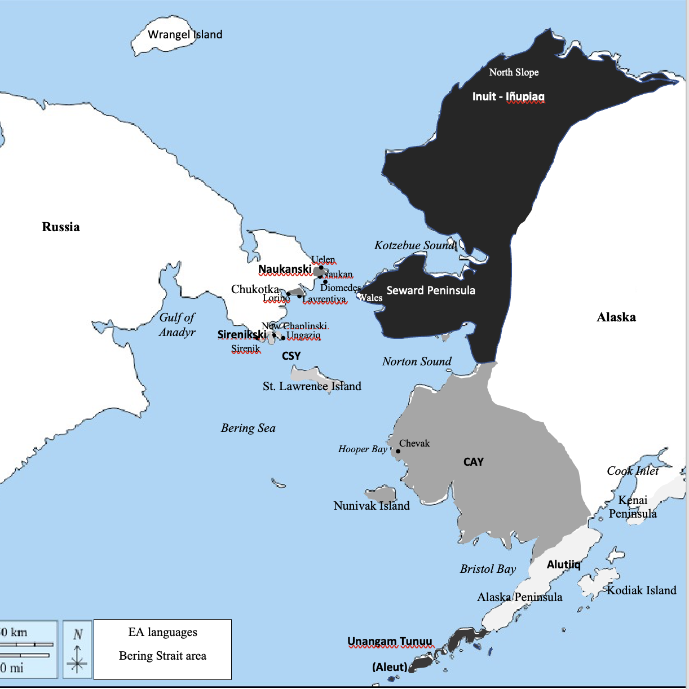
Sirenikski as a separate branch
The ‘shared’ elements with Inuit are generally limited and irregular
The resemblance to Inuit sipjaq ‘hip’ is deceptive: Inuit sipjaq is from Seward Peninsula, an area at the crossroads of Yupik-Inuit contact. Notice that Naukanski Yupik also has retains the glide. Other Inuit dialects have sivviaq ‘hip,’ with a glide but with additional fricativization.
The shared Sirenikski and Inuit feature of word-final -tə is also deceptive; CAY and Alaskan Iñupiaq -tə reappears in derivations, and older Eastern Inuit varieties also have –n word-finally.
PE | Sir | Nauk | CSY | NSY, CAY, Alu | SPI | NAI, WCI, ECI | GRI
*cipjaʁ ‘hip’ | sipj̊əχ | sipj̊aχ | sipsaq | cipsaq | sipjaq | sivviaq | siffiaq

Slide 23
Sirenikski as a separate branch
The best arguments given for viewing Sirenikski as a conservative, isolated relic, turn out to be weak
Jacobson (1990) on what defines the differentiation between Yupik and Inuit
“CAY and CSY both have systems of basically alternating vowel mora stress which is lacking in Inupiaq/Inuit (except in an indirect form in Seward Peninsula where it is probably the result of a form of Yupik previously having been spoken there); both CAY and CSY have the fourth vowel, the schwa, which is lacking in Inupiaq/Inuit (again except in a vestigial form in Seward Peninsula, though the consequences of an old distinction between schwa and i can be seen to varying degrees in all of Inupiaq/Inuit); and both CAY and CSY have merged the ablative and modalis cases which remain distinct in all of Inupiaq/Inuit. These three features are the most salient points that distinguish the Yupik side of Eskimo from the Inupiaq/Inuit side.”
These distinguishing features of Yupik are also found in Sirenikski.

Slide 24
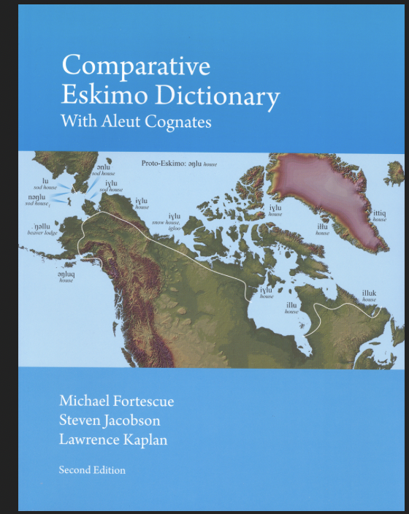
Reevaluating Sirenikski’s place on the family tree
We have not reexamined the assumptions underlying the categorization of Y/I/S languages for decades (although cf. Berge 2019)
New archaeological evidence of continuous contact
New availability of data sets (Comparative Eskimo Dictionary 1994 and 2010, i.e. after the major decisions concerning the language tree)
New examination of Menovshchikov’s (1964) description of
Sirenikski

Slide 25
New Evidence from Archaeology
Archaeological (and genetic) evidence for a minimum of 2500 years of constant intercultural contacts around Bering Sea
2500-1200 BP: Old Bering Sea Cultures (I, II, and III) on both sides of the Sea
thought to be direct ancestors of Yupik, Inuit, and Sirenikski
they occupy the area of the curent Sirenikski, CSY, and Naukanski peoples
2500-800 BP: Norton and Ipiutak in Alaska
thought to be partially ancestral to the modern Yupik groups
1500-800 BP: Birnirk, Punuk, Thule
thought to be directly ancestral to the Inuit
they occupy the area of the current CSY, Naukanski, and Iñupiat peoples
500 BP: Backmigration of Siberian Yupik
2000 BP, again 800 BP significant relations with neighboring Chukchi
There is archaeological evidence of multiple contemporaneous cultures in overlapping territories, including in the same villages. We should expect long-term, pervasive language contact effects, not conservativism from isolation

Slide 26
Sirenikski as A branch of the Yupik languages
Linguistically, Sirenikski most closely resembles Yupik languages.
Proponents of Sirenikski as a Yupik language include Krauss (1985:4, although it was qualified support), Bergsland (1986), and by default, most descriptions that lump all Siberian EA languages together as Siberian Yupik

Slide 27
Sirenikski as A branch of the Yupik languages
The Sirenikski lexicon is most like that of Yupik languages
There is a significant separation between Inuit and S-Y in the Comparative Eskimo Dictionary (cf. also Bergsland 1997)
Bergsland (1997, referring to Fortescue et al. 1994 Comparative Eskimo Dictionary)
Sirenikski cognates are not attested for all PE roots; but they are, of necessity, for PY-S (or they woud just be PY)
20% of the reconstructions involving Sirenikski are for PY-S rather than PE. Fortescue et al. (2010) point out that some of these probably include borrowings from CSY to Sirenikski; but we find about the same percentage of PY-S in the morphology as well
The CED does not list Sirenikski non-cognate roots (i.e. PS); there are no PI-S roots
Sirenikski is most like CSY than CAY (both morphologically and semantically)
Roots listed in CED | Shared Y & I (PE) | non-I (PY, PY-S) | I only (PI)
2251 | 1364 (60.6%) | 243 (10.8%) 43 (2%) in Siberian Yupik only | 465 (20.7%)

Slide 28
3. Sirenikski as A branch of the Yupik languages
Lexical root | Sirenikski | Yupik |  | Inuit
 |  | CSY | CAY
*aɣə- ‘go over or past’ | aɣə- | aɣə- |  | ai-
*aɣittaʁ- ‘open mouth’ | aɣətaʁ- ‘yawn’ | aɣitaʁ- | aitaʁ- | SPI aitaʁ- NAI aatcaq- WCI, ECI aittaq- GRI aatsaʁ-
*akuʁ- ‘space between, lower part’ | akeʁ ‘root’ | akuq ‘root’ | CAY aku(q) ‘skirt, lower part of garment’ | SPI aguq rest of Inuit akuq ‘lower part of (women’s) garment,’ GRI ‘mouth of river’
*amɬuʁ- ‘step over’ | amleqaʁ- ‘take a step’ | amɬuʁ- ‘take a step’ | amɬuʁ- ‘step over’ | SPI, NAI, WCI avluq ‘take a step’ ECI alluq- ‘step over’ GRI aɬɬuʁ- ‘step over, straddle’
*ciɣəðquʁ ‘knee’ | siɣəsqəχ | səɣəsquq | CAY ciisquq | SPI, WCI siitquq NAI siicquq ECI, GRI siiqquq
*cil(ə)quʁ or *ciɬ(e)quʁ ‘hind flipper’ | siɬəqəχ | əsɬəquq (regular metathesis of *si/ci >əs/#_) | -- | SPI, WCI sitquq NAI sicquq ECI, GRI siqquq

Slide 29
3. Sirenikski as A branch of the Yupik languages
Sirenikski phonological developments are most like those of Yupik
Sir and Y have the same associated sound rules for these, e.g. -tə#: > 0 / s
PE | Sirenikski | Yupik | Inuit
*ə | retained | retained | traces only
*t# | tə | tə | t
*#n | → j / _i | → j / _i | retained
*tj | → ts, s | → ts, s
*ɬ | retained | retained | merges with l
*C₁C₁ | lost | lost | retained
Sirenikski | mitə- ‘to grow’ | mi-təqəχ-tə-χ grow-prs-ind-3sg | mis-əɣə-te-χ grow-neg-ind-3sg
Yupik | təkitə- ‘to arrive’ | təki-tuq arrive-3sg.ind | təkis-aqa- > tekis-kan arrive-3sg.conting

Slide 30
3. Sirenikski as A branch of the Yupik languages
Sirenikski derivational morphemes are most like those in the Yupik languages
PI *-muaq ‘go toward,’ cf. Sir. asiməruʁ- ‘go down,’ from asi- ‘down’ (Fortescue et al. 2010:456) but the phonological correspondences are wrong
PI *-lrammiq, -tkammiq ‘recently,’ cf. Sir –miχ ‘one that has just V-ed’ (Fortescue et al. 2010:450), but there is no other mention of Sir –miχ
The percentage of PY-S is in fact higher, because there are morphemes shared between CSY and Sirenikski not listed in Fortescue et al. (2010)
Of these bound morphemes, phonologically, if there are differences between the languages, the big split is Y – I, with CAY~SPI sometimes
Derivational suffixes in Sirenikski in CED | PE | PY-S | PI
113 | 94 (83%) | >19 (>16.8%) | 2 (1.7%) (no compelling evidence)

Slide 31
3. Sirenikski as A branch of the Yupik languages
morpheme | Sireniksi | Yupik | Inuit
*kə ‘have as’ | -kə | -kə | -gi
*kə ‘present passive/transitive’ | -kə | -kə | -gi
*kiɣ ‘have a good’ | -kəxtax | -kəxtə, kəxci | -ɣik
*ləɣ ‘one provided with’ | -ləx | -lək | -lik
*liʁ ‘provide with’ | -cəʁ | -liʁ | -ɫiq
*uma ‘past, perfective’ | -əmə | -uma | -sima
*nəɣ, -ŋə ‘get, catch, kill’ | -ŋə | -ŋə | -nik
*nəʁ ‘nominalizer’ | -nəʁ | nəʁ | -niq
*ni(C)aʁ- ‘try to’ | -niʁ ‘hunt for’ | CSY -niiʁ ‘hunt for, ask for, work with’ CAY -niaʁ ‘try to’ | -niaq
*nqiɣ, *ngiɣca(C)aʁ ‘be good at’ | -n̥əqəsxaʁ ‘entirely, exactly’ | CSY -ŋqəxtə ‘easily, readily’ CAY -ŋqəxcaaʁaʁ ‘thoroughly’ | SPI -tqiɣi ‘find too’ NAI, WCI -tqiq, GRI -qqissaar ‘be good at’
enclitic *=ɬu ‘and’ | =-ɬu | =ɬu | =lu

Slide 32
3. Sirenikski as A branch of the Yupik languages
Inflectional morphology of Sirenikski is closer to that of Yupik than Inuit:
Sirenikski 1st person transitive endings:
CSY 1st person transitive endings:
Greenlandic 1st person transitive endings
subject/ object |  | 1 |  | 2 |  | 3
 |  | sg | pl | sg | pl | sg | pl
1subj | sg |  |  | -mkən | -msi | -qa | -nəka
 | pl |  |  | -mtəkən | -mtəsi | -χ-pu | -pu
person |  | 1 obj |  |  | 2 obj |  |  | 3 obj
 |  | sg | du | pl | sg | du | pl | sg | du | pl
1 subj | sg |  |  |  | -mken | -mtek | -msi | -qa | -gka | -nka
 | du |  |  |  | -mken | -mtek | -msi | -rpuk |  | -puk
 | pl |  |  |  | -mken | -mtek | -msi | -rput |  | -put
person |  | 1 obj |  | 2 obj |  | 3 obj
 |  | sg | pl | sg | pl | sg | pl
1 subj | sg |  |  | -akkit | -assi | -ara | -akka
 | pl |  |  | -atsigit | -assi | -arput | -avut

Slide 33
3. Sirenikski as A branch of the Yupik languages
The Sirenikski moods were obfuscated by Menovshchikov’s (1964) analysis; however, the mood system is as follows (Berge, forthcoming)
Mood | Sirenikski | Yupik |  | Inuit
Indicative Intr *-ðuʁ- Tr *-ðaʁ- | Intr –tə(ʁ)- Intr past -ra- Tr –tə(ʁ)- | -ju-/-tu- -(ɣ)a(ʁ)- |  | -vu-/-pu- -va-/-pa-
Participial | Intr -ləʁə- Tr -kəŋə- | -ɬʁia- -kə- |  | Western -jua-/-tua-Eastern -ju-/-tu- Tr -ɣi-
Interrogative | Intr -ɣ- / -tə- | -c- / -tə- |  | -v-
Imperative | 0 | 0 |  | -ɣi-
Optative | Intr -ɬa- Tr -suk- ‘want’ | 1 -la- 3 -li- |  | 1 -la- 3 -li-
Conjunctive | Pos -lə- Neg -pəna- | -lu- -na- |  | -lu-, -ɬu-, -tiɬɬu- (various app. moods) -na-
Anterior | -ja-/-sa- | CSY -ja- / -sa- | CAY -ŋa- | -ŋa-
Conditional | -qəɣə- | -ku- |  | -ɣu-
Contemporative | -məŋa-
Consequential | -ʁə- | cf. CSY consII –(ɣ)aqŋ(a)- or ctmpI -nəʁ-

Slide 34
3. Sirenikski as A branch of the Yupik languages
The suppletive participial -ləʁəχ, specifically related to Central Siberian Yupik and Central Alaskan Yup’ik –lɣi and not to Inuit participials; this extends to the negative participial of descriptive verbs as well
Language | Sirenikski | Yupik | Inuit
Indicative | taməχ-təqəχ-təχ | nəʁ’-uq | Alaskan niri-juq Other niri-vuq
Participial | taməχ-ɬəʁəχ | CSY nəʁə-ɬrii CAY nəʁə-ɬria | Alaskan niri-juaq Other niri-juq

Slide 35
3. Sirenikski as A branch of the Yupik languages
The data show the existence of a mood with a morpheme -ʁə-, with dependent person inflection, encompassing the functions of the Yupik connective moods (CSY -ja-, –(ɣ)aqŋ(a)-), CSY -nəʁ-) (Berge forthcoming).
It is not found in Inuit languages, and Inuit languages have innovated with another mood altogether.
Natən How | naʁət-inəqə-tə-ta live-near.fut-inter-1pl | mangu-ʁə-mta sit-conseq-1pl | taməχ-pəna-ʁə-mta? eat-neg-conseq-1pl
‘How are we going to live sitting, not eating?’ (Menovshchikov 1964:135)

Slide 36
OTHER WAYS IN WHICH SIR = CSY
Sirenikski is particularly like CSY at multiple grammatical levels
Like Yupik languages (cf. de Reuse 1994:34 and Jacobson (1982), Sirenikski allows verbs to be inflected with oblique cases as nouns
Like CSY (cf. de Reuse 1994:32-33, 140), Sirenikski uses a comitative derivational affix or a verb with locative case to indicate comitative
Personal pronouns like CSY, and yet not necessarily borrowed (cf. Sir 3sg laŋa, CSY əlŋa)
Like CSY in having expanded the use of the schwa (cf. Sir siɣəsqəχ, CSY səɣəsquq ‘fish roe,’ but nevertheless independent development (cf. Sir siɬəqəχ
CSY əsɬəquq ‘hind flipper’)
Like CSY in semantic differences with other Y/I languages
Etc.
Nukə-ka sister-1sg.poss/sg.posm | nuskiʁ-ə-pəjəχ older.sibling-cop-real.abs.sg | məŋə-nəŋ 1sg-ins
‘My sister was older than me’ (Menovshchikov 1964:168)

Slide 37
Comparison of features in Sireniski, yupik, and inuit
Features | Sirenikski | Yupik | Inuit
overall lexicon (Swadesh) | + | + | -
vowels | 4 | 4 | 3
common sound rules | + | + | -
prosody vs gemination | prosody | prosody | gemination
ablative/instrumental | same | same | different
indicative/participial | suppletive | suppletive | same
common reconstruction of roots between Sir and … |  | 20% | almost none
common reconstruction of derivational morphemes |  | 16.8% | (1.7%, doubtful)
person inflection phonology | same | same | different
mood morphology | same | same | different

Slide 38
Sirenikski as a separate branch
Contact effects have masked the degree to which Sirenikski is similar to Yupik languages
The assumption has been that similarities with Yupik, especially CSY, is due to recent and close contact between CSY and Sirenikski
reconstruction to PY-S corrupted by an unknowable level of borrowing
In fact, the differences are a result of different periods and types of contact, and not particularly of Sirenikski conservatism
vowel reduction and epenthesis, from contact with Chukchi, led to the belief that Sirenikski prosody is qualitatively different from Yupik, and that its intervocalic consonant retention is unique
sound rules shared by SPI, gave the false impression that Sirenikski is intermediate between Yupik and Inuit
long-term contact with CSY has resulted in similar, but not necessarily identical, phonological and semantic developments

Slide 39
Conclusions
Weight of evidence suggests that Sirenikski is, in fact, a Yupik language
It changes how we must view Sirenikski within EA, and the time depth of the language family
It points out how little we really know about the development of the Y/I/S languages
inadequate knowledge of lexical, phonological, and semantic changes
inadequate appreciation for the role of contact on both Sirenikski as an individual language and on the language family itself
We need to go back and reevaluate our assumptions about the developments in the language family, and account for more lateral changes

Slide 40
SELECTED REFERENCES
Berge, Anna. 2018. Re-evaluating the linguistic reconstruction of Proto-Eskimo-Aleut. Journal of Historical Linguistics 8(2). 231–273.Berge, Anna. submitted. Innovation in Eskaleut Dependent Moods.
Bergsland, Knut, 1986. ‘Comparative Eskimo-Aleut phonology and lexicon’, Journal de la Société Finno-ougrienne 80, 63-137.
Bergsland, Knut. 1997. How Did the Aleut Language Become Different From the Eskimo Languages? Languages of the Pacific Rim 2:1-17.
De Reuse, Willem Joseph, 1994. Siberian Yupik Eskimo: The Language and its Contacts with Chukchi. Studies in the Indigenous Languages of the Americas. Salt Lake City: University of Utah.
Dunn, Michael John. 1999. A Grammar of Chukchi. Ph.D. dissertation, mss. Canberra: Australian National University.

Slide 41
Fortescue, Michael, Jacobson, Steven & Kaplan, Lawrence, 1994 [2nd ed. 2010]. Comparative Eskimo Dictionary with Aleut Cognates, 2nd ed., Fairbanks: Alaska Native Language Center.
Jacobson, Steven A. 1982. Types of Partial Nominalization in Central Yup'ik Eskimo. Études/Inuit/Studies 6:2:51-59
Jacobson, Steven A. 1990. Comparison of Central Alaskan Yup'ik Eskimo and Central Siberian Yupik Eskimo. Journal of American linguistics 56(2). 264–286.
Kaplan, Lawrence D. 1985. Seward Peninsula consonant gradation and its relationship to Prosody. In Michael Krauss (ed.), Yupik Eskimo prosodic systems: Descriptive and comparative studies, 191–210. (Alaska Native Language Center Research Papers 7). Fairbanks: Alaska Native Language Center.
Krauss, Michael, 1985. ‘Sirenikski and Naukanski’, in Michael Krauss (ed.), Yupik Eskimo Prosodic Systems: Descriptive and Comparative Studies (Alaska Research Papers 7), Fairbanks: ANLC.
Krauss, Michael, 1994. ‘Sirenikski y- and Proto-Eskimo *ñ-’, in Jens Elmegård Rasmusson (ed.), Linguistic Studies in Honour of Jørgen Rischel, Acta Linguistica Hafnensia, the International Journal of the Copenhagen Linguistic Center vol 27,2, Copenhagen: C.A. Reitzel, 323-341.
Krupnik, Igor, 1991. ‘Extinction of the Sirenikski language: 1895-1960’, Études/Inuit/Studies 15,2, 3-22.

Slide 42
Marsh, Gordon & Morris Swadesh. 1951. Kleinschmidt Centennial V: Eskimo Aleut Correspondences. International journal of American linguistics 17(4). 209–216.
Menovshchikov, Georgiy A., 1964. Yazik Sirenikskikh Eskimosov: Fonetika, Ocherk Morfologii, Teksty i Slovar [The language of the Sireniki Eskimos: phonetics, morphological sketch, texts, and dictionary], Moscow and Leningrad: Nauka.
Vakhtin, Nikolai B. & Evgeniy V. Golovko. 1987. The relations in the Yupik Eskimo sub-group according to lexicostatistics. Études/Inuit/Studies 11(1). 3–18.

