Slide 1
Improving the Master’s Thesis Supervision Process at Aalto University
Helsinki University-Aalto University
Miniconference
Thursday 27.11.2014
Ken Pennington & Jan-Mikael Rybicki,
14.00-14.30
Notes:
Today I would like to tell you about a workshop that we arranged in co-operation with Aalto’s pedagogical unit (TOST) and the School of Electrical engineering to improve the master’s thesis supervision process in that school.

Slide 2
Background:
Aalto University’s goal is to become a world-class university
School of Electric Engineering (ELEC)
1. Largest school in the field of Science and Technology at Aalto
2. All ELEC master’s programs → English
_{3. ELEC MSc theses}
Highest number written in English
Writing process not to exceed six months
_{Detailed thesis grading rubric}
_{Aalto language Centre (LC)}
Undergraduate introductory writing courses
_{Master’s thesis writing course}
Thesis abstract correction service
_{Writing Clinic}
_{PhD-level language workshops}
Notes:
Through these projects, we successfully have created a niche for our services and valuable contacts with ELEC staff
Raised awareness in the school about language issues and the usefulness of our services

Slide 3
Background:
However…
Thesis quality → weak
Graduation times → too long
Insufficient support from LC and ELEC
Only one writing course (non-compulsory) for MSc students
No uniform thesis writing process
Help → wrong time
Help → not directly relevant to academic writing
Notes:
However, the problem with our current services is that the support that we give thesis writers is either (1) insufficient, (2) provided at the wrong time or is (3) not directly relevant to thesis writing
Moreover, there exists no uniform system in the school to guide students in the thesis writing process.
How to give students guidance DURING the thesis writing process?

Slide 4
Solution:
Supervision of Master´s Thesis in English Workshop
Participants:
Both newly recruited and experienced professors in ELEC
Time:
Spring 2014
Five workshop sessions:
Process and culture of Master thesis supervision
The Supervisor's role
Creating User-Friendly Theses (Analyze sample theses using ELEC’s rubric)
Designing groups for thesis supervision
Giving and receiving feedback: assessing and evaluating theses
Final Project: Designing a group process for thesis supervision

Slide 5
Creating User-Friendly Theses
Supervision of Master´s Thesis in English
7.4.2014
Ken Pennington Jan-Mikael Rybicki Laura Mendoza

Slide 6
Creating User-Friendly Theses
Analysis (categories 1-4) of sample theses
How would you interpret and assess the fifth category (Presentation and language)?
What is a user-friendly text?

Slide 7
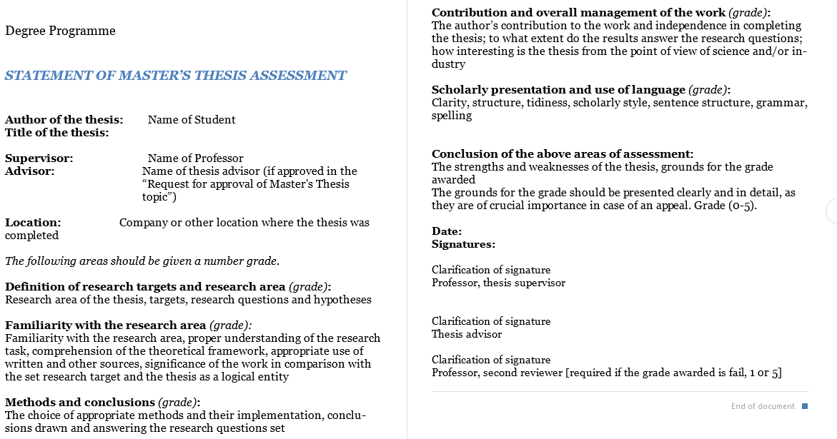
STATEMENT OF MASTER’S THESIS ASSESSMENT
https://into.aalto.fi/display/enmasterelec/New+guideline+for+master%27s+thesis+evaluation+effective+as+of+1+August+2012

Slide 8
1. Definition of research scope and goals
How do you define "success" in these sub-areas?
1.1
The research scope has been defined (Työn tehtäväalue on määritelty)
The goals of the thesis are "evident" (Työstä ilmenevät sen tavoitteet)
The research questions and hypotheses contained in the scope of research and goals are evident from the thesis. (Työstä ilmenevät tehtävän ja tavoitteiden sisältämät tutkimuskysymykset ja –olettamukset)
1.2
1.3

Slide 9
STATEMENT OF MASTER’S THESIS ASSESSMENT
https://into.aalto.fi/display/enmasterelec/New+guideline+for+master%27s+thesis+evaluation+effective+as+of+1+August+2012

Slide 10
2. Command of the topic
How do you define "success" in these sub-areas?
The student demonstrates command of the topic and understanding of the scope of research (Työ osoittaa, että tutkimusaiheeseen on perehdytty ja tehtävä on oikein ymmärretty)
The student demonstrates understanding of the relevant theoretical framework. (Työ osoittaa, että työlle merkittävä teoreettinen viitekehys on ymmärretty)
The student demonstrates skills in making use of literature and other sources of information. (Työ osoittaa, että kirjallisuus- ja muita tietolähteitä osataan käyttää)
2.1
2.2
2.3

Slide 11
STATEMENT OF MASTER’S THESIS ASSESSMENT
https://into.aalto.fi/display/enmasterelec/New+guideline+for+master%27s+thesis+evaluation+effective+as+of+1+August+2012

Slide 12
3. Methods and conclusions
How do you define "success" in these sub-areas?
3.1
The student demonstrates ability to choose justified methods for reaching the goals. (Työstä ilmenee, että opiskelija on kyennyt valitsemaan perustellut menetelmät tavoitteidensa saavuttamiseksi)
The student demonstrates ability to apply the chosen methods. (Työ osoittaa kykyä käyttää valittuja menetelmiä)
The thesis contains references to scientific publications.
(Työssä on käytetty hyväksi kirjallisuuslähteitä)
The thesis presents well-founded conclusions drawn from the results.
(Työssä esitetään saaduista tuloksista perusteltuja johtopäätöksiä)
The results answer the research questions presented (Tulokset vastaavat esitettyihin tutkimuskysymyksiin)
3.2
3.3
3.4
3.5

Slide 13
STATEMENT OF MASTER’S THESIS ASSESSMENT
https://into.aalto.fi/display/enmasterelec/New+guideline+for+master%27s+thesis+evaluation+effective+as+of+1+August+2012

Slide 14
4. Contribution to knowledge & thesis structure
How do you define "success" in these sub-areas?
4.1
The thesis is relevant to the set goal. (Työllä on merkittävyyttä verrattuna asetettuun tavoitteeseen)
The thesis is a well-organised logical whole. (Työ muodostaa ryhmitellyn loogisen kokonaisuuden)
The thesis makes an original contribution to knowledge (i.e., it is produced by the student).
(Työ on alkuperäinen kontribuutio eli tekijän itsensä tuottama)
4.2
4.3
Use of "We" ?

Slide 15
Task 1: Analysis of master’s thesis
Sample Thesis #4: Nanostructured thermoelectric materials
Let's divide into 4 groups!
Each group will initially analyze only one sample thesis

Slide 16
Final grade = "3"
Sample Thesis #1: Automatic Test System for Type Tests of the Uninterruptible Power Supply
Criterion | Grade (1-5) | Justification for the grade / comments
Definition of research scope and goals
Command of the topic
Methods and conclusions
Contribution to knowledge and thesis structure
Presentation and language
?
Determining the need for a test system and its development turned out to be too demding for a master's thesis.
?
Student showed understanding of the topic area through a literature review.
?
Conclusions demonstrated student's ability to objectively assess study results
?
The thesis produced a prototype test system and 2 type tests that comply with IEC-62040 standards in LabVIEW
Consistent presentation, the language is somewhat fluent and the thesis, as a whole, is suitably executed
?

Slide 17
Final grade = "4"
Sample Thesis #2: A measurement-based analysis of machine-to-machine communications over a cellular network
Criterion | Grade (1-5) | Justification for the grade / comments
Definition of research scope and goals
Command of the topic
Methods and conclusions
Contribution to knowledge and thesis structure
Presentation and language
4
The goals of the thesis are clearly defined, the scope well justified, research questions well explained, but hypothesis is hidden.
4
Good familiarity with research area and task, broad knowledge of both scientific literature and industry documents, but little theoretical framework
4
Uses network measurements, to understand the deplyment status. Conclusions are general in nature
3
Results are scarce, and some thesis goals not fulfilled
3
Although argumentation is generally good, some parts are long discussions that include speculations and loose conclusions

Slide 18
Final grade = "5"
Sample Thesis #3: Novel Resource-Efficient Algorithms for State Estimation in the Future Grid
Criterion | Grade (1-5) | Justification for the grade / comments
Definition of research scope and goals
Command of the topic
Methods and conclusions
Contribution to knowledge and thesis structure
Presentation and language
?
Work is precisely defined, and the goals have been reached
?
Gained a thorough understanding of challenges related to…
?
Novel state estimators derived
?
The results are novel and have been reported in a conference paper, as well as an IEEE paper
?
The thesis is well organized and the written in perfect English language

Slide 19
Final grade = "5"
Sample Thesis #4: Nanostructured thermoelectric materials
Criterion | Grade (1-5) | Justification for the grade / comments
Definition of research scope and goals
Command of the topic
Methods and conclusions
Contribution to knowledge and thesis structure
Presentation and language
?
Production of new thermoelectrical composite materials, implementation of measurement system, and compared measurements abroad.
?
Good critical review of the literature
?
The measurement results could easily be used to publish a research article
?
There is still very little experimental work demonstrating that nanocontruction could improve the effectiveness of thermoelectrical conversion.
?
The work is very clear, neatly written and documented

Slide 20
STATEMENT OF MASTER’S THESIS ASSESSMENT
https://into.aalto.fi/display/enmasterelec/New+guideline+for+master%27s+thesis+evaluation+effective+as+of+1+August+2012

Slide 21
Presentation and language
5.1 Clarity |  | Cohesion (topical flow, logical connectors, metalanguage)
5.2 Structure |  | Organization (Abstract, Introduction, Conclusion, and Paragraphing)
5.3 Tidiness |  | Formatting (numbering, bulleted lists, referencing)
5.4 Scholarly style |  | Word choice and Sentence style
5.5 Sentence structure |  | Complex sentences
5.6 Grammar |  | Grammar (e.g., articles [the, a, Ø], tense)
5.7 Spelling |  | Spelling (capitalization, appostrophe [ ' ], hyphenation [−])
Other criterion |  | Punctuation (comma [,], colon [:], semicolon [;], hyphen [−])

Slide 22
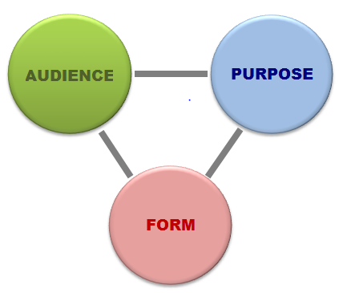
Types of engineering theses?
Phillip's two-category definition (1999):
The Engineering Thesis (" oriented towards engineering practice")
The Engineering Science Thesis ("advances scientific knowledge in support of future solutions to engineering problems")
Phillips, Greg. 1999. What is an engineering thesis, anyway? Retrieved March 13, 2013. http://last3.in/ggg/thesis.html

Slide 23
Types of engineering theses?
Phillip's two-category definition (1999):
The Engineering Thesis should answer four questions:
What engineering problem requires a solution?
What's wrong with previous solutions that have attempted to solve this problem?
What is your solution?
How does your solution compare with earlier solutions? What are the weaknesses and strengths of your solution?
Phillips, Greg. 1999. What is an engineering thesis, anyway? Retrieved March 13, 2013. http://last3.in/ggg/thesis.html

Slide 24
Types of engineering theses?
Phillip's two-category definition (1999):
The Engineering Science Thesis should answer four questions:
What question about the world needs to be answered?
What's wrong with previous answers to this question?
What is your answer to this question?
How does your answer compare to earlier answers?
Phillips, Greg. 1999. What is an engineering thesis, anyway? Retrieved March 13, 2013. http://last3.in/ggg/thesis.html

Slide 25
Types of engineering theses?
Phillip's two-category definition (1999):
The Engineering Science Thesis
2.1 Exploratory Thesis “What are the properties of system S?”
2.2 Experimental thesis “Is prediction P made by theory T accurate?”
2.3 Theoretical thesis “what theory adequately explains observations O?”
Phillips, Greg. 1999. What is an engineering thesis, anyway? Retrieved March 13, 2013. http://last3.in/ggg/thesis.html

Slide 26
Types of engineering theses?
MIT's four-category definition:
Design of a system followed by construction, testing, and evaluation;
Formulation of an analytical or computational model of a system or process, simulation of the model, and comparison with actual data;
Development of a computer program that might:
simulate a real system (e.g. Artificial Intelligence);
aid in a diagnostic procedure;
provide sophisticated, real-time analysis of measured data;
develop and analyze a theory or theorem which is an abstraction or idealization of an actual process or system;
apply standard methods to aid in understanding a process or system.
Experimental study of physical phenomena.
M.Eng. Thesis Guide: parts 1-2-3. What is the M.Eng. Thesis? Electrical Engineering & Computer Science, Massachusetts Institute of technology. Retrieved March 13, 2013. http://www.eecs.mit.edu/academics-admissions/undergraduate-programs/6-p-meng-program/thesis-guide/1-2-3

Slide 27
Types of engineering theses?
Ken's (outsider’s) view:
Weak claim
State-of-the-Art (What are available solutions?)
Feasibility Study (Can this technology be successfully applied?)
Recommendation (Which technology offers the best solution?)
Design Problem (Does this design meet the requirements for an adequate solution)
Trouble Shooting (Why don't current solutions work?)
Strong claim

Slide 28
How to structure your thesis?
Experimental
Introduction
(Theory/Literature review)
Materials and Methods
Results
Discussion
Engineering¹
Introduction
Literature review
Own contribution
Conclusions
Engineering²
Problem
Methodology
Solution
Verification
¹Timo Laakso's structural model
²Prof. Raimo Kantola's four-part model mentioned in Laakso's guidebook referenced below.
Laakso, Timo. 1999. How to write the diploma thesis. Helsinki University of Technology. Retrieved March 13, 2013. https://into.aalto.fi/download/attachments/1021746/how_to_write_diploma_thesis.pdf

Slide 29
Thesis Structure (Computer Science)
Chapter 1.
Introduction
Chapter 6.
Conclusions and
Future Work
Chapter 2.
Literature Review
Chapter 5.
Evaluation
Chapter 3.
Design
Chapter 4.
Development
Gordon, Damian. Literature Survey, Comprehension & Review, Lecture slides, School of Computing, Dublin Institute of Technology, Dublin, Ireland. Retrieved March 13, 2013 www.comp.dit.ie/dgordon/courses/researchmethods/Lectures/RM0003.ppt

Slide 30
Thesis Structure (Computer Science)
Chapter 1.
Introduction
Chapter 6.
Conclusions and
Future Work
Chapter 2.
Literature Review
Chapter 5.
Evaluation
Chapter 3.
Design
Chapter 4.
Development
Gordon, Damian. Literature Survey, Comprehension & Review, Lecture slides, School of Computing, Dublin Institute of Technology, Dublin, Ireland. Retrieved March 13, 2013 www.comp.dit.ie/dgordon/courses/researchmethods/Lectures/RM0003.ppt

Slide 31
How to structure your thesis?
Chinneck (1999) emphasizes:
"Don't make the readers work too hard! This is fundamentally important. You know what few questions the examiners need answers for. Choose section titles and wordings to clearly give them this information. The harder they have to work to ferret out your problem, your defence of the problem, your answer to the problem, your conclusions and contributions, the worse mood they will be in, and the more likely that your thesis will need major revisions".
Chinneck, John W. How to Organize your Thesis. Dept. of Systems and Computer Engineering, Carleton University, Ottawa, Canada. 1999. Retrieved March 13, 2013. http://www.sce.carleton.ca/faculty/chinneck/thesis.html

Slide 32
How to keep you supervisor happy?
Make your text reader-friendly!
Use metalanguage (i.e., language that talks about your text) to make explicit your structure and purpose.
Table of Contents
Introduction (Chapter 1)
2.1 Purpose statement
2.2 Overview of thesis structure
Headings and subheadings
Chapter and section previews
Topic sentences
Linking words

Slide 33
The traditional IMRD Pattern
Introduction (I)
Methods & materials (M)
Results (R)
Discussion (D)
General
Specific
Specific
General
Fig. 3. Overall shape of a research paper (RP)

Slide 34
Chapter 1: Introduction
 | Does the "topic" follow a general-specific ordering?
Thesis 1
Thesis 2
Thesis 3
Thesis 4
"3"
”4"
”5"
”5"

Slide 35
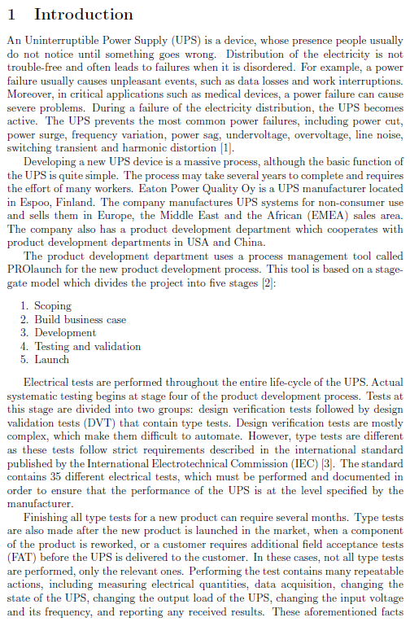
Thesis #1
UPS
Power failure
Development process
Eaton power Oy
Prod. Dev. Dept.
PROlaunch Tool

Slide 36
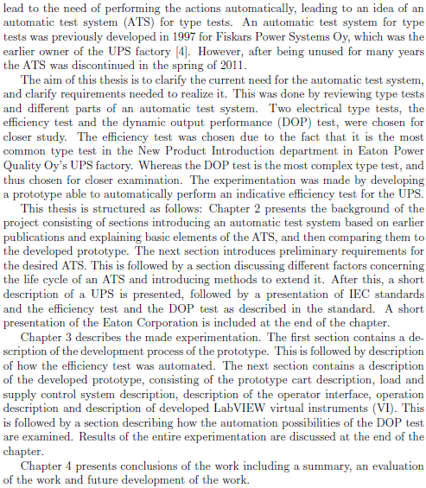
Thesis #1
UPS
Power failure
Development process
Eaton power Oy
Prod. Dev. Dept.
PROlaunch Tool
Electrical tests
Verification
Type tests
Repeatable actions
ATS

Slide 37
Chapter 1: Introduction
 | Does the "topic" follow a general-specific ordering?
Thesis 1
Thesis 2
Thesis 3
Thesis 4
Good General-Specific ordering
"3"
Satisfactory General-Specific ordering
”4"
Excellent General-Specific ordering
”5"
Poor ordering, new topics pop up
”5"

Slide 38
Presentation and language
5.1 Clarity
5.2 Structure |  | Organization (Abstract, Introduction, Conclusion, and Paragraphing)
5.3 Tidiness
5.4 Scholarly style
5.5 Sentence structure
5.6 Grammar
5.7 Spelling
Other criterion

Slide 39
Academic writing also employs many other organizational patterns.
Problem-Solution Pattern:
Situation: Description of current situation
Problem: Identification of a problem/ need arising from the current situation
Solution: Description of a solution
Evaluation: Is the solution a good one?
(Hoey, 1983)

Slide 40
The CARS Model for Journal Paper introductions
MOVE 1: Establishing a Territory
MOVE 2: Establishing a Niche
MOVE 3: Occupying the Niche
STEP A: Claiming centrality
STEP B: Making topic generalizations
STEP C: Reviewing items of previous research
STEP A: Counter-claiming
STEP A: Outlining purposes
STEP B: Announcing main findings
STEP D: Indicating structure of the article
SITUATION
PROBLEM
STEP B: Indicating a Gap
SOLUTION
STEP C: Evaluating the value of the research
EVALUATION

Slide 41
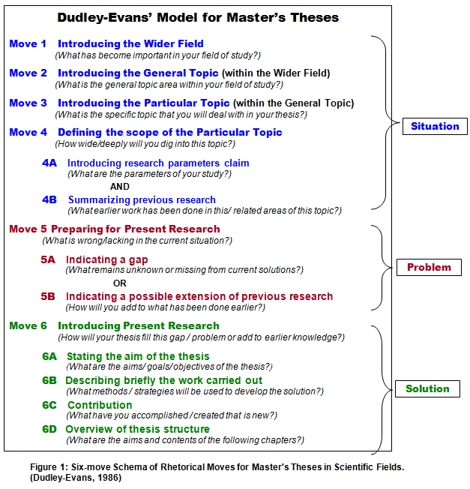
What about master’s thesis introductions?

Slide 42
What about master’s thesis introductions?

Slide 43
How successful are the sample theses in following the Problem-Solution Pattern?

Slide 44
Chapter 1: Introduction
 | Where is the problem that motivates the aim?
Thesis 1
Thesis 2
Thesis 3
Thesis 4
"3"
”4"
”5"
”5"

Slide 45
However, peforming the test involves many repeatable tasks
Thesis #1

Slide 46
Chapter 1: Introduction
 | Where is the problem that motivates the aim?
Thesis 1
Thesis 2
Thesis 3
Thesis 4
Weak problem: not signaled by “however”, nor does he state “why” the earlier system was discontinued.
"3"
BETTER:
In order to categorize and group M2M, this thesis analyzes and identifies [what?]
”4"
”5"
”5"

Slide 47
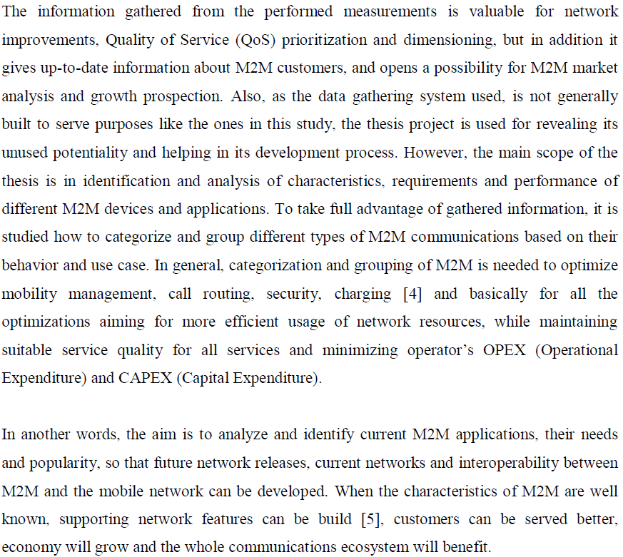
Thesis #2
AIMS??
Motivating problem??
AIMS again

Slide 48
Chapter 1: Introduction
 | Where is the problem that motivates the aim?
Thesis 1
Thesis 2
Thesis 3
Thesis 4
Weak problem: not signaled by “however”, nor does he state “why” the earlier system was discontinued.
"3"
BETTER:
In order to categorize and group M2M, this thesis analyzes and identifies [what?]
”4"
Larger, more complicated systems and the enormous amount of measurement data generated by new measurement technologies call for a rethinking of the traditional estimation paradigm
”5"
”5"

Slide 49
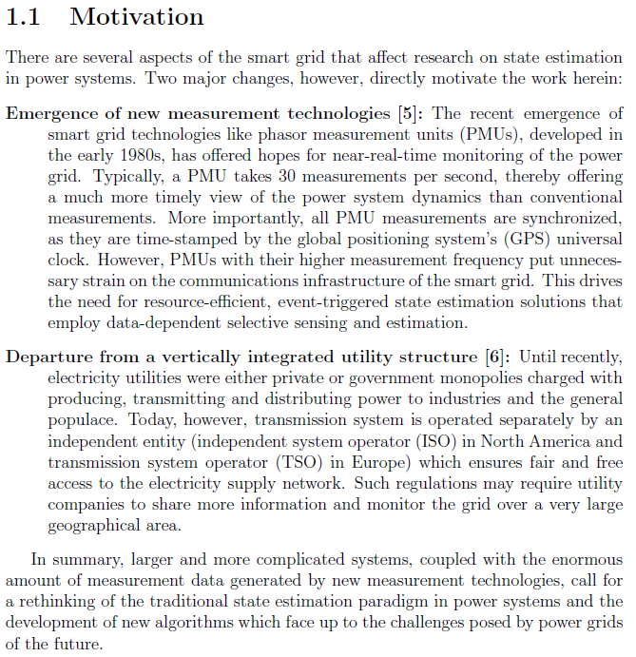
Thesis #3

Slide 50
Chapter 1: Introduction
 | Where is the problem that motivates the aim?
Thesis 1
Thesis 2
Thesis 3
Thesis 4
Weak problem: not signaled by “however”, nor does he state “why” the earlier system was discontinued.
"3"
BETTER:
In order to categorize and group M2M, this thesis analyzes and identifies [what?]
Larger, more complicated systems and the enormous amount of measurement data generated by new measurement technologies call for a rethinking of the traditional estimation paradigm
”5"
The weaknesses of “ZT” and the need for an alternative to ZT
”5"

Slide 51
Sample Thesis #4: Nanostructured thermoelectric materials
What is the motivation (i.e., "problem") for this thesis?
(pp 3-4)

Slide 52
How to keep you supervisor happy?
Make your text reader-friendly!
Use metalanguage (i.e., language that talks about your text) to make explicit your structure and purpose.
Table of Contents
Introduction (Chapter 1)
2.1 Purpose statement
2.2 Overview of thesis structure
Headings and subheadings
Chapter and section previews
Topic sentences
Linking words

Slide 53
Chapter 1: Introduction
 | What is the purpose of the thesis?
Thesis 1
Thesis 2
Thesis 3
Thesis 4
The aim of this thesis is to clarify the current need for the automatic test system, and clarify requirements needed to realize it.
"3"
Very confusing, since ordering is (1) purpose followed by (2) problems justifying that purpose. Confuses “scope” with “aims”
”4"
”5"

Slide 54
Thesis #2
”4"
AIMS??
Motivating problem??
AIMS again

Slide 55
Chapter 1: Introduction
 | What is the purpose of the thesis?
Thesis 1
Thesis 2
Thesis 3
Thesis 4
The aim of this thesis is to clarify the current need for the automatic test system, and clarify requirements needed to realize it.
"3"
Very confusing, since ordering is (1) purpose followed by (2) problems justifying that purpose. Confuses “scope” with “aims”
”4"
Excellent problem-solution argumentation. The introduction is divided into 4 sections: motivation, scope, contributions and organization.
”5"

Slide 56
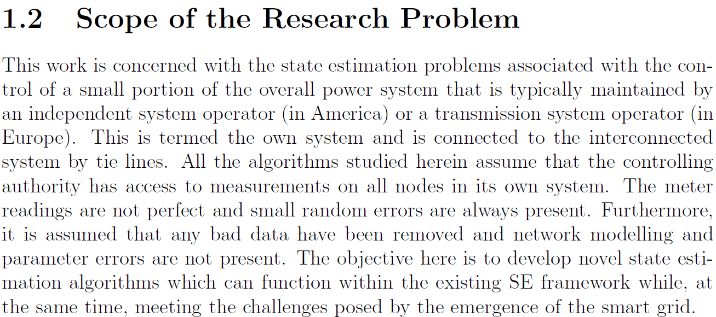
Chapter 1: Introduction
The aim of this thesis is to clarify the current need for the automatic test system, and clarify requirements needed to realize it.
Very confusing, since ordering is (1) purpose followed by (2) problems justifying that purpose. Confuses “scope” with “aims”

Slide 57
Sample Thesis #4: Nanostructured thermoelectric materials
What is the purpose (i.e., "aim") for this thesis?
Not in the Introduction
Not in the abstract
Grade = ”5"
Not in the Conclusions

Slide 58
Chapter 1: Introduction
 | What is the purpose of the thesis?
Thesis 1
Thesis 2
Thesis 3
Thesis 4
The aim of this thesis is to clarify the current need for the automatic test system, and clarify requirements needed to realize it.
"3"
Very confusing, since ordering is (1) purpose followed by (2) problems justifying that purpose. Confuses “scope” with “aims”
”4"
Excellent problem-solution argumentation. The introduction is divided into 4 sections: motivation, scope, contributions and organization.
”5"
No purpose statement!

Slide 59
How to keep you supervisor happy?
Make your text reader-friendly!
Use metalanguage (i.e., language that talks about your text) to make explicit your structure and purpose.
Table of Contents
Introduction (Chapter 1)
2.1 Purpose statement
2.2 Overview of thesis structure
Headings and subheadings
Chapter and section previews
Topic sentences
Linking words

Slide 60
Chapter 1: Introduction
 | Is the "overview of structure" successful?
Thesis 1
Thesis 2
Thesis 3
Thesis 4
"3"
”4"
”5"
”5"

Slide 61
Chapter 1: Introduction
 | Is the "overview of structure" successful?
Thesis 1 | Too much detail; most info would have been better moved to section or chapter previews
Thesis 2
Thesis 3
Thesis 4
"3"
”4"
”5"
”5"

Slide 62
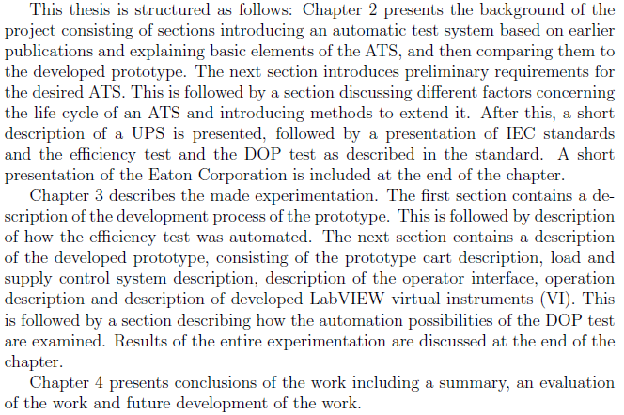
Thesis #1

Slide 63
Chapter 1: Introduction
 | Is the "overview of structure" successful?
Thesis 1 | Too much detail; most info would have been better moved to section or chapter previews
Thesis 2 | Lacks introductory topic sentence. Abuses “focuses on”. The verbs are empty in meaning, fail to describe the function and relationship between the chapters.
Thesis 3
Thesis 4
"3"
”4"
”5"
”5"

Slide 64
Thesis #2

Slide 65
Chapter 1: Introduction
 | Is the "overview of structure" successful?
Thesis 1 | Too much detail; most info would have been better moved to section or chapter previews
Thesis 2 | Lacks introductory topic sentence. Abuses “focuses on”. The verbs are empty in meaning, fail to describe the function and relationship between the chapters.
Thesis 3 | Good. Uses introductory topic sentence: “The remainder of this work is organized as follows.” However, meta-language is affected by obtrusive use of author-focused “we”
Thesis 4
"3"
”4"
”5"
”5"

Slide 66
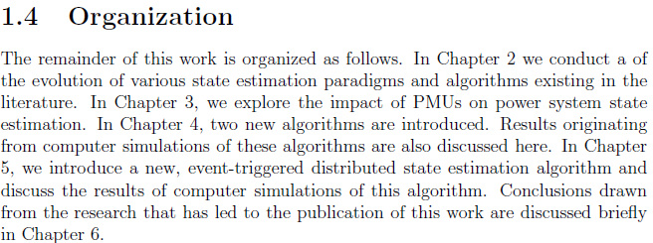
Thesis #3

Slide 67
Chapter 1: Introduction
 | Is the "overview of structure" successful?
Thesis 1 | Too much detail; most info would have been better moved to section or chapter previews
Thesis 2 | Lacks introductory topic sentence. Abuses “focuses on”. The verbs are empty in meaning, fail to describe the function and relationship between the chapters.
Thesis 3 | Good. Uses introductory topic sentence: “The remainder of this work is organized as follows.” However, meta-language is affected by obtrusive use of author-focused “we”
Thesis 4
"3"
”4"
”5"
”5"
No overview in introduction! (the abstract describes structure)

Slide 68
How to keep you supervisor happy?
Make your text reader-friendly!
Use metalanguage (i.e., language that talks about your text) to make explicit your structure and purpose.
Table of Contents
Introduction (Chapter 1)
2.1 Purpose statement
2.2 Overview of thesis structure
Headings and subheadings
Chapter and section previews
Topic sentences
Linking words

Slide 69
Metalanguage: Chapter and section previews
Previews contents
of chapter

Slide 70
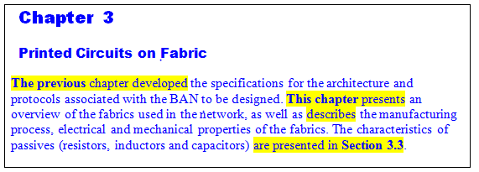
Metalanguage: Chapter and section previews
Restate-forecast

Slide 71
Metalanguage: Chapter and section previews
Previews contents
of section

Slide 72
Chapter 1: Introduction
 | Any chapter or section previews (whole thesis)?
Thesis 1
Thesis 2
Thesis 3
Thesis 4
"3"
1 chapter preview, but 10 section previews (3 at end of previous section)
Yes, 3 chapter previews and 1 section preview. However, empty in meaning, fail to describe the function and relationship between the chapters.
”4"
”5"
Yes, 3 chapter previews and 5 section previews, as well as
“Discussion sections” at the end of each chapter. However, meta-language is affected by obtrusive use of author-focused “we” (e.g., Section 4.3)
”5"
No chapter preview, only 1 section preview.

Slide 73
How to keep you supervisor happy?
Make your text reader-friendly!
Use metalanguage (i.e., language that talks about your text) to make explicit your structure and purpose.
Table of Contents
Introduction (Chapter 1)
2.1 Purpose statement
2.2 Overview of thesis structure
Headings and subheadings
Chapter and section previews
Topic sentences
Linking words

Slide 74
Chapter 1: Introduction
 | Any topic sentences (whole thesis)?
Thesis 1
Thesis 2
Thesis 3
Thesis 4
"3"
Yes, some, though not many, claims followed by supporting info
Almost none, though several used to introduce vertical bulleted lists. Most sentences introducing paragraphs are definitions. .
”4"
”5"
Yes, Many!
No topic sentences that summarize or interpret the main message of the paragraph.

Slide 75
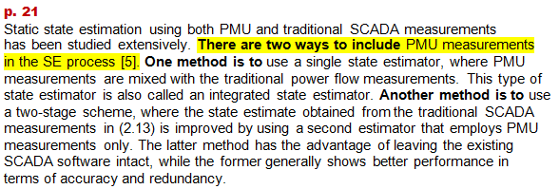
Metalanguage: Topic Sentences (enumeration)
h
Thesis #3

Slide 76
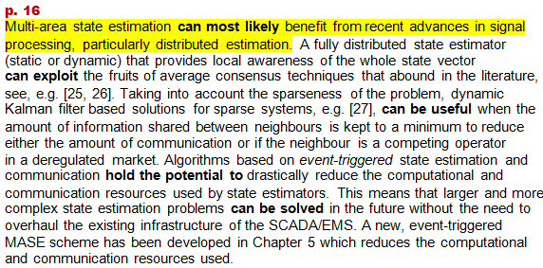
Metalanguage: Topic Sentences (claim)
h
Thesis #3

Slide 77
Presentation and language
5.1 Clarity |  | Cohesion (topical flow, logical connectors, metalanguage)
5.2 Structure |  | Organization (Abstract, Introduction, Conclusion, and Paragraphing)
5.3 Tidiness
5.4 Scholarly style |  | Word choice and Sentence style
5.5 Sentence structure
5.6 Grammar
5.7 Spelling
Other criterion

Slide 78
Thesis #1
2 Background
2.1 Automatic Test System
An automatic test system generally means a system which performs any kind of
tests such as electrical measurements, mechanical actions or software related tests,
automatically for a device under test (DUT). In this chapter, basic elements of the
ATS is discussed according to various sources.
2 Background
2.1 Automatic Test System
An automatic test system generally means a system which performs any kind of
tests such as electrical measurements, mechanical actions or software related tests,
automatically for a device under test (DUT). In this chapter, basic elements of the
ATS is discussed according to various sources.
2 Background
2.1 Automatic Test System
An automatic test system generally refers to a system which performs any kind of
tests such as electrical measurements, mechanical actions or software related tests,
automatically for a device under test (DUT). In this chapter, basic elements of the
ATS is discussed according to various sources.
2 Background
2.1 Automatic Test System
An automatic test system generally refers to a system which performs any kind of tests such as electrical measurements, mechanical actions or software related tests, automatically for a device under test (DUT). In this chapter, basic elements of the ATS is discussed according to various sources.
2 Background
2.1 Automatic Test System
An automatic test system generally refers to a system which performs tests, such as electrical measurements, mechanical actions or software related tests, automatically for a device under test (DUT). In this chapter, basic elements of the ATS is discussed according to various sources.
2 Background
2.1 Automatic Test System
An automatic test system generally refers to a system which performs any type of tests such as electrical measurements, mechanical actions or software related tests, automatically for a device under test (DUT). In this chapter, basic elements of the ATS is discussed according to various sources.
2 Background
2.1 Automatic Test System
An automatic test system generally refers to a system which performs tests, such as electrical measurements, mechanical actions or software related tests, automatically for a device under test (DUT). In this chapter, basic elements of the ATS is discussed according to various sources.
2 Background
2.1 Automatic Test System
An automatic test system generally refers to a system which automatically performs tests, such as electrical measurements, mechanical actions or software related tests, for a device under test (DUT). In this chapter, basic elements of the ATS is discussed according to various sources.
2 Background
2.1 Automatic Test System
An automatic test system generally refers to a system which automatically performs tests, such as electrical measurements, mechanical actions or software related tests, for a device under test (DUT). In this chapter, basic elements of the ATS are discussed according to various sources.
2 Background
2.1 Automatic Test System
An automatic test system generally refers to a system which automatically performs tests, such as electrical measurements, mechanical actions or software related tests, for a device under test (DUT). In this chapter, basic elements of the ATS are discussed according to various sources.
2 Background
2.1 Automatic Test System
An automatic test system generally refers to a system which automatically performs tests, such as electrical measurements, mechanical actions or software related tests, for a device under test (DUT). This chapter discusses basic elements of the ATS using / based on various sources.
2 Background
2.1 Automatic Test System
An automatic test system generally refers to a system which automatically performs tests, such as electrical measurements, mechanical actions or software related tests, for a device under test (DUT). In this chapter, basic elements of the ATS are discussed according to various sources.
2 Background
2.1 Automatic Test System
An automatic test system generally refers to a system which automatically performs tests, such as electrical measurements, mechanical actions or software related tests, for a device under test (DUT). This chapter discusses basic elements of the ATS according to various sources.
2 Background
2.1 Automatic Test System
An automatic test system generally refers to a system which automatically performs tests, such as electrical measurements, mechanical actions or software related tests, for a device under test (DUT). This chapter discusses basic elements of the ATS according to various sources.

Slide 79
Thesis #2
Grade = ”4"
It’s hard for some use cases to examine if the application is really a machine based or a human based. The outlining is getting blur, especially when the application is judged purely from the network usage point of view (bottom-up). This is due to a fact that many of the devices are built so that they can be used for serving the needs of both M2M and H2H. This is especially the case for consumer targeted devices. For example, a normal computer can be running a M2M type of an application, but if it is using a typical integrated or USB (Universal Serial Bus) connected cellular modem, normal subscription and public APN, it can be reliably recognized as M2M only after a detailed packet capture and analysis.
It is difficult in some use cases to determine whether an application is actually machine-based or a human-based. The distinction has become blurred, especially when assessing the application purely in terms of network usage (bottom-up), since many of the devices are built for serving the needs of both M2M and H2H. This is especially the case for consumer targeted devices. For example, although a normal computer can be operating a M2M application, if it is using a typical integrated or USB (Universal Serial Bus) connected cellular modem, normal subscription and public APN, it can be reliably recognized as M2M only after a detailed packet capture and analysis.

Slide 80
Presentation and language
5.1 Clarity |  | Cohesion (topical flow, logical connectors, metalanguage)
5.2 Structure |  | Organization (Abstract, Introduction, Conclusion, and Paragraphing)
5.3 Tidiness |  | Formatting (numbering, bulleted lists, referencing)
5.4 Scholarly style |  | Word choice and Sentence style
5.5 Sentence structure |  | Complex sentences
5.6 Grammar |  | Grammar (e.g., articles [the, a, Ø], tense)
5.7 Spelling |  | Spelling (capitalization, appostrophe [ ' ], hyphenation [−])
Other criterion |  | Punctuation (comma [,], colon [:], semicolon [;], hyphen [−])

Slide 81
A more exemplary thesis introduction
B. Kyazze, “Centralized Ethernet Switching,” M.Sc. thesis, School of Electricakl Engineering, Dept. of Communications and Networking, Aalto University, Helsinki, Finland, 2013.

Slide 82
What about master’s thesis introductions?

Slide 83
Exercise 4-3: Master’s thesis introductions
Identify and label the Adapted CARS moves and steps in the following Master’s thesis introduction.
Draw lines between each move and step (the first part has been done for you).
Circle language features used to signal each move?
Can you identify any stylistic problems that need improvement?

Slide 84
Exercise 4-3: Master’s thesis introductions
¹Daily communication using mobile phones and the Internet has increasingly become dependent on fast and effective networks for transferring data. ²Today, high-speed connections are required for many Internet applications, including VoIP for web telephoning and BitTorrent for downloads of movies. ³Current networks technologies have struggled to cope with these increasing demands, leading to the development of various technologies, such as Frame Relay, Token Ring, and Fiber Distributed Data Interface (FDDI). ⁴Token Ring was among the first protocols to be implemented for data transmission. ⁵However, it proved to be inefficient because of the various collisions over the domains. ⁶In response to these weaknesses, the Frame Relay protocol and Ethernet were developed. ⁸Although the Frame Relay protocol has been shown to be easily deployable in wide-area networks, it remains too slow for many current applications, due to bandwidth problems. ⁹As a result, both FDDI and the Ethernet have continued to be widely deployed because of their high communication speeds. ¹⁰However, since FDDI relies on optical fiber cables, it remains prohibitively expensive and difficult to install. ¹¹Thus, Ethernet has become the leading choice for transferring data over Local Area Networks (LANs), due to its many advantages, including low cost, easy implementation, flexibility in installations, high speed, and wide compatibility with other standards.
¹Daily communication using mobile phones and the Internet has increasingly become dependent on fast and effective networks for transferring data. ²Today, high-speed connections are required for many Internet applications, including VoIP for web telephoning and BitTorrent for downloads of movies. ³Current networks technologies have struggled to cope with these increasing demands, leading to the development of various technologies, such as Frame Relay, Token Ring, and Fiber Distributed Data Interface (FDDI). ⁴Token Ring was among the first protocols to be implemented for data transmission. ⁵However, it proved to be inefficient because of the various collisions over the domains. ⁶In response to these weaknesses, the Frame Relay protocol and Ethernet were developed. ⁸Although the Frame Relay protocol has been shown to be easily deployable in wide-area networks, it remains too slow for many current applications, due to bandwidth problems. ⁹As a result, both FDDI and the Ethernet have continued to be widely deployed because of their high communication speeds. ¹⁰However, since FDDI relies on optical fiber cables, it remains prohibitively expensive and difficult to install. ¹¹Thus, Ethernet has become the leading choice for transferring data over Local Area Networks (LANs), due to its many advantages, including low cost, easy implementation, flexibility in installations, high speed, and wide compatibility with other standards.
Move 1-A: Claiming centrality

Slide 85
Exercise 4-3: Master’s thesis introductions
¹Daily communication using mobile phones and the Internet has increasingly become dependent on fast and effective networks for transferring data. ²Today, high-speed connections are required for many Internet applications, including VoIP for web telephoning and BitTorrent for downloads of movies. ³Current networks technologies have struggled to cope with these increasing demands, leading to the development of various technologies, such as Frame Relay, Token Ring, and Fiber Distributed Data Interface (FDDI). ⁴Token Ring was among the first protocols to be implemented for data transmission. ⁵However, it proved to be inefficient because of the various collisions over the domains. ⁶In response to these weaknesses, the Frame Relay protocol and Ethernet were developed. ⁸Although the Frame Relay protocol has been shown to be easily deployable in wide-area networks, it remains too slow for many current applications, due to bandwidth problems. ⁹As a result, both FDDI and the Ethernet have continued to be widely deployed because of their high communication speeds. ¹⁰However, since FDDI relies on optical fiber cables, it remains prohibitively expensive and difficult to install. ¹¹Thus, Ethernet has become the leading choice for transferring data over Local Area Networks (LANs), due to its many advantages, including low cost, easy implementation, flexibility in installations, high speed, and wide compatibility with other standards.
¹Daily communication using mobile phones and the Internet has increasingly become dependent on fast and effective networks for transferring data. ²Today, high-speed connections are required for many Internet applications, including VoIP for web telephoning and BitTorrent for downloads of movies. ³Current networks technologies have struggled to cope with these increasing demands, leading to the development of various technologies, such as Frame Relay, Token Ring, and Fiber Distributed Data Interface (FDDI). ⁴Token Ring was among the first protocols to be implemented for data transmission. ⁵However, it proved to be inefficient because of the various collisions over the domains. ⁶In response to these weaknesses, the Frame Relay protocol and Ethernet were developed. ⁸Although the Frame Relay protocol has been shown to be easily deployable in wide-area networks, it remains too slow for many current applications, due to bandwidth problems. ⁹As a result, both FDDI and the Ethernet have continued to be widely deployed because of their high communication speeds. ¹⁰However, since FDDI relies on optical fiber cables, it remains prohibitively expensive and difficult to install. ¹¹Thus, Ethernet has become the leading choice for transferring data over Local Area Networks (LANs), due to its many advantages, including low cost, easy implementation, flexibility in installations, high speed, and wide compatibility with other standards.
Move 1-A: Claiming centrality
Move 2-B: Identifying a problem
Move 1-C: Previous Research

Slide 86
Exercise 4-3: Master’s thesis introductions
¹Daily communication using mobile phones and the Internet has increasingly become dependent on fast and effective networks for transferring data. ²Today, high-speed connections are required for many Internet applications, including VoIP for web telephoning and BitTorrent for downloads of movies. ³Current networks technologies have struggled to cope with these increasing demands, leading to the development of various technologies, such as Frame Relay, Token Ring, and Fiber Distributed Data Interface (FDDI). ⁴Token Ring was among the first protocols to be implemented for data transmission. ⁵However, it proved to be inefficient because of the various collisions over the domains. ⁶In response to these weaknesses, the Frame Relay protocol and Ethernet were developed. ⁸Although the Frame Relay protocol has been shown to be easily deployable in wide-area networks, it remains too slow for many current applications, due to bandwidth problems. ⁹As a result, both FDDI and the Ethernet have continued to be widely deployed because of their high communication speeds. ¹⁰However, since FDDI relies on optical fiber cables, it remains prohibitively expensive and difficult to install. ¹¹Thus, Ethernet has become the leading choice for transferring data over Local Area Networks (LANs), due to its many advantages, including low cost, easy implementation, flexibility in installations, high speed, and wide compatibility with other standards.
¹Daily communication using mobile phones and the Internet has increasingly become dependent on fast and effective networks for transferring data. ²Today, high-speed connections are required for many Internet applications, including VoIP for web telephoning and BitTorrent for downloads of movies. ³Current networks technologies have struggled to cope with these increasing demands, leading to the development of various technologies, such as Frame Relay, Token Ring, and Fiber Distributed Data Interface (FDDI). ⁴Token Ring was among the first protocols to be implemented for data transmission. ⁵However, it proved to be inefficient because of the various collisions over the domains. ⁶In response to these weaknesses, the Frame Relay protocol and Ethernet were developed. ⁸Although the Frame Relay protocol has been shown to be easily deployable in wide-area networks, it remains too slow for many current applications, due to bandwidth problems. ⁹As a result, both FDDI and the Ethernet have continued to be widely deployed because of their high communication speeds. ¹⁰However, since FDDI relies on optical fiber cables, it remains prohibitively expensive and difficult to install. ¹¹Thus, Ethernet has become the leading choice for transferring data over Local Area Networks (LANs), due to its many advantages, including low cost, easy implementation, flexibility in installations, high speed, and wide compatibility with other standards.
Move 1-A: Claiming centrality
Move 2-B: Identifying a problem
Move 1-C: Previous Research
Move 1-B: Topic Generalization

Slide 87
Exercise 4-3: Master’s thesis introductions
¹Daily communication using mobile phones and the Internet has increasingly become dependent on fast and effective networks for transferring data. ²Today, high-speed connections are required for many Internet applications, including VoIP for web telephoning and BitTorrent for downloads of movies. ³Current networks technologies have struggled to cope with these increasing demands, leading to the development of various technologies, such as Frame Relay, Token Ring, and Fiber Distributed Data Interface (FDDI). ⁴Token Ring was among the first protocols to be implemented for data transmission. ⁵However, it proved to be inefficient because of the various collisions over the domains. ⁶In response to these weaknesses, the Frame Relay protocol and Ethernet were developed. ⁸Although the Frame Relay protocol has been shown to be easily deployable in wide-area networks, it remains too slow for many current applications, due to bandwidth problems. ⁹As a result, both FDDI and the Ethernet have continued to be widely deployed because of their high communication speeds. ¹⁰However, since FDDI relies on optical fiber cables, it remains prohibitively expensive and difficult to install. ¹¹Thus, Ethernet has become the leading choice for transferring data over Local Area Networks (LANs), due to its many advantages, including low cost, easy implementation, flexibility in installations, high speed, and wide compatibility with other standards.
¹Daily communication using mobile phones and the Internet has increasingly become dependent on fast and effective networks for transferring data. ²Today, high-speed connections are required for many Internet applications, including VoIP for web telephoning and BitTorrent for downloads of movies. ³Current networks technologies have struggled to cope with these increasing demands, leading to the development of various technologies, such as Frame Relay, Token Ring, and Fiber Distributed Data Interface (FDDI). ⁴Token Ring was among the first protocols to be implemented for data transmission. ⁵However, it proved to be inefficient because of the various collisions over the domains. ⁶In response to these weaknesses, the Frame Relay protocol and Ethernet were developed. ⁸Although the Frame Relay protocol has been shown to be easily deployable in wide-area networks, it remains too slow for many current applications, due to bandwidth problems. ⁹As a result, both FDDI and the Ethernet have continued to be widely deployed because of their high communication speeds. ¹⁰However, since FDDI relies on optical fiber cables, it remains prohibitively expensive and difficult to install. ¹¹Thus, Ethernet has become the leading choice for transferring data over Local Area Networks (LANs), due to its many advantages, including low cost, easy implementation, flexibility in installations, high speed, and wide compatibility with other standards.
Move 1-A: Claiming centrality
Move 2-B: Identifying a problem
Move 1-C: Previous Research
Move 1-B: Topic Generalization
Move 2-B: Identifying a problem

Slide 88
Exercise 4-3: Master’s thesis introductions
¹Daily communication using mobile phones and the Internet has increasingly become dependent on fast and effective networks for transferring data. ²Today, high-speed connections are required for many Internet applications, including VoIP for web telephoning and BitTorrent for downloads of movies. ³Current networks technologies have struggled to cope with these increasing demands, leading to the development of various technologies, such as Frame Relay, Token Ring, and Fiber Distributed Data Interface (FDDI). ⁴Token Ring was among the first protocols to be implemented for data transmission. ⁵However, it proved to be inefficient because of the various collisions over the domains. ⁶In response to these weaknesses, the Frame Relay protocol and Ethernet were developed. ⁸Although the Frame Relay protocol has been shown to be easily deployable in wide-area networks, it remains too slow for many current applications, due to bandwidth problems. ⁹As a result, both FDDI and the Ethernet have continued to be widely deployed because of their high communication speeds. ¹⁰However, since FDDI relies on optical fiber cables, it remains prohibitively expensive and difficult to install. ¹¹Thus, Ethernet has become the leading choice for transferring data over Local Area Networks (LANs), due to its many advantages, including low cost, easy implementation, flexibility in installations, high speed, and wide compatibility with other standards.
¹Daily communication using mobile phones and the Internet has increasingly become dependent on fast and effective networks for transferring data. ²Today, high-speed connections are required for many Internet applications, including VoIP for web telephoning and BitTorrent for downloads of movies. ³Current networks technologies have struggled to cope with these increasing demands, leading to the development of various technologies, such as Frame Relay, Token Ring, and Fiber Distributed Data Interface (FDDI). ⁴Token Ring was among the first protocols to be implemented for data transmission. ⁵However, it proved to be inefficient because of the various collisions over the domains. ⁶In response to these weaknesses, the Frame Relay protocol and Ethernet were developed. ⁸Although the Frame Relay protocol has been shown to be easily deployable in wide-area networks, it remains too slow for many current applications, due to bandwidth problems. ⁹As a result, both FDDI and the Ethernet have continued to be widely deployed because of their high communication speeds. ¹⁰However, since FDDI relies on optical fiber cables, it remains prohibitively expensive and difficult to install. ¹¹Thus, Ethernet has become the leading choice for transferring data over Local Area Networks (LANs), due to its many advantages, including low cost, easy implementation, flexibility in installations, high speed, and wide compatibility with other standards.
Move 1-A: Claiming centrality
Move 2-B: Identifying a problem
Move 1-C: Previous Research
Move 1-B: Topic Generalization
Move 2-B: Identifying a problem
Move 1-B: Topic Generalization

Slide 89
Exercise 4-3: Master’s thesis introductions
⁶In response to these weaknesses, the Frame Relay protocol and Ethernet were developed. ⁸Although the Frame Relay protocol has been shown to be easily deployable in wide-area networks, it remains too slow for many current applications, due to bandwidth problems. ⁹As a result, both FDDI and the Ethernet have continued to be widely deployed because of their high communication speeds. ¹⁰However, since FDDI relies on optical fiber cables, it remains prohibitively expensive and difficult to install. ¹¹Thus, Ethernet has become the leading choice for transferring data over Local Area Networks (LANs), due to its many advantages, including low cost, easy implementation, flexibility in installations, high speed, and wide compatibility with other standards.
⁶In response to these weaknesses, the Frame Relay protocol and Ethernet were developed. ⁸Although the Frame Relay protocol has been shown to be easily deployable in wide-area networks, it remains too slow for many current applications, due to bandwidth problems. ⁹As a result, both FDDI and the Ethernet have continued to be widely deployed because of their high communication speeds. ¹⁰However, since FDDI relies on optical fiber cables, it remains prohibitively expensive and difficult to install. ¹¹Thus, Ethernet has become the leading choice for transferring data over Local Area Networks (LANs), due to its many advantages, including low cost, easy implementation, flexibility in installations, high speed, and wide compatibility with other standards.
Move 1-B: Topic Generalization
Move 1-C: Previous Research
Move 2-B: Identifying a problem

Slide 90
Exercise 4-3: Master’s thesis introductions
⁶In response to these weaknesses, the Frame Relay protocol and Ethernet were developed. ⁸Although the Frame Relay protocol has been shown to be easily deployable in wide-area networks, it remains too slow for many current applications, due to bandwidth problems. ⁹As a result, both FDDI and the Ethernet have continued to be widely deployed because of their high communication speeds. ¹⁰However, since FDDI relies on optical fiber cables, it remains prohibitively expensive and difficult to install. ¹¹Thus, Ethernet has become the leading choice for transferring data over Local Area Networks (LANs), due to its many advantages, including low cost, easy implementation, flexibility in installations, high speed, and wide compatibility with other standards.
⁶In response to these weaknesses, the Frame Relay protocol and Ethernet were developed. ⁸Although the Frame Relay protocol has been shown to be easily deployable in wide-area networks, it remains too slow for many current applications, due to bandwidth problems. ⁹As a result, both FDDI and the Ethernet have continued to be widely deployed because of their high communication speeds. ¹⁰However, since FDDI relies on optical fiber cables, it remains prohibitively expensive and difficult to install. ¹¹Thus, Ethernet has become the leading choice for transferring data over Local Area Networks (LANs), due to its many advantages, including low cost, easy implementation, flexibility in installations, high speed, and wide compatibility with other standards.
Move 1-B: Topic Generalization
Move 1-C: Previous Research
Move 2-B: Identifying a problem
Move 1-B: Topic Generalization

Slide 91
Exercise 4-3: Master’s thesis introductions
⁶In response to these weaknesses, the Frame Relay protocol and Ethernet were developed. ⁸Although the Frame Relay protocol has been shown to be easily deployable in wide-area networks, it remains too slow for many current applications, due to bandwidth problems. ⁹As a result, both FDDI and the Ethernet have continued to be widely deployed because of their high communication speeds. ¹⁰However, since FDDI relies on optical fiber cables, it remains prohibitively expensive and difficult to install. ¹¹Thus, Ethernet has become the leading choice for transferring data over Local Area Networks (LANs), due to its many advantages, including low cost, easy implementation, flexibility in installations, high speed, and wide compatibility with other standards.
⁶In response to these weaknesses, the Frame Relay protocol and Ethernet were developed. ⁸Although the Frame Relay protocol has been shown to be easily deployable in wide-area networks, it remains too slow for many current applications, due to bandwidth problems. ⁹As a result, both FDDI and the Ethernet have continued to be widely deployed because of their high communication speeds. ¹⁰However, since FDDI relies on optical fiber cables, it remains prohibitively expensive and difficult to install. ¹¹Thus, Ethernet has become the leading choice for transferring data over Local Area Networks (LANs), due to its many advantages, including low cost, easy implementation, flexibility in installations, high speed, and wide compatibility with other standards.
⁶In response to these weaknesses, the Frame Relay protocol and Ethernet were developed. ⁸Although the Frame Relay protocol has been shown to be easily deployable in wide-area networks, it remains too slow for many current applications, due to bandwidth problems. ⁹As a result, both FDDI and the Ethernet have continued to be widely deployed because of their high communication speeds. ¹⁰However, since FDDI relies on optical fiber cables, it remains prohibitively expensive and difficult to install. ¹¹Thus, Ethernet has become the leading choice for transferring data over Local Area Networks (LANs), due to its many advantages, including low cost, easy implementation, flexibility in installations, high speed, and wide compatibility with other standards.
Move 1-B: Topic Generalization
Move 1-C: Previous Research
Move 2-B: Counter-claiming
Move 1-B: Topic Generalization
Move 2-B: Identifying a problem

Slide 92
Exercise 4-3: Master’s thesis introductions
⁶In response to these weaknesses, the Frame Relay protocol and Ethernet were developed. ⁸Although the Frame Relay protocol has been shown to be easily deployable in wide-area networks, it remains too slow for many current applications, due to bandwidth problems. ⁹As a result, both FDDI and the Ethernet have continued to be widely deployed because of their high communication speeds. ¹⁰However, since FDDI relies on optical fiber cables, it remains prohibitively expensive and difficult to install. ¹¹Thus, Ethernet has become the leading choice for transferring data over Local Area Networks (LANs), due to its many advantages, including low cost, easy implementation, flexibility in installations, high speed, and wide compatibility with other standards.
⁶In response to these weaknesses, the Frame Relay protocol and Ethernet were developed. ⁸Although the Frame Relay protocol has been shown to be easily deployable in wide-area networks, it remains too slow for many current applications, due to bandwidth problems. ⁹As a result, both FDDI and the Ethernet have continued to be widely deployed because of their high communication speeds. ¹⁰However, since FDDI relies on optical fiber cables, it remains prohibitively expensive and difficult to install. ¹¹Thus, Ethernet has become the leading choice for transferring data over Local Area Networks (LANs), due to its many advantages, including low cost, easy implementation, flexibility in installations, high speed, and wide compatibility with other standards.
Move 1-B: Topic Generalization
Move 1-C: Previous Research
Move 2-B: Identifying a problem claiming
Move 1-B: Topic Generalization
Move 2-B: Identifying a problem
Move 1-B: Topic Generalization

Slide 93
Exercise 4-3: Master’s thesis introductions
¹²Despite these advantages, the Ethernet protocol has suffered from some notable weaknesses, including scalability, delays, packet losses, band width choke points, security and unidirectional link failures. ¹³Recently, considerable attention has focused on solving most of these problems [1-5]. ¹⁴These solutions have included TRILL, Shortest Path Bridging (SPB), CISCO and Juniper solutions. ¹⁵More recently, other approaches (e.g., ETHANE, EU ETNA, Open flow) have been proposed to improve the efficiency of Ethernet. ¹⁶However, despite all these solutions, they have focused mostly on data transmissions within LAN networks (i.e., use either a centralized or distributed data movement approach), and little or no attention has been directed towards their scalability.
¹²Despite these advantages, the Ethernet protocol has suffered from some notable weaknesses, including scalability, delays, packet losses, band width choke points, security and unidirectional link failures. ¹³Recently, considerable attention has focused on solving most of these problems [1-5]. ¹⁴These solutions have included TRILL, Shortest Path Bridging (SPB), CISCO and Juniper solutions. ¹⁵More recently, other approaches (e.g., ETHANE, EU ETNA, Open flow) have been proposed to improve the efficiency of Ethernet. ¹⁶However, despite all these solutions, they have focused mostly on data transmissions within LAN networks (i.e., use either a centralized or distributed data movement approach), and little or no attention has been directed towards their scalability. ¹⁷To address these Ethernet problems, this thesis will examine the feasibility of scaling the centralised Ethernet routing approach.
Move 2-B: Identifying a problem

Slide 94
Exercise 4-3: Master’s thesis introductions
¹²Despite these advantages, the Ethernet protocol has suffered from some notable weaknesses, including scalability, delays, packet losses, band width choke points, security and unidirectional link failures. ¹³Recently, considerable attention has focused on solving most of these problems [1-5]. ¹⁴These solutions have included TRILL, Shortest Path Bridging (SPB), CISCO and Juniper solutions. ¹⁵More recently, other approaches (e.g., ETHANE, EU ETNA, Open flow) have been proposed to improve the efficiency of Ethernet. ¹⁶However, despite all these solutions, they have focused mostly on data transmissions within LAN networks (i.e., use either a centralized or distributed data movement approach), and little or no attention has been directed towards their scalability. ¹⁷To address these Ethernet problems, this thesis will examine the feasibility of scaling the centralised Ethernet routing approach.
¹²Despite these advantages, the Ethernet protocol has suffered from some notable weaknesses, including scalability, delays, packet losses, band width choke points, security and unidirectional link failures. ¹³Recently, considerable attention has focused on solving most of these problems [1-5]. ¹⁴These solutions have included TRILL, Shortest Path Bridging (SPB), CISCO and Juniper solutions. ¹⁵More recently, other approaches (e.g., ETHANE, EU ETNA, Open flow) have been proposed to improve the efficiency of Ethernet. ¹⁶However, despite all these solutions, they have focused mostly on data transmissions within LAN networks (i.e., use either a centralized or distributed data movement approach), and little or no attention has been directed towards their scalability.
Move 2-B: Identifying a problem
Move 1-C: Previous Research

Slide 95
Exercise 4-3: Master’s thesis introductions
¹²Despite these advantages, the Ethernet protocol has suffered from some notable weaknesses, including scalability, delays, packet losses, band width choke points, security and unidirectional link failures. ¹³Recently, considerable attention has focused on solving most of these problems [1-5]. ¹⁴These solutions have included TRILL, Shortest Path Bridging (SPB), CISCO and Juniper solutions. ¹⁵More recently, other approaches (e.g., ETHANE, EU ETNA, Open flow) have been proposed to improve the efficiency of Ethernet. ¹⁶However, despite all these solutions, they have focused mostly on data transmissions within LAN networks (i.e., use either a centralized or distributed data movement approach), and little or no attention has been directed towards their scalability. ¹⁷To address these Ethernet problems, this thesis will examine the feasibility of scaling the centralised Ethernet routing approach. ¹⁸For this purpose, the thesis developed a centralized routing solution, which was then compared using three parameters (delays, packet loss and convergence times) to the current distributed Ethernet routing approach.
¹²Despite these advantages, the Ethernet protocol has suffered from some notable weaknesses, including scalability, delays, packet losses, band width choke points, security and unidirectional link failures. ¹³Recently, considerable attention has focused on solving most of these problems [1-5]. ¹⁴These solutions have included TRILL, Shortest Path Bridging (SPB), CISCO and Juniper solutions. ¹⁵More recently, other approaches (e.g., ETHANE, EU ETNA, Open flow) have been proposed to improve the efficiency of Ethernet. ¹⁶However, despite all these solutions, they have focused mostly on data transmissions within LAN networks (i.e., use either a centralized or distributed data movement approach), and little or no attention has been directed towards their scalability. ¹⁷To address these Ethernet problems, this thesis will examine the feasibility of scaling the centralised Ethernet routing approach. ¹⁸For this purpose, the thesis developed a centralized routing solution, which was then compared using three parameters (delays, packet loss and convergence times) to the current distributed Ethernet routing approach.
Move 2-B: Identifying a problem
Move 1-C: Previous Research
Move 2-A: Indicating a Gap

Slide 96
Exercise 4-3: Master’s thesis introductions
¹⁶However, despite all these solutions, they have focused mostly on data transmissions within LAN networks (i.e., use either a centralized or distributed data movement approach), and little or no attention has been directed towards their scalability. ¹⁷To address these Ethernet problems, this thesis will examine the feasibility of scaling the centralised Ethernet routing approach. ¹⁸For this purpose, the thesis developed a centralized routing solution, which was then compared using three parameters (delays, packet loss and convergence times) to the current distributed Ethernet routing approach.
¹⁶However, despite all these solutions, they have focused mostly on data transmissions within LAN networks (i.e., use either a centralized or distributed data movement approach), and little or no attention has been directed towards their scalability. ¹⁷To address these Ethernet problems, this thesis will examine the feasibility of scaling the centralised Ethernet routing approach. ¹⁸For this purpose, the thesis developed a centralized routing solution, which was then compared using three parameters (delays, packet loss and convergence times) to the current distributed Ethernet routing approach.
Move 2-A: Indicating a Gap
Move 3-1: Outlining Purposes

Slide 97
Exercise 4-3: Master’s thesis introductions
¹⁹In this study, we used the Boson network simulator using topologies with 10, 19 and 38 operational nodes. ²⁰These settings were used to compare both the centralized and the distributed Ethernet systems, focusing on three parameters: convergence times, packet loss and delay. ²¹The results show that in terms of these parameters, the proposed centralized routing solution is best used in LANs with fewer nodes, whereas larger networks with more than 19 nodes should use a distributed system.
1.2 Problem statement.
²²This thesis looks at centralized Ethernet routing as an alternative to the distributed Ethernet routing with the focus on scalability, convergence times, packet loss and delay. ²³In other words, the thesis will check to what extent the centralized Ethernet routing can scale and become a solution to Ethernet problems. ²⁴In an attempt to answer the above question, a comparison between the centralized and distributed Ethernet routing focusing on three parameters (delays, packet loss and convergence times) was looked at.
¹⁹In this study, we used the Boson network simulator using topologies with 10, 19 and 38 operational nodes. ²⁰These settings were used to compare both the centralized and the distributed Ethernet systems, focusing on three parameters: convergence times, packet loss and delay. ²¹The results show that in terms of these parameters, the proposed centralized routing solution is best used in LANs with fewer nodes, whereas larger networks with more than 19 nodes should use a distributed system.
1.2 Problem statement.
²²This thesis looks at centralized Ethernet routing as an alternative to the distributed Ethernet routing with the focus on scalability, convergence times, packet loss and delay. ²³In other words, the thesis will check to what extent the centralized Ethernet routing can scale and become a solution to Ethernet problems. ²⁴In an attempt to answer the above question, a comparison between the centralized and distributed Ethernet routing focusing on three parameters (delays, packet loss and convergence times) was looked at.
Move 3-3: Methodology

Slide 98
Exercise 4-3: Master’s thesis introductions
¹⁹In this study, we used the Boson network simulator using topologies with 10, 19 and 38 operational nodes. ²⁰These settings were used to compare both the centralized and the distributed Ethernet systems, focusing on three parameters: convergence times, packet loss and delay. ²¹The results show that in terms of these parameters, the proposed centralized routing solution is best used in LANs with fewer nodes, whereas larger networks with more than 19 nodes should use a distributed system.
1.2 Problem statement.
²²This thesis looks at centralized Ethernet routing as an alternative to the distributed Ethernet routing with the focus on scalability, convergence times, packet loss and delay. ²³In other words, the thesis will check to what extent the centralized Ethernet routing can scale
¹⁹In this study, we used the Boson network simulator using topologies with 10, 19 and 38 operational nodes. ²⁰These settings were used to compare both the centralized and the distributed Ethernet systems, focusing on three parameters: convergence times, packet loss and delay. ²¹The results show that in terms of these parameters, the proposed centralized routing solution is best used in LANs with fewer nodes, whereas larger networks with more than 19 nodes should use a distributed system.
1.2 Problem statement.
²²This thesis looks at centralized Ethernet routing as an alternative to the distributed Ethernet routing with the focus on scalability, convergence times, packet loss and delay. ²³In other words, the thesis will check to
Move 3-3: Methodology
Move 3-4: Contribution

Slide 99
Exercise 4-3: Master’s thesis introductions
1.2 Problem statement.
²²This thesis looks at centralized Ethernet routing as an alternative to the distributed Ethernet routing with the focus on scalability, convergence times, packet loss and delay. ²³In other words, the thesis will check to what extent the centralized Ethernet routing can scale and become a solution to Ethernet problems. ²⁴In an attempt to answer the above question, a comparison between the centralized and distributed Ethernet routing focusing on three parameters (delays, packet loss and convergence times) was looked at.
1.2 Problem statement.
²²This thesis looks at centralized Ethernet routing as an alternative to the distributed Ethernet routing with the focus on scalability, convergence times, packet loss and delay. ²³In other words, the thesis will check to what extent the centralized Ethernet routing can scale and become a solution to Ethernet problems. ²⁴In an attempt to answer the above question, a comparison between the centralized and distributed Ethernet routing focusing on three parameters (delays, packet loss and convergence times) was looked at.
Move 3-1: Outlining Purposes
This section was not necessary, but was included because of department requirements. Nevertheless, this is not a problem statement. What is it?

Slide 100
Exercise 4-3: Master’s thesis introductions
1.2 Problem statement.
²²This thesis looks at centralized Ethernet routing as an alternative to the distributed Ethernet routing with the focus on scalability, convergence times, packet loss and delay. ²³In other words, the thesis will check to what extent the centralized Ethernet routing can scale and become a solution to Ethernet problems. ²⁴In an attempt to answer the above question, a comparison between the centralized and distributed Ethernet routing focusing on three parameters (delays, packet loss and convergence times) was looked at.
1.2 Problem statement.
²²This thesis looks at centralized Ethernet routing as an alternative to the distributed Ethernet routing with the focus on scalability, convergence times, packet loss and delay. ²³In other words, the thesis will check to what extent the centralized Ethernet routing can scale and become a solution to Ethernet problems. ²⁴In an attempt to answer the above question, a comparison between the centralized and distributed Ethernet routing focusing on three parameters (delays, packet loss and convergence times) was looked at.
Move 3-1: Outlining Purposes
Move 3-3: Methodology

Slide 101
Exercise 4-3: Master’s thesis introductions
1.3 Objectives and Scope.
²⁵This thesis had two main objectives. ²⁶First, to overcome current Ethernet problems, such as packet loss, choke points and delays, this thesis develops a centralized Ethernet solution by analyzing the maximum number of nodes needed to provide the least amount of packet loss, delay and convergence times. ²⁷Another objective is to determine the feasibility of our solution by comparing it with the existing distributed solution.
1.4 Structure
²⁸The thesis is divided into five chapters. 29Chapter two describes the devices, various topologies and technologies used in legacy Ethernet, as well as highlights the main weaknesses and solutions for that period,. ³⁰Chapter three summarizes recent advanced solutions to Ethernet, including TRILL, Shortest Path
1.3 Objectives and Scope.
²⁵This thesis had two main objectives. ²⁶First, to overcome current Ethernet problems, such as packet loss, choke points and delays, this thesis develops a centralized Ethernet solution by analyzing the maximum number of nodes needed to provide the least amount of packet loss, delay and convergence times. ²⁷Another objective is to determine the feasibility of our solution by comparing it with the existing distributed solution.
1.4 Structure
²⁸The thesis is divided into five chapters. 29Chapter two describes the devices, various topologies and technologies used in legacy Ethernet, as well as highlights the main weaknesses and solutions for that period,. ³⁰Chapter three summarizes recent advanced solutions to Ethernet, including TRILL, Shortest Path
Move 3-1: Outlining Purposes
Where is the scope? What has been excluded from the analysis?

Slide 102
Exercise 4-3: Master’s thesis introductions
1.4 Structure
²⁸The thesis is divided into five chapters. ²⁹Chapter two describes the devices, various topologies and technologies used in legacy Ethernet, as well as highlights the main weaknesses and solutions for that period. ³⁰Chapter three summarizes recent advanced solutions to Ethernet, including TRILL, Shortest Path Bridging (SPB), Cisco solutions and Juniper solutions. ³¹Chapter four reviews various research proposals directed towards improving Ethernet, including Ethane, ETNA andOpen flow. ³²In chapter five, a centralized solution is presented and compared with the distributed system. ³³Chapter six discusses the finding and suggests future areas of research.
1.4 Structure
²⁸The thesis is divided into five chapters. ²⁹Chapter two describes the devices, various topologies and technologies used in legacy Ethernet, as well as highlights the main weaknesses and solutions for that period. ³⁰Chapter three summarizes recent advanced solutions to Ethernet, including TRILL, Shortest Path Bridging (SPB), Cisco solutions and Juniper solutions. ³¹Chapter four reviews various research proposals directed towards improving Ethernet, including Ethane, ETNA andOpen flow. ³²In chapter five, a centralized solution is presented and compared with the distributed system. ³³Chapter six discusses the finding and suggests future areas of research.
Move 3-5: Overview of thesis structure

Slide 103
What did we find out?
Quality control
No department- or school-wide practices (inconsistent or ad hoc)
Rubric exists, but not in wide use
Conflicting interests
Students carry out thesis for an external stakeholder, a client company
Different expectations of company and university
Unsure of the role of the company advisor or the advisor’s academic qualifications
Language issues
Lack expertise in language issues
Unfamiliar with process writing
Time constraints
Overworked supervisors (no time to deal with language problems)
Unsure of how to deal with special requirements of international students

Slide 104
What did we find out?
Very eager to get LC to guide student writing
Implementing a process:
creating milestones
Establishing a thesis seminar
Integrating language teaching and feedback

Slide 105
LC Proposal:
Master’s Thesis Seminar
Time scale: Second half of first year
Length: 3 Semesters (9 months)
Instructors: Professor(s) + Language teachers

Slide 106
LC Proposal:
First year (Periods 3-4)
Theme | Professor | Language instructor
Finding a client and a Supervisor | Example Advisor-Supervisor contracts Case studies | Language issues
Information search and management | Library staff | Language issues
Avoiding plagiarism | Analysis of past theses: - What to cite? | Information- vs. author-prominent citations, reporting verbs, tense
Thesis Structure | Thesis assessment rubric Analysis of past theses : - Overall structure - Methods - validation/ verification | Differences between Research articles and the Master’s thesis
Annotated Bibliography | Analysis of past theses: - Focus on methods | Outlining (Reverse engineering) Paraphrasing and summarizing strategies
Thesis Proposal (TP) Deadline: August |  | Structure and content of TP Describing aims/ goals
1
2
3
4

Slide 107
What will you do during this course?
Analysis of example texts
information
About
Target text
Discuss analysis in class
Target texts:
Annotated bibliography
Thesis proposal
Presenting and interpreting results
Theory/Literature review
Introduction
Abstract
Write target text
Revise Text
FINAL VERSION
Feedback on Language
Feedback on content & structure
Revise Text

Slide 108
LC Proposal:
Second year (Periods 1-2)
Theme | Professor | Language instructor
Presenting and interpreting results | Analysis of past theses: Figures and visuals | Analysis of past theses: Structure, content and language
Writing task: Results chapter | Feedback on content | Small-group, peer-feedback sessions: Structure & Cohesion
Revision task: Results chapter |  | On-line Teacher feedback
Theory/Literature review (6 weeks) | Analysis of past theses | Analysis of past theses: Structure, content and language
Writing task: Lit. Review | Feedback on content | Small-group, peer-feedback sessions: Structure & Cohesion
Revision task: Lit. Review |  | On-line Teacher feedback
1
2
(6 weeks)
3
4

Slide 109
LC Proposal:
Second year (Periods 3-4)
Theme | Professor | Language instructor
Presenting and interpreting results | Analysis of past theses: Figures and visuals | Analysis of past theses: Structure, content and language
Writing task: Results chapter | Feedback on content | Small-group, peer-feedback sessions: Structure & Cohesion
Revision task: Results chapter |  | On-line Teacher feedback
Theory/Literature review (6 weeks) | Analysis of past theses | Analysis of past theses: Structure, content and language
Writing task: Lit. Review | Feedback on content | Small-group, peer-feedback sessions: Structure & Cohesion
Revision task: Lit. Review |  | On-line Teacher feedback
1
2
3
4
(6 weeks)

Slide 110
LC Proposal:
Second year (Periods 3-4)
Theme | Professor | Language instructor
Chapter 1 Introduction | Analysis of past theses | Analysis of past theses: The CARS Model
Writing task: Introduction | Feedback on content | Small-group, peer-feedback sessions: Structure & Cohesion
Revision task: Introduction |  | On-line Teacher feedback
Abstracts | Analysis of past theses | Analysis of past theses: Structure, content and language
Writing task: Abstract | Feedback on content | Small-group, peer-feedback sessions: Structure & Cohesion
Revision task: Abstract |  | On-line Teacher feedback
1
2
3
4

Slide 111
LC Proposal:
Second year (Periods 3-4)
Theme | Professor | Language instructor
Chapter 1 Introduction | Analysis of past theses | Analysis of past theses: The CARS Model
Writing task: Introduction | Feedback on content | Small-group, peer-feedback sessions: Structure & Cohesion
Revision task: Introduction |  | On-line Teacher feedback
Abstracts | Analysis of past theses | Analysis of past theses: Structure, content and language
Writing task: Abstract | Feedback on content | Small-group, peer-feedback sessions: Structure & Cohesion
Revision task: Abstract |  | On-line Teacher feedback
1
2
3
4

