Slide 1
Books & libraries
Kimmo.Tuominen‘at ‘helsinki.fi
University Librarian
Helsinki University Library

Slide 2
What are research monographs?
Research Monographs | Text books | General non-fiction books
book-length scholarly study of a focused and unified theme, topic, or issue | general overview of a specific scholarly approach / area/ methodology | broader concept (authors of non-fiction try to convey true information)
narrative / argumentative chapter structure (the book is more than the content of its chapters) & original knowledge claims | narrative chapter structure (presents existing knowledge, does not make own / original knowledge claims) | many kinds of structures and genres (e.g. memoirs, biographies, popular history/science/ technology, literary criticism, reference publications, …)
intended (primarily) for scholarly audiences / author’s peers | intended (primarily) for students & study purposes | intended for broader / various audiences
Cf. Kivistö & Pihlström (2015)

Slide 3
Digital environment makes new things possible
Nothing is carved into stone and all that is solid melts into air
Document genres are blurring
Reference books are not monographs, they are (textual) databases
Textbooks are becoming more like digital learning environments
Booklets are a new genre somewhere in-between journal articles and research monographs
The practices of publishers, libraries and users are changing
How long will we see books as objects (copies or files), not as learning and research environments?
What happens in the next 20 years?

Slide 4
Current situation of university libraries
We do not own most of the information we provide access to
We still buying separate (e-)monographs & subscribe individual journals. However, we also subscribe large document bundles (both toll access journals and e-book bundles & different kinds of databases)
Most of the acquisition money goes to toll access journals & journal bundles (Elsevier’s Freedom Collection, etc.)
University libraries are operating in two different document universes (digital and printed) and will do so in the foreseeable future

Slide 5
The usage of e-books @ HuLib

Slide 6
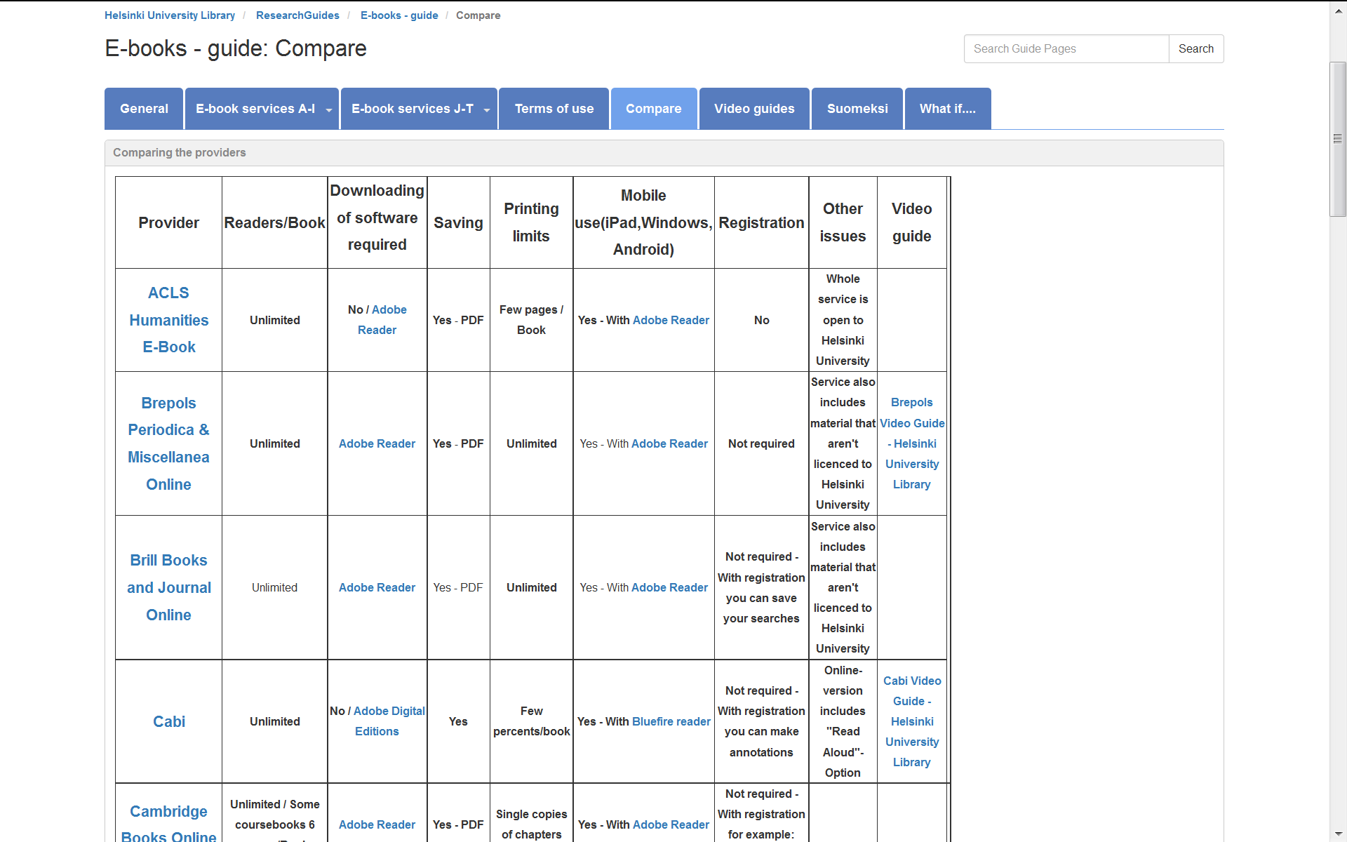
How to access eBooks - patrons can
Search Helka - eBooks are catalogued in Helka
Use the search box on library website and limit searches to online resources only by ticking the check box (see slide)
Browse ebooks in new more visual way in
BookNavigator
http://www.terkko.helsinki.fi/booknavigator/
D. By using categories to see the latest / recent acquisitions
E. By using tags - word clouds - lead to similar or related titles
F. Search for a certain title and click subject terms / keywords to display related content ( #rituaalit)

Slide 7
University libraries and Open Access
Our dilemma: funding cuts & rising subscription prices (5-7 % yearly)
global scientific publishing is a lucrative business
University libraries have been active in promoting OA for a long time
scholarly community should take more active role in scientific publishing

Slide 8
Would it be possible to flip over?
Should we move from subscriptions to Article Processing Charges and Book Processing Charges? Who should pay the bills?
One might consider human scientific publishers & university libraries as traditional and conservative actors
Nowadays some of the most exiting ”flip over” innovations come from human sciences & university libraries (e.g., Knowledge Unlatched, Aleksandria Library Concortium, Stockholm UP, UCL Press, …)
Finnish libraries, publishers and research funders should co-operate nationally and internationally to find new kinds of ”flip over” business models and practices
University libraries would like book-publishing to flourish (also) in Finnish and Swedish

