Slide 1
A village method

Slide 2
Case Mansikkala: a village method

Slide 5
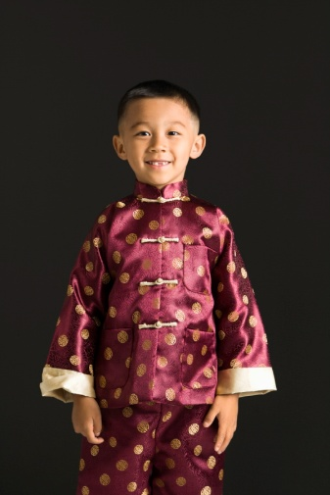

Slide 6
Learning culture
Typical street
names
Typical places:
Shopping
mall
Typical river names
Typical places:
Café
Typical places:
Post office
Typical places:
Cinema

Slide 7
Learning phrases and interaction
Asking for way in the bus station
Describing your problem in a hospital
Asking for help in a shop
Meeting sbd in a restaurant
Discussion in a café
Reporting an accident to the police

Slide 8
Learning grammar in interaction
Station: directions,
instructions
Hospital:
complex sentences, precise descriptions
Shop:
expressing possession
Restaurant:
emotions,
emotive sentences
Café:
basic sentences
Police: causal expressions

Slide 9
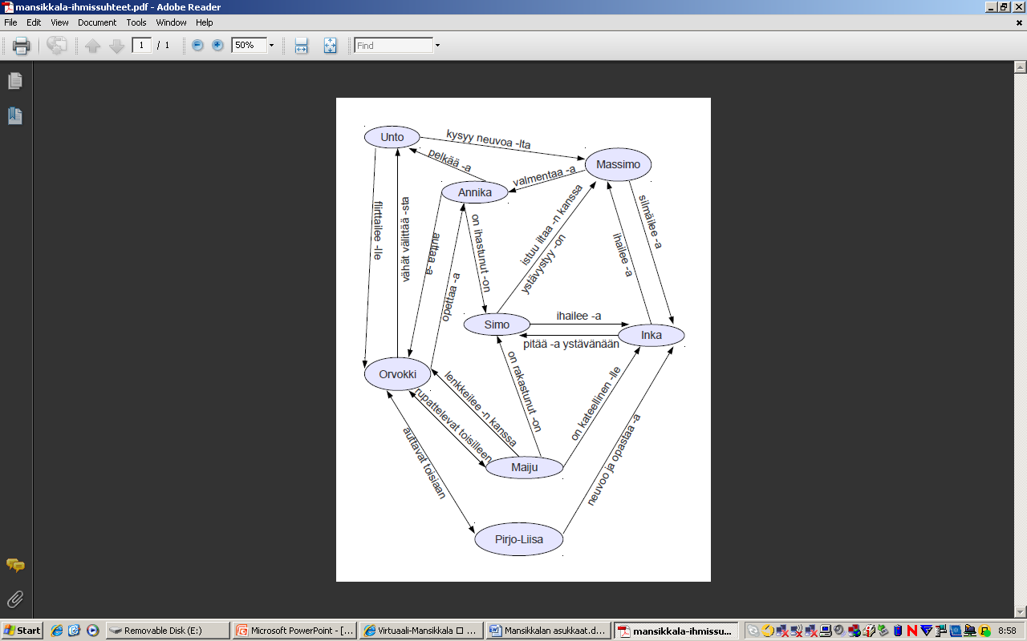
Simulating relationships
Who likes whom?
Who is afraid of somebody?
Who is in love with somebody?
Who do have a relationship?
Who is jealous?
Who admires whom?
Who do help one another?
Notes:
A lot of fun!

Slide 10
Mansikkala’s advantages
A coherent appearance, but with permission to heterogeneity.
Creates group spirit.
Using learners’ products as learning materials is a positive feedback per se.
Up to date, never oldfashioned.
Creativity allowed.

Slide 11
…and challenges
Pretty worky to the teacher.
Teaching grammatical structures – or whatever the chosen topic is – must be ”plotted” each time again.

