Slide 1
datasupport network
April 29, 2016
Pälvi Kaiponen Mari Elisa Kuusniemi
This work is licensed under a Creative Commons Attribution 4.0 International License.

Slide 2
Collaborative Support services
Researcher
IT Center
researchdata@helsinki.fi
Human Resources and Legal Affairs
Research Funding
University Library:
Linkage between university units and services = one-stop shop
Research Ethics Commitees
Central Archives
Research Affairs – Central administration: network coordination
Kuva: http://www.e-sciencecity.org/

Slide 3
Collaborative Support services
Data Management Support – Helsinki University Library
Technical Support – IT Center
Research Integrity – Research Ethics Committees
Legal Questions – Legal Counseling Services
Data Protection Issues – Research Affairs
Good Information Management Practices – Central Archives
Research Funding – Research Affairs
More information:
https://flamma.helsinki.fi/en/research-data-management-support

Slide 4
libraryguides.helsinki.fi/rdm

Slide 5
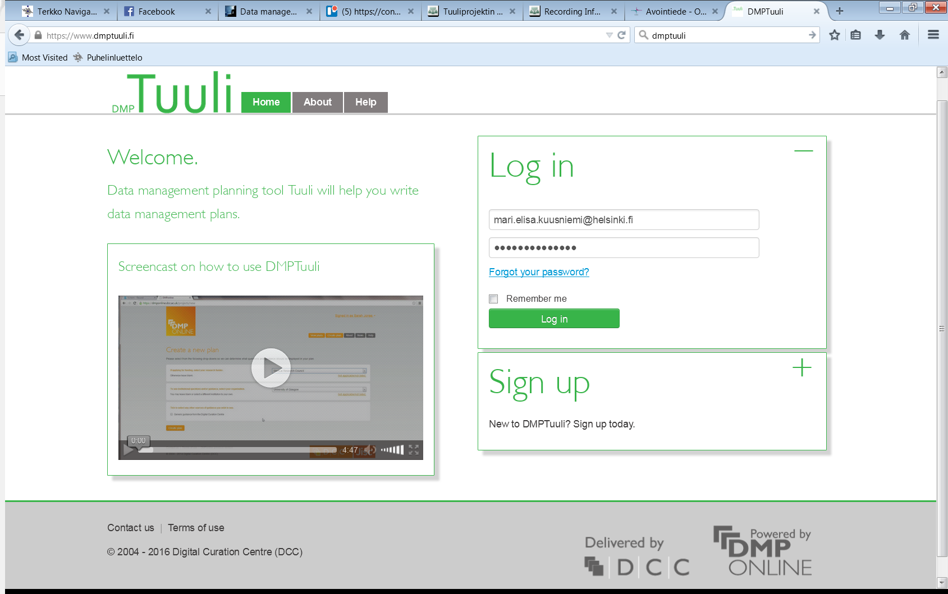
www.dmptuuli.fi

