Slide 1
OpenAIRE national event Date: 12.3.2019 Venue: Paasitorni, Helsinki Opening words: Open Science in the European context Sami Niinimäki, MOEC

Slide 2
Council Conclusions on the transition towards an Open Science system (9526/16), 27 May 2016.
Open science
Open Science Policy Platform and European Open Science Agenda
Removing barriers and fostering incentives
Open access to scientific publications
10. WELCOMES open access to scientific publications as the option by default for publishing the results of publicly funded research; RECOGNISES that the full scale transition towards open access should be based on common principles such as transparency, research integrity, sustainability, fair pricing and economic viability; and CALLS on Member States, the Commission and stakeholders to remove financial and legal barriers, and to take the necessary steps for successful implementation in all scientific domains, including specific measures for disciplines where obstacles hinder its progress.
12. AGREES to further promote the mainstreaming of open access to scientific publications by continuing to support a transition to immediate open access as the default by 2020, using the various models possible and in a cost-effective way, without embargoes or with as short as possible embargoes, and without financial and legal barriers, taking into account the diversity in research systems and disciplines, and that open access to scientific publications should be achieved in full observance of the principle that no researcher should be prevented from publishing; INVITES the Commission, Member States and relevant stakeholders, including research funding organisations, to catalyse this transition; and STRESSES the importance of clarity in scientific publishing agreements

Slide 3
Council Conclusions on the transition towards an Open Science system (9526/16), 27 May 2016.
Optimal reuse of research data
14. UNDERLINES that research data originating from publicly funded research projects could be considered as a public good, and ENCOURAGES the Member States, the Commission and stakeholders to set optimal reuse of research data as the point of departure, whilst recognising the needs for different access regimes because of Intellectual Property Rights, personal data protection and confidentiality, security concerns, as well as global economic competitiveness and other legitimate interests. Therefore, the underlying principle for the optimal reuse of research data should be: “as open as possible, as closed as necessary”.
16. EMPHASISES that the opportunities for the optimal reuse of research data can only be realised if data are consistent with the FAIR principles (findable, accessible, interoperable and re-usable) within a secure and trustworthy environment; RECALLS the importance of storage, long term preservation and curation of research data, taking into consideration the capacity of the research group or organisation, as well as ensuring the existence of metadata based on international standards; ENCOURAGES Member States, the Commission and stakeholders to follow the FAIR principles in research programmes and funding mechanisms.
Follow-up
18. CALLS on the Commission, the Member States and the stakeholders to take the necessary actions needed for making open science a reality and to advocate the need for concerted actions in relevant national, EU, multilateral and international fora; CALLS on the Commission to keep the Member States informed of and involved in the work of the Open Science Policy Platform and to coordinate its activities with the Member States, and AGREES to take stock on the progress together with the Commission and the Platform on a regular basis, starting no later than one year from now.

Slide 4
The European Strategy Forum on Research Infrastructures (ESFRI) Roadmaps
The European Strategy Forum on Research Infrastructures (ESFRI) periodically updates its Roadmap as mandated by the Competitiveness Council of the European Union to provide a coherent and strategic vision ensuring that Europe has excellent Research Infrastructures (RIs) in all fields of science and innovation.
ESFRI fosters the definition, implementation and further development of advanced solutions for the effective provision and use of high-quality scientific data, with effective descriptors, ease of access, interoperability and reusability, fully implementing the FAIR principles. It also develops and promotes Data Commons as practised by ESFRI Research Infrastructures and horizontal e-Infrastructures.

Slide 5
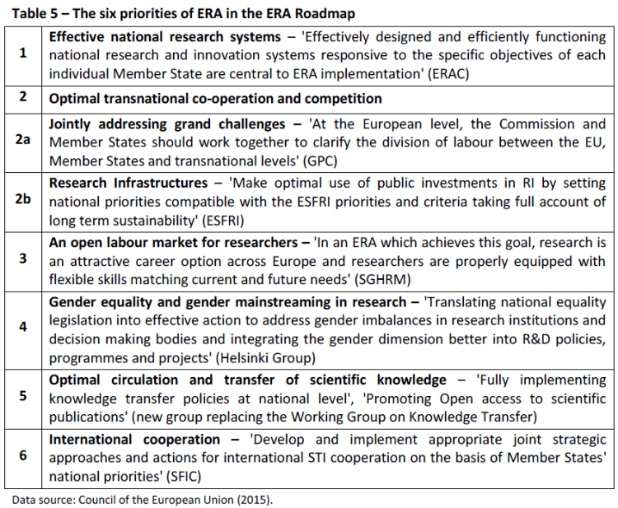
European Research Area (ERA)
The Council Conclusions of 29 May 2015 adopted the ERA Roadmap 2015-2020.
The purpose of the Roadmap is to identify a limited number of key implementation priorities which are likely to have the biggest impact on Europe’s science, research and innovation systems if all the members of the ERA Partnership get them right. It is important to underline that the Roadmap (like the ERA itself) covers both research and innovation.

Slide 6
ERA PRIORITY 5 – OPTIMAL CIRCULATION AND TRANSFER OF SCIENTIFIC KNOWLEDGE
High level objective/rationale
Removing the legal, political and technical barriers to the wider circulation and greater use of knowledge will lead to increased growth and competitiveness for Europe, with benefits for scientists, research institutions, citizens and businesses of all sizes. The practical focus of this priority should be on a) fully implementing knowledge transfer policies at national level in order to maximize the exploitation of scientific results and b) open access to publications and data in an open science context.
ERAC 1208/15 European Research Area (ERA) Roadmap 2015-2020

Slide 7
Commission Recommendation of 17 July 2012 on "Access to and preservation of scientific information"
In its Recommendation to the Member States on access to and preservation of scientific information C(2012)4890, the Commission called on Member States to designate National Points of Reference (NPRs) whose tasks would be to co-ordinate the measures listed in the Recommendation (relating to open access to publications, open research data, preservation of scientific information, and e-infrastructures); to act as interlocutor with the Commission; and to report on the follow-up of the Recommendation.
==> so far EC has published two reports on the implementation of C(2012)4890
==> update of the recommendation is in the making, will include references to FAIR data and PSI

Slide 8
Report on the implementation of C(2012) 4890 – Study completed in May 2018
Member States largely believe that the Recommendation has been valuable and impactful at European and national level.
The majority of the countries have adopted, are implementing or currently discussing policies for open access to publications at the national level, with one third of the countries preferring self-archiving, a few countries with a strong preference for open access publishing and half of the countries supporting both means of open access.
National governments, as well as funders and institutions, are at different stages of progress in implementing open access to research data policy (e.g. Research Data Management (RDM), Findable, Accessible, Interoperable, Reusable (FAIR) data, RDM costs). The respondents suggested that more coordination would be necessary to assure alignment of policies and practices. A number of countries are working on open research data principles with approximately half of the countries surveyed making DMPs and FAIR data part of their policies.
The majority of the countries reported projects or initiatives at national level to develop cloud services and/or ensure interoperability of e-infrastructures.
Rewards for practicing Open Science (i.e. the culture of sharing) built into the career assessment and related education and skills initiatives and strategies is being implemented mostly at the institutional level.
Only half of the countries monitor the development and/or growth of open access publications at national level while the majority of countries do not monitor the development/growth of access to research data nor the impact of open access.
The majority of countries are involved in collaborative efforts for digital journal subscriptions and interoperability of e-infrastructures in the national or transnational context.

Slide 9
Horizon 2020 and Horizon Europe
Horizon 2020 - The Framework Programme for Research and Innovation (2014-2020)
Open Innovation, Open Science, Open to the World – a vision for Europe (EC 2016)
For the next long-term EU budget 2021-2027, the Commission is proposing €100 billion for research and innovation.
A European Innovation Council (EIC)
New EU-wide research and innovation missions
Maximising the innovation potential across the EU
A new generation of European Partnerships and increased collaboration with other EU programmes
More openness: The principle of 'open science' will become the modus operandi of Horizon Europe, requiring open access to publications and data. This will assist market uptake and increase the innovation potential of results generated by EU funding.
===> In principle, the Finnish Government welcomes the Commission's proposals for new openings of the Horizon Europe framework program to strengthen open science and open innovation, and to reinforce breakthrough innovations and market-creating innovations within the framework of commonly agreed principles. Strengthening the open approach to research and innovation can improve the reliability, transparency and effectiveness of research, as well as more efficient and effective utilization of research results.
(Government brief to the parliament U 70/2018 vp)

Slide 10
Recent actions in Finland
Vision for Higher Education and Research 2030
Research and Innovation Council vision and roadmap to 2030
Ethical information policy in the age of artificial intelligence
Data Management and Scientific Computing Development Program 2017-2021
The European High-Performance Computing Joint Undertaking - EuroHPC

Slide 11
The Federation of Finnish Learned Societies
National coordination of open science has been assigned to The Federation of Finnish Learned Societies.
Webpages
Steering bodies
Expert groups
Roadmaps
Forum meetings
Training
Etc…
The Federation of Finnish Learned Societies hosts three expert bodies:
The Committee for Public Information,
Finnish Advisory Board on Research Integrity and
Publication Forum.

