Slide 1
European Open Science Cloud –
From vision into useful services
Saara Kontro, CSC – IT Center For Science / EOSCsecretariat.eu

Slide 2
Presentation outline
European Open Science Cloud – Vision
Benefits
Implementing the EOSC
Governance
Services

Slide 3
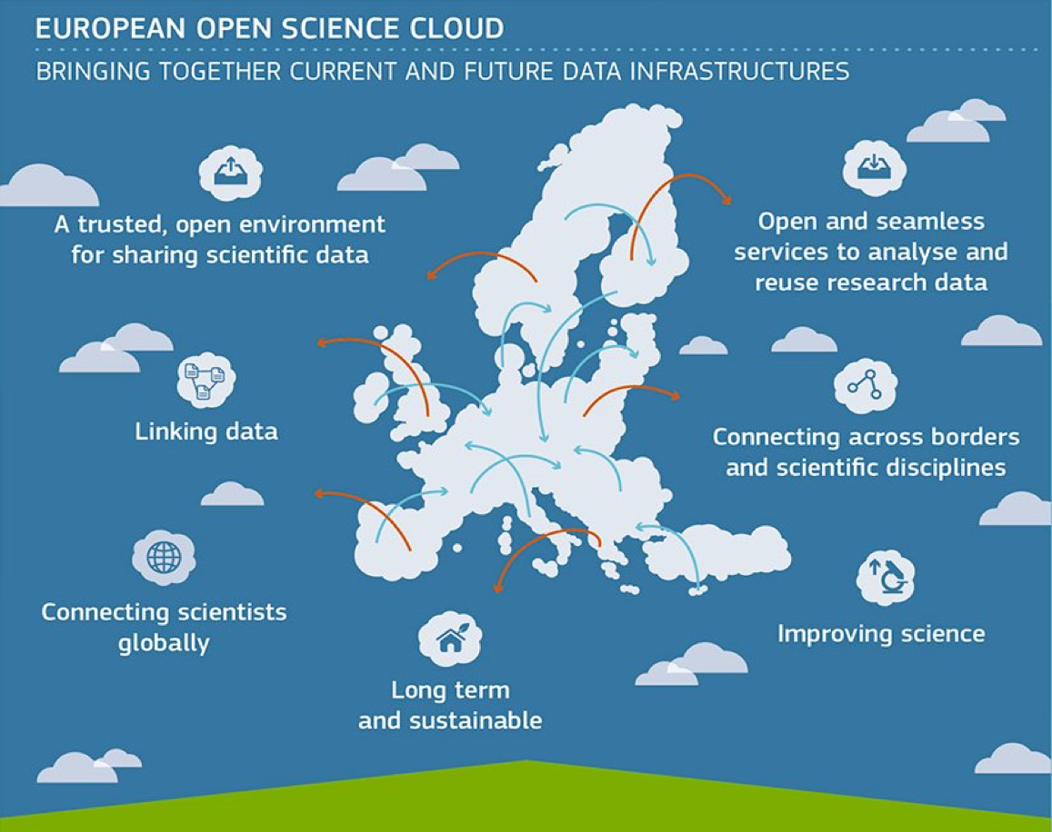
EOSC - European Commission’s vision for Federating Data Infrastructures
Vision for the European Open Science Cloud (EOSC) presented in the Commission communication on the ‘European Cloud Initiative’, as a part of the Digital Single Market Strategy [April 2016]
”A seamless environment enabling interdisciplinary research, an environment to foster data-intensive innovation. The EOSC will allow for universal access to data and a new level playing field for EU researchers.” [EOSC Strategic Implementation Roadmap 2018-2020]
From 2021 fully operational

Slide 4
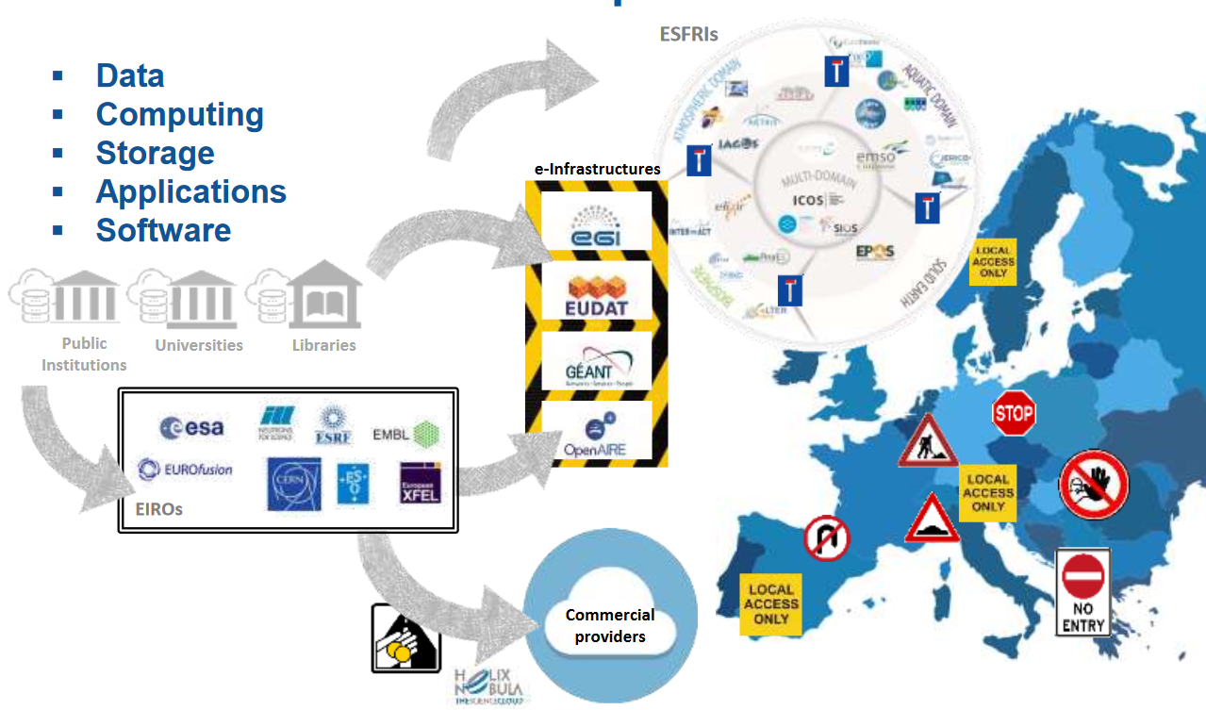
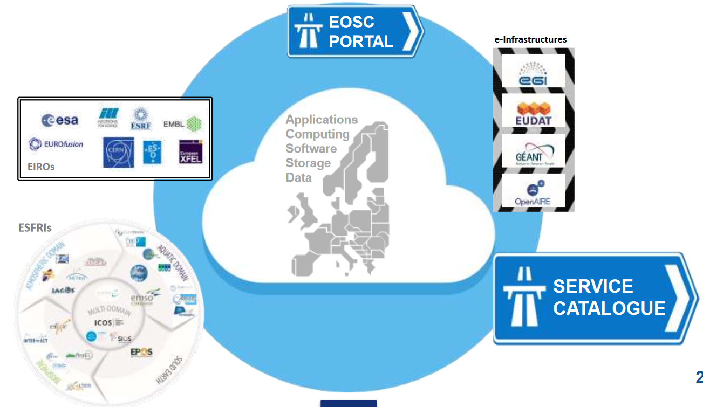
From fragmentation and uneven access to information to a federated model, where access to data would be universal, building on a strong legacy
Current model of European data infrastructures
Source: EOSC Strategic Implementation Roadmap 2018-2020, May 2018, European Commission
Future EOSC model: federation of data infrastructures

Slide 5
What does and will the EOSC bring to researchers in Finland?
Brokering frictionless services for data-driven research and international research collaboration
  an opportunity for researchers and innovators to discover, access, use and reuse a broad spectrum of resources for advanced data-driven research.
  broader access to services supporting scientific discovery and collaboration across disciplinary and geographical boundaries
A wider / better selection of services available
  new attractive data sets available
  thanks to more effective use of resources available for supporting science we can enlarge our service catalogue and at the same time focus in providing and developing our specialized services
Competitive advantage
  Finnish researchers will be in a good position to begin to use EOSC services, once available, and will appear as attractive research partners for international research teams.
Notes:
More effective use of resources means sharing the cost and resources needed to have help desk and other support needed when launching a service

Slide 6
Benefits that EOSC will bring to the whole society
More and better research, when Open Science practises and FAIR data principles are widely in use, as promoted by EOSC
More effective use and distribution of resources for science and support of science (reuse of existing datasets for new research, common services on a European scale)
Improving the quality and transparency of decision-making, empowering and engaging citizens
Turning data into a source of growth and innovation: Collaborating and assisting companies in opening their data, getting access to research findings, a source for new start-up opportunities

Slide 7
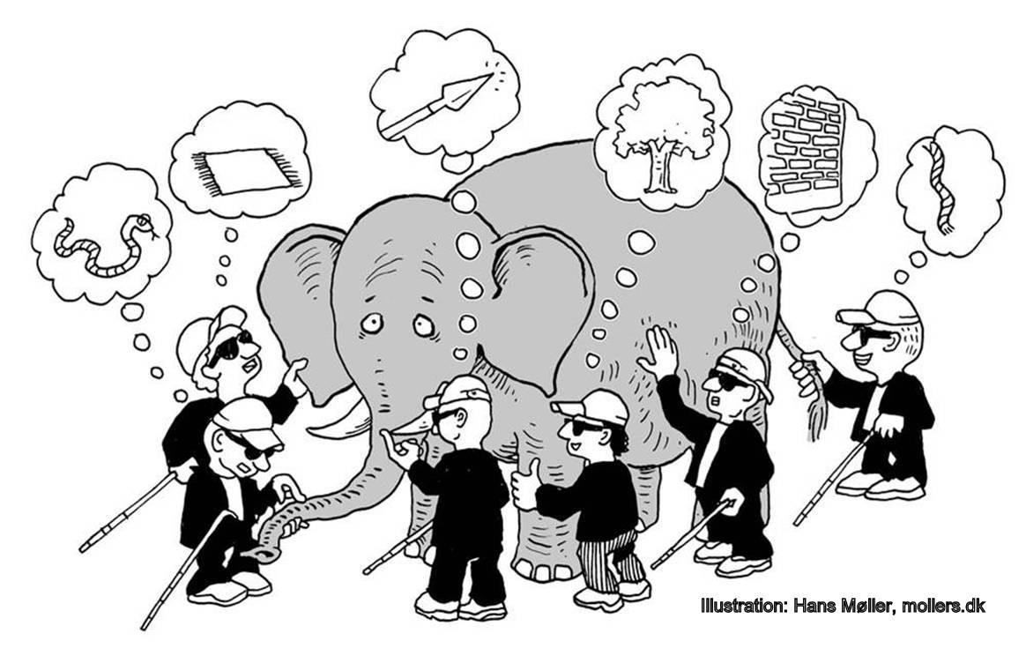
Implementing the EOSC
Six blind men and the elephant (John G. Saxe, 1816-1887)
If everyone
is thinking alike,
then no one
is thinking.
Benjamin Franklin

Slide 8

EOSC-hub 2018-2020 / 30M€ Multiple service providers creating the Hub: an opportunity for researchers and innovators to discover, access, use and reuse a broad spectrum of resources for advanced data-driven research. | EOSCpilot 2017-2019 / 10M€ Piloting the EOSC, governance, stakeholder engagement | EOSCsecretariat.eu 2019-2021 / 10M€ 360°support to EOSC Governance, working openly & inclusively with communities to co-create all-encompassing EOSC | EOSC Nordic From Sept. 2019 – 2022 / 6M€ Coordinates EOSC relevant initiatives in Nordic and Baltic countries to exploit synergies & obtaining harmonization at policy and service provisioning Strong consortium with unique capacity to realise outcomes of EOSC design
eInfraCentral 2017-2019 / 1,5M€ European catalogue of e-Infrastructure services and resources. A standardised registry makes it easier to discover and access services and resources. | FREYA 2017-2020 / 5,3M€ Extends the infrastructure for persistent identifiers (PIDs) as a core component of open research, in the EU and globally. Improves discovery, navigation, retrieval, and access to research resources. | OCRE 2019-2021 / 14,4M€ Open Clouds for Research Environments (OCRE) gives the European research community access to commercial digital services (IaaS, SaaS and PaaS cloud services), as well as Earth Observation (EO) services. | OpenAIRE-Advance 2018-2021 / 10M€ Facilitates the move to a more open and reproducible scientific landscape by offering a unique set of services to embed Open Science into researcher workflows for opening up, sharing & reusing of research outcomes
RDA Europe 4.0 2018-2020 / 3,5M€ European plug-in to RDA , focuses on the need for open and interoperable sharing of research data and builds social, technical and cross-disciplinary links to enable such sharing on a global scale. | FairsFair 2019 – 2022 / 10M total budget Supplies practical solutions for the use of the FAIR data principles throughout the research data life cycle. Fosters FAIR data culture and the uptake of good practices in making data FAIR | PaNOSC 2018-2022 / 12M€ Photon and Neutron Open Science Cloud builds on top of the existing local meta-data catalogues and data repositories to provide federated services for making data easily FAIR, and develops data analysis services | EOSC-Life 2019-2022/ 24M€ Part of EOSC tackling challenges of analyzing and reusing the prodigious amounts of data produced by life-science Providing an open collaborative space for digital biology in Europe
ENVRI-FAIR 2019-2022 Connection of the ESFRI Cluster of Environmental Research Infrastructures (ENVRI) to EOSC. All participating RIs is to build a set of FAIR data. | ESCAPE: Astronomy & Particle Physics 2019-2022 / 16M€ Implementing Science Analysis Platforms for EOSC researchers to stage data collections, analyse them, access ESFRIs’ software tools, bring their own custom workflows | Social Sciences & Humanities Open Cloud (SSHOC) 2019- 2022 / 14,5M€ Providse a full-fledged Social Sciences and Humanities Open Cloud where data, tools, and training are available and accessible for users of SSH data. | + 3 regional EOSC-projects and 1 thematic EOSC-project to be launched + other EOSC-related upcoming calls for proposals

Slide 9















EOSC projects’ contribution to the EOSC implementation roadmap
EOSC Implementation
Roadmap action line
On-going EOSC projects contributing to the implementation
Architecture
Data
Services
Access and Interface
Governance
Rules of Participation
https://ec.europa.eu/research/openscience/pdf/swd_2018_83_f1_staff_working_paper_en.pdf

Slide 10
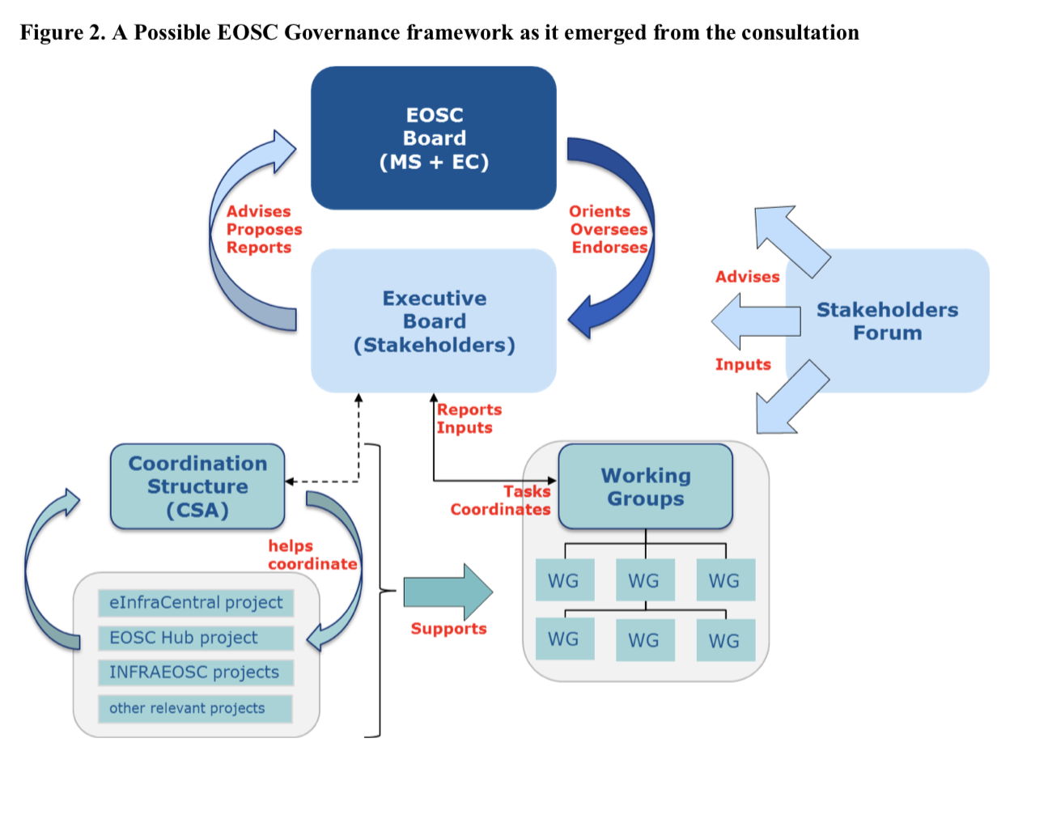
EOSC Governance framework
Finland represented by
Ministry of Education and Culture
and Academy of Finland
CSC as partner of
EOSCsecretariat.eu
These bodies about to launch: Let’s get more Finns on board in developing the EOSC!

Slide 11
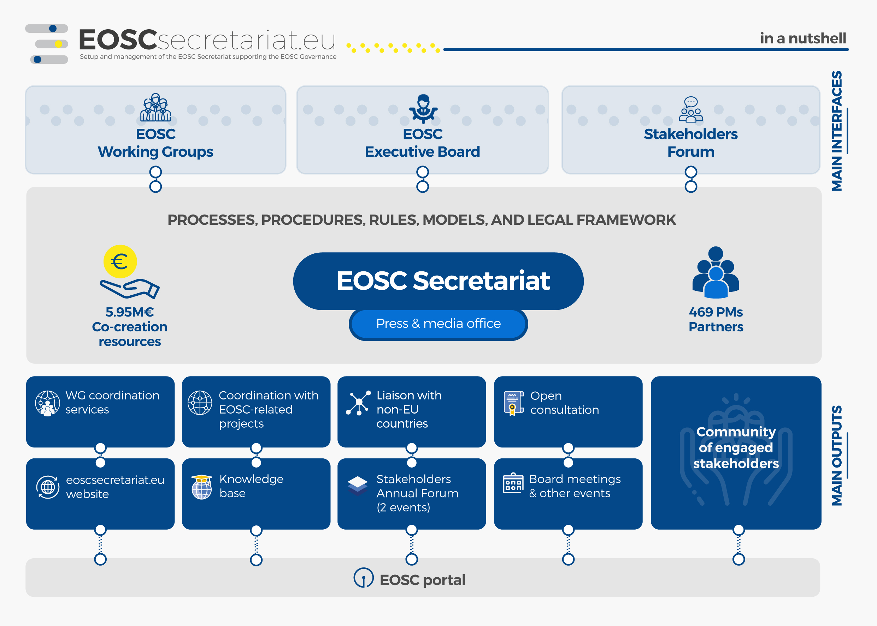
EOSCsecretariat.eu
360°support to EOSC Governance, working openly & inclusively with communities to co-create all-encompassing EOSC
Independency & neutrality
Interim character, with an enabling and advisory approach
Supporting a user centric EOSC implementation, with the Co-creation budget at the command of the EB
Flexibility & agility
Transparency & openness

Slide 12
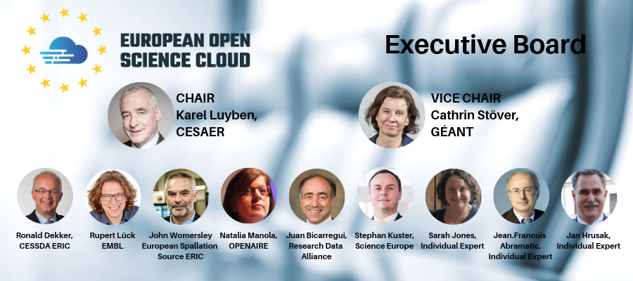
At the heart of the EOSC

Slide 13
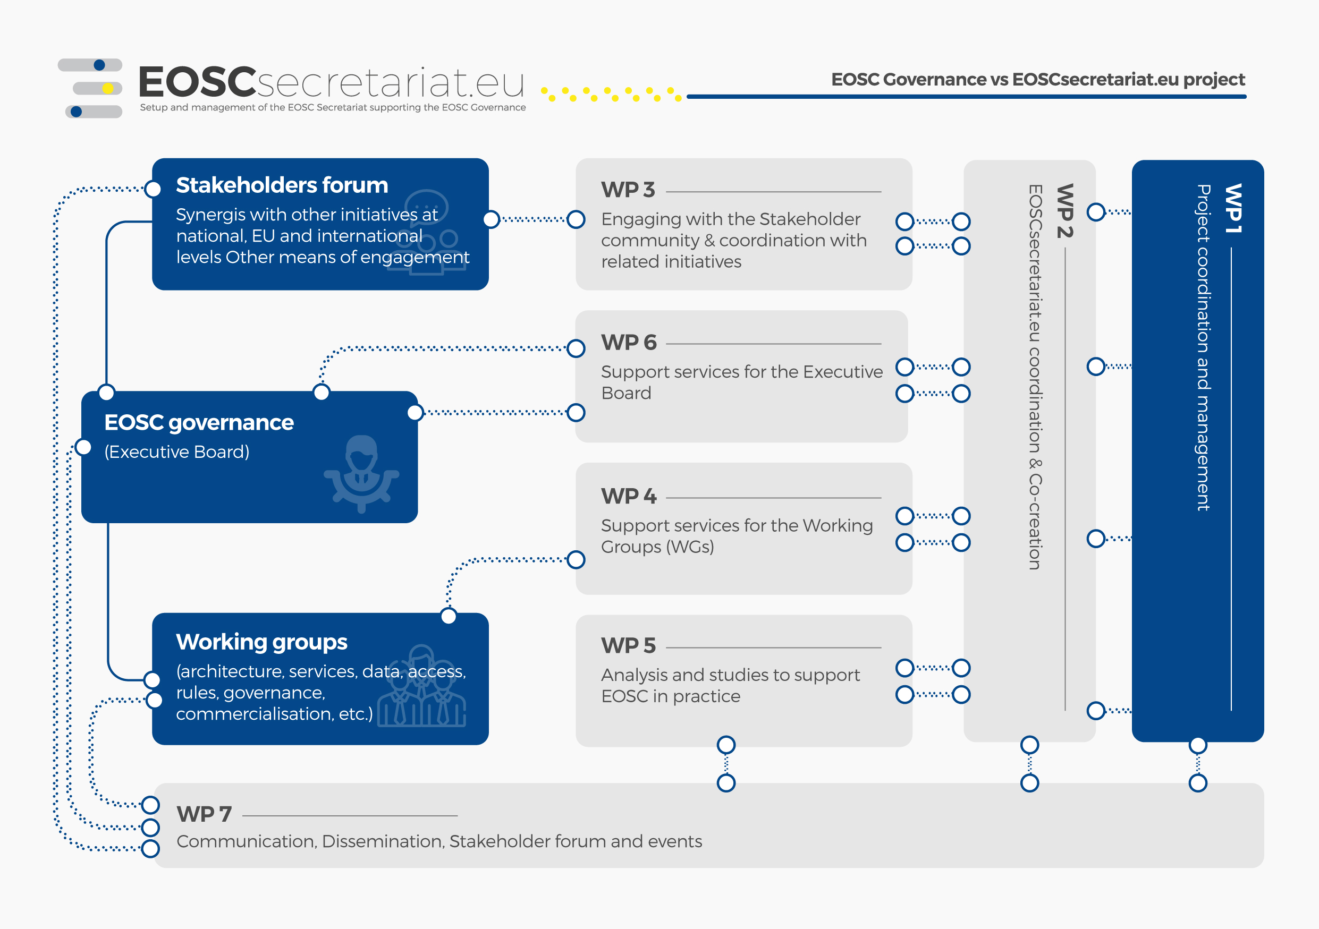

Slide 14


What you can do?
The EOSC Secretariat is at the heart of the activities happening around EOSC. Sign up to our community to receive immediate updates. Here's how you can take a more active role under the EOSC Secretariat:
Benefit from the co-creation funding
Contribute to the Working Groups
Bring your assets to EOSC
Shape the EOSC 2021 by joining the EOSC Stakeholder Forum

Slide 15
EOSC model will provide these services for European researchers
[EOSC Strategic Implementation Roadmap 2018-2020]
Identification and authentication, and access to the resources of the EOSC
A protected & personalised work environment/space (e.g. logbook, settings, compliance record and pending issues)
Access to relevant information (e.g. status of EOSC, list of infrastructures, policy-related information, compliance framework) and specific guidelines (e.g. how to make data FAIR, certify a repository or service, procure joint services)
Services to find, access, store, re-use and analyse (e.g. analytics, data merge/fusion, mining) the data generated by others, catalogued appropriately
Services to make their own data FAIR, to store them and ensure long-term preservation

Slide 16




Research Infrastructure Roles in EOSC-hub
Service/Product providers
  Contribute to the portfolio & Integrate
  Promote, Train, Exploit
  Participate in the Hub
Consumers
  Credit allocation & exploit
  Support
  Improve with feedback
  Use
Early adopters
  Pilot
  Use
  Co-develop

Slide 17

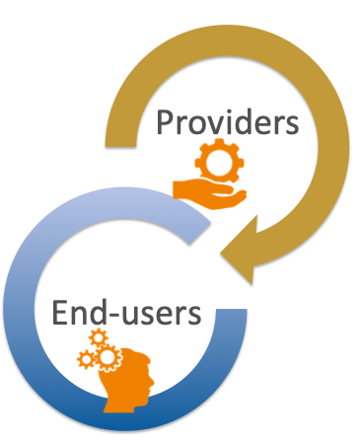

The Hub – A Collaboration Platform for ESFRIs
Research communities
  Discover services through a secure online catalogue with a central access point.
  Access services via harmonised access policies and Service Level Agreements. Depending on the customer’s needs, access will be provided through a centrally managed credit-based allocation system and/or through long-term resource allocation.
  Leverage a large portfolio of generic and thematic services via standard interfaces
  Provide requirements, co-design, testing
Research Infrastructures - Providers
  Contribute to EOSC with services based on a harmonised corpus of access, security and provisioning policies.
  Integrate and Federate services by relying on harmonised processes and tools for service integration and management.
  Scale-up in-house capacity by procuring services via a centrally run procurement and purchase framework.
  Reach out to user communities and support
  Collaborate with other providers

Slide 18
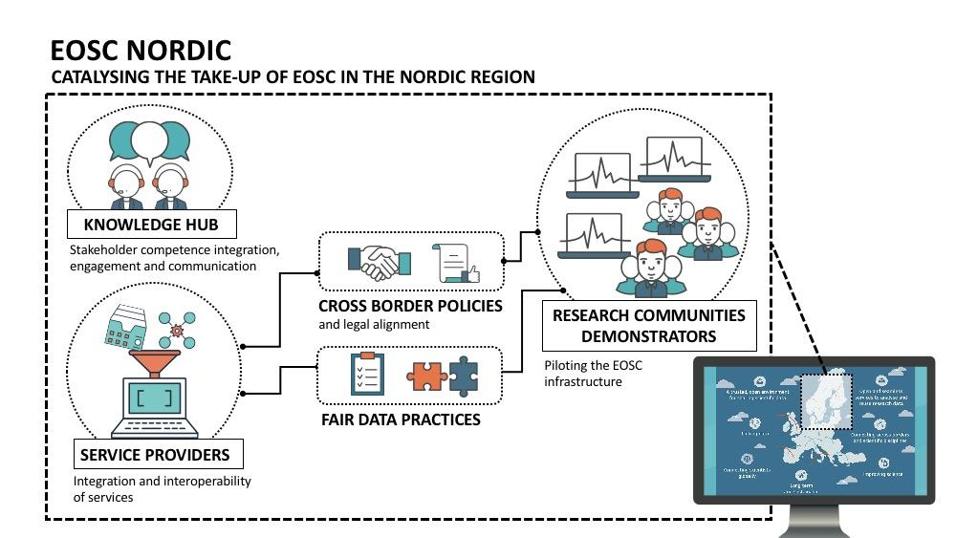
EOSC Nordic – bringing the EOSC into reality in the Nordics
Coordinator: NeIC (NordForsk)
Budget: 5.99 M€
Duration: 36 Months, starting September 2019
Effort: 550 PM
24 Partners from Nordics + DE, NL, LV, EE, and LT

Slide 19
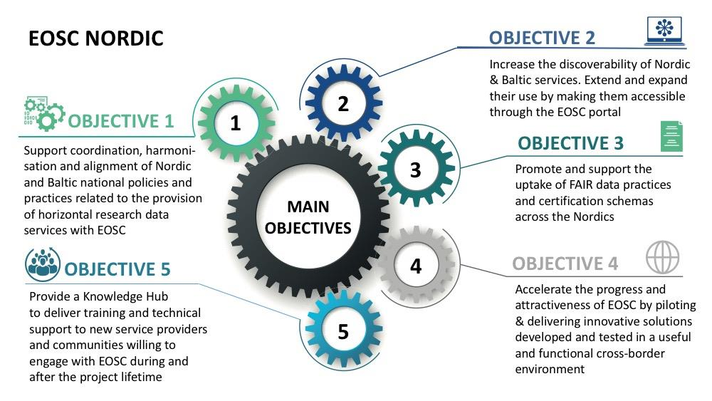

Slide 20
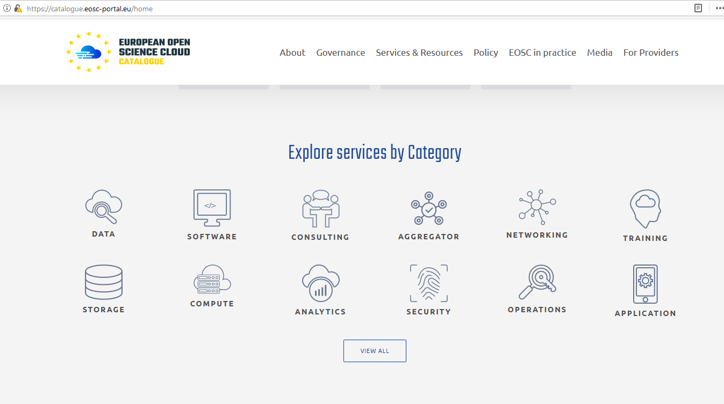
EOSCportal.eu - Gateway for European Services for Research
154 services and resources
Offered by 17 service providers from the public and private sector

Slide 21
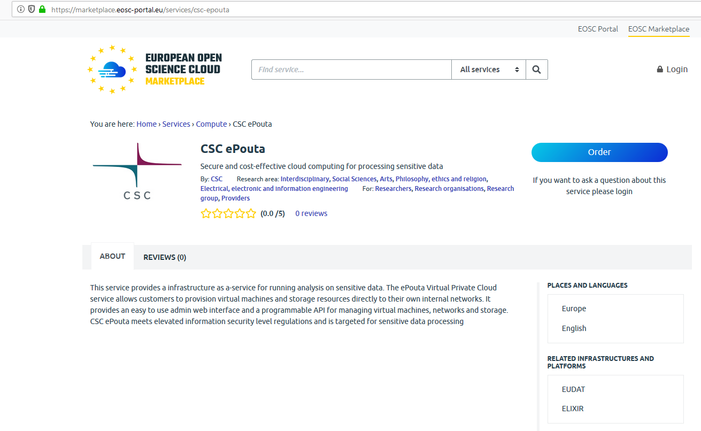
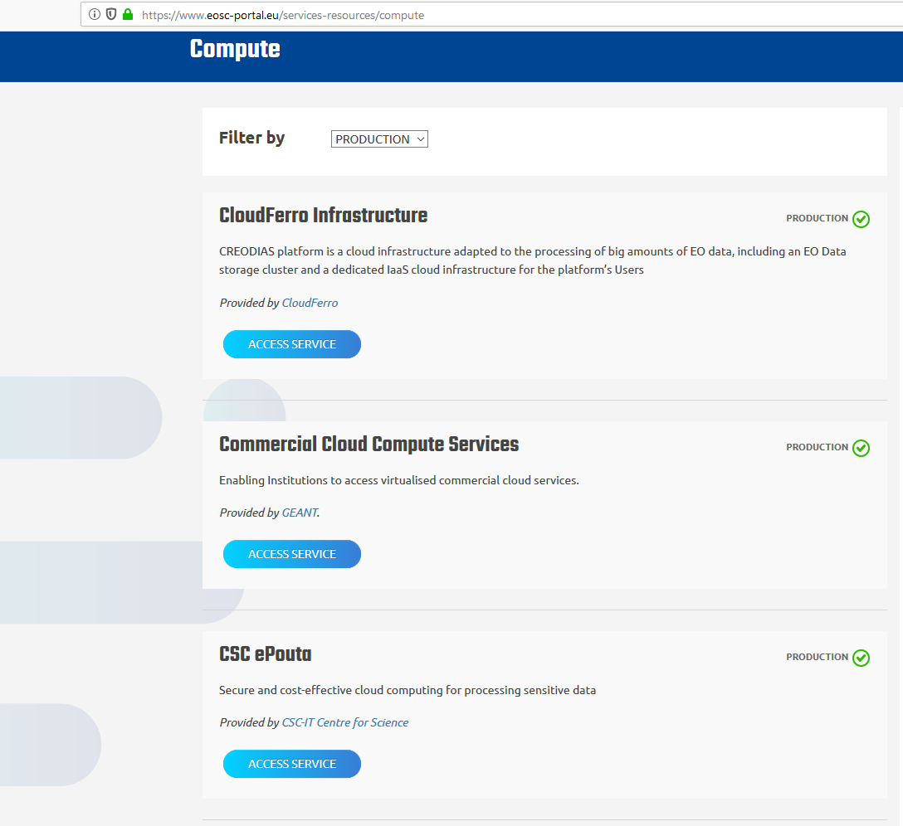
Example of compute services available at EOSC portal

Slide 22
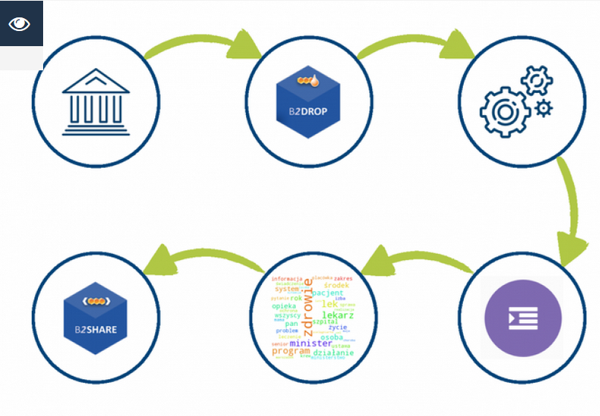
CLARIN use case: From language data to insight
Integration of the CLARIN infrastructure into the EOSC portal facilitates the study of language data
How the Portal itself can support the Social Sciences and Humanities (SSH) community at large in the future
CLARIN use case

Slide 23
Summary
EOSC - a federation of Data Infrastructures
EOSC portal with a service catalogue at eoscportal.eu
Many opportunities to participate in shaping the future EOSC, for instance the Working Groups and activities of the Stakeholders Forum in the EOSC governance framework. More information at eoscsecretariat.eu

Slide 24
Saara Kontro
saara.Kontro@csc.fi

