Slide 1
Case from RDA - Solutions for Data Management Jungle
Making sense of Open Science jungle - optimizing your use of Open Science services
12.3.2019

Slide 2
What is it?
RDA is an international member based organisation
8000 individual members from 137 countries
56 organisational & affiliate members
101 working groups and interest groups
9 European national nodes, target 22
Two plenary meetings per year
P13 in Philadelhia, USA, 2-4 April 2019
P14 in Espoo and Helsinki,

Slide 5
Why is it?
The RDA Vision: Researchers and innovators openly share data across technologies, disciplines, and countries to address the grand challenges of society.
The RDA Mission: RDA builds the social and technical bridges that enable open sharing and re-use of data.

Slide 6
RDA Finland
Housed at CSC IT Center for Science
Gets funding from RDA EU 4.0 project
Node coordinator Heidi Laine (since Feb. -19)
Aims at
Acting as central contact point between national/regional data practitioners and RDA
Growing RDA membership and encouraging involvment
Fostering a diverse data community of stakeholders across domains
Running events to engage, train and build consensus on nationally important data issues

Slide 7
What’s in it for you?
Grants
Travel grants for plenary meetings (separate calls for early careers and experts), output application grants, grants for RDA ambassadors
Community and outreach opportunities
RDA in Finland group has 166 research data champions as members (and counting)
P14 in Finland is a huge opportunity to highlight Finnish awesomeness and network like no tomorrow!
Answers
10 endorsed recommendations (+ 8 under review), 12 supporting outputs

Slide 8
RDA outputs & recommendations to be translated/localised
In National Node even 6 June -18 participants voted about most interesting outputs and recommendations they would like to hear about
These 4 will be translated into Finnish or localised some other way
Metadata Standards Directory
Scalable Dynamic-data Citation Methodology
Workflows for Research Data Publishing: Models and Key Components
Persistent Identifiers Type Registry

Slide 9
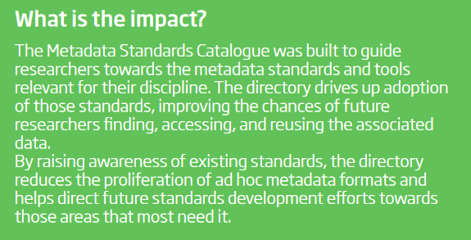
Metadata Standards Directory

Slide 10
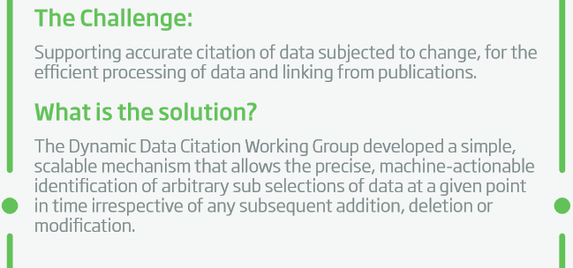
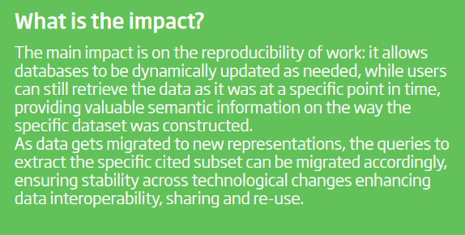
Scalable dynamic-data citation methodology

Slide 11
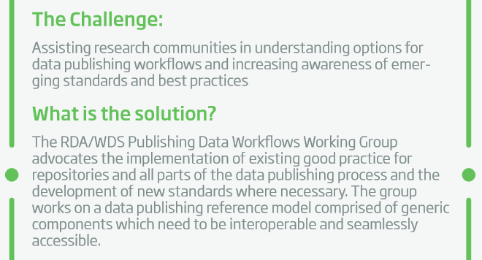
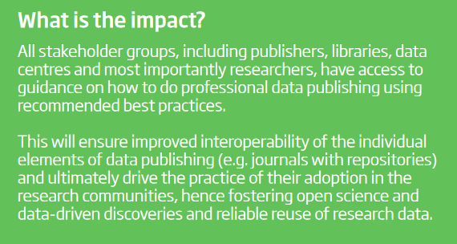
Workflows for Research Data Publishing

Slide 12
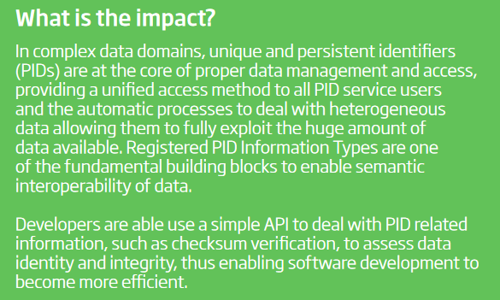
Persistent Identifier Type Registry

Slide 13
RDA Finland meeting and workshop on sensitive data @ Tiedekulma 25 April 2019, 10.00-15.00
For updates follow RDA Finland @ rd-alliance.org and CSC channels @CSCfi

Slide 14
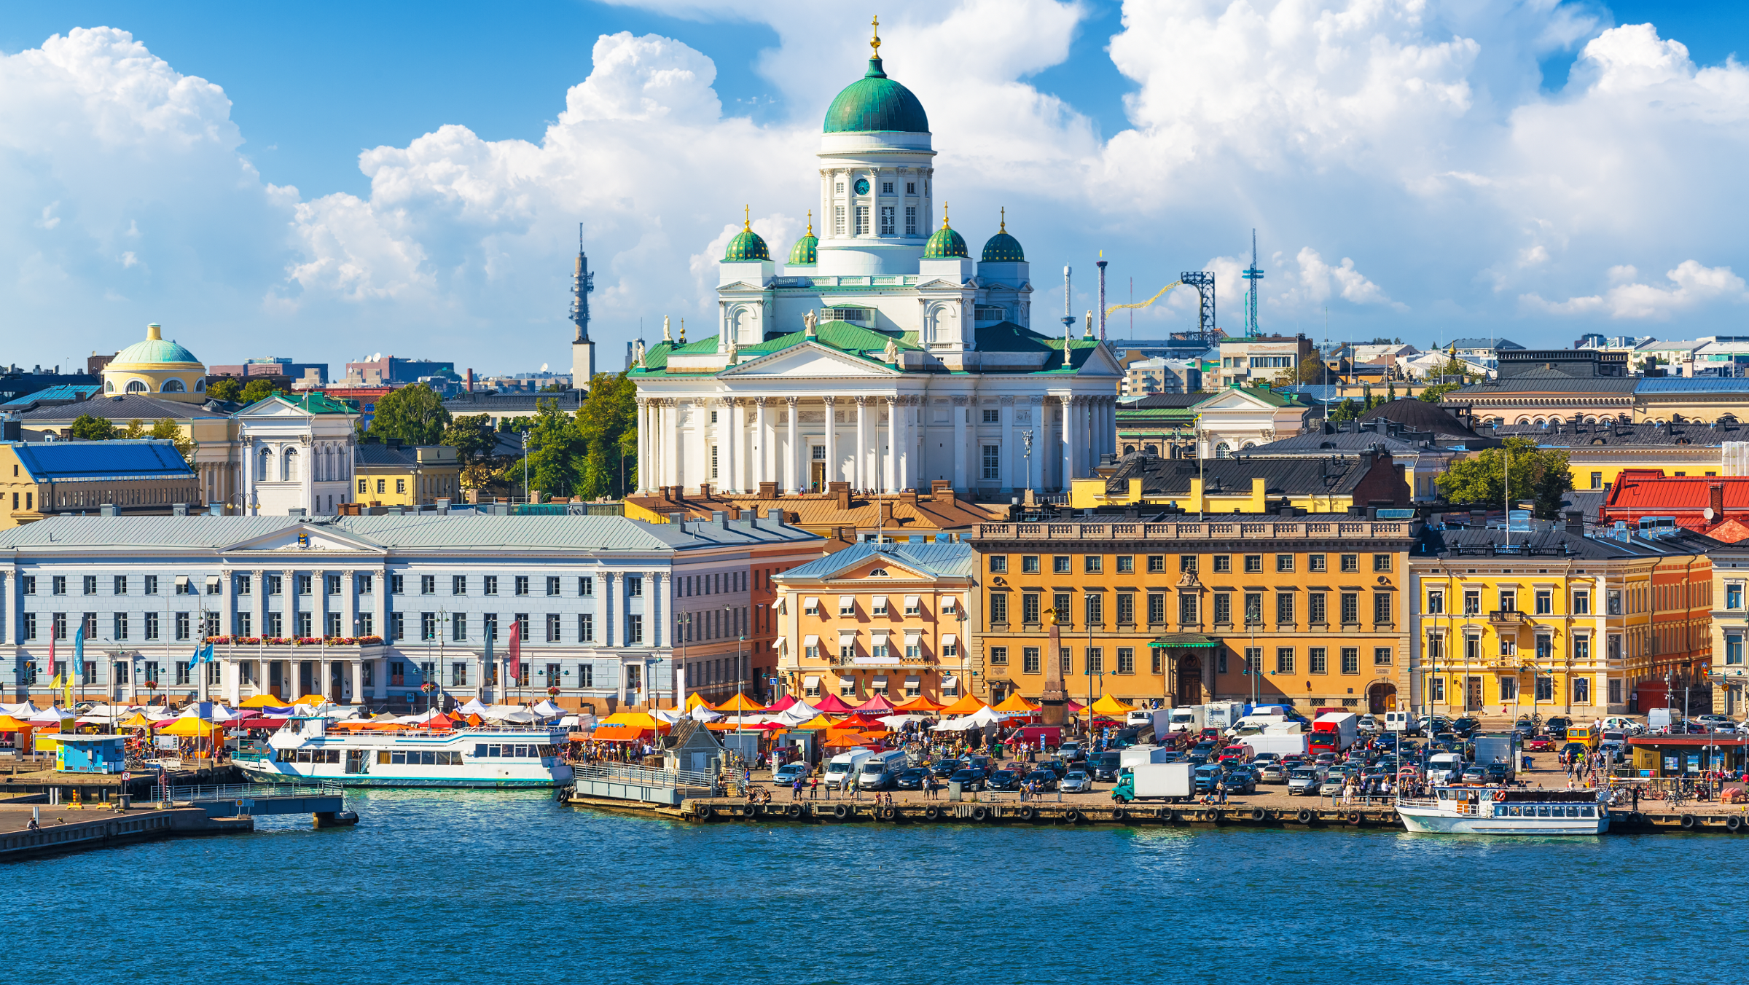
RDA P14 IS HEADED
TO FINLAND
HELSINKI/ESPOO
OCTOBER 23-25, 2019
Photo: Shutterstock

Slide 15
THANK YOU!
Contact
heidi.laine@csc.fi
www.rd-alliance.org/groups/rda-finland

