Slide 1
Connecting Finnish publication data to OpenAIRE - case VIRTA
Joonas Nikkanen, Project Manager, CSC - IT Center for Science, https://orcid.org/0000-0002-5036-6444
Making sense of Open Science jungle - 12.3.2019 Helsinki

Slide 2
Agenda
Background on VIRTA:
VIRTA Publication Information Service
Context:
Finnish publication metadata from OpenAIRE’s point of view
Case:
Implementation of OpenAIRE Guidelines for CRIS Managers

Slide 3
VIRTA Publication Information Service

Slide 4
Publication information collection in Finland
Ministry of Education and Culture collects bibliographic information on scientific publications annually from
14 universities and 5 university hospital districts (since 2011)
23 universities of applied sciences (since 2012)
12 state research institutes (gradually since 2014)
Used as criteria in performance-based funding model of higher education institutions
For universities 13 % of core funding (~200 mill. euros) is allocated via publication points
Publication points are calculated based on publication types and their level (evaluated by national scholarly panels - Publication Forum - http://www.julkaisufoorumi.fi/en)
Publication type | Level 3 | Level 2 | Level 1 | Level 0
Peer-reviewed monograph (C1) | 16 | 12 | 4 | 0.4
Peer-reviewed article in journal (A1-2) | 4 | 3 | 1 | 0.1
Peer-reviewed article in book (A3) | 4 | 3 | 1 | 0.1
Peer-reviewed article in proceedings (A4) | 4 | 3 | 1 | 0.1
Peer-reviewed edited work (C2) | 4 | 3 | 1 | 0.1
Not-peer-reviewed monographs | 0.4
Not-peer-reviewed articles | 0.1

Slide 5
Use of publication information in Finland
Organizations provide a copy of their publication information to VIRTA making it a national data warehouse (or data hub) for other services to use the publication metadata
In total some 60 000 publications per year
= books, journal articles, conference papers, non-scholarly publications, dissertations, artistic publications
All scientific fields are covered
The data can be…
…examined on bibliographic level: http://www.juuli.fi/
…pivoted on statistical level: www.vipunen.fi/en-gb/
…queried via authenticated REST API (XML, JSON) and OAI-PMH API (Dublin Core, XML)

Slide 6
Annual publication data
National funding model
Vipunen
Juuli
Statistical portal for analysis
Portal for examining publications
+60k publications annually
Academy of Finland
14 universities, 5 univ. hosp.
Funding calls and reporting
Pure / Converis / SoleCRIS
VIRTA Publication Information System
23 universities of applied sci.
+350k
publications
total
Organisations’ systems
Mostly JUSTUS / some manually
Validating / de-duplicating / REST and OAI-PMH APIs available
For master data purposes
12 state research institutes
JUSTUS
Varies from Pure to manual
2019
2019
For prefilling co-publications
Research Information Hub
OpenAIRE
Wider linking and interoperability
National aggregator

Slide 7
Finnish publication metadata from OpenAIRE’s point of view

Slide 8
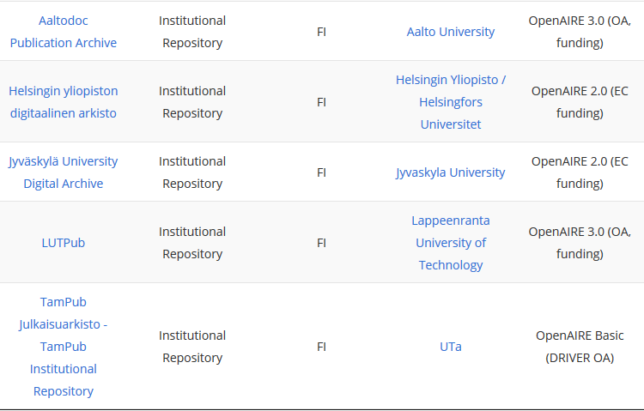
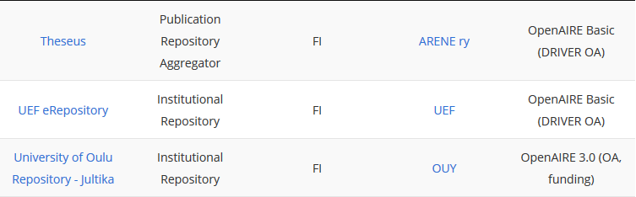
Finnish repositories supporting OpenAIRE harvesting
Includes
The repositories from 7 universities (+ 2 as sub-repositories)
Common repository for universities of applied sciences (Theseus)
One research institution (VTT) (+ 4 as sub-repositories)
Self-archived (green OA) publications
Theses
Missing
Repositories from 5 universities + most research institutions
Publications not archived in repositories, e.g.
Aaltodoc repository 2011-2017:
3049 publications
AaltoCRIS 2011-2017:
35 886 publications
Aalto publications in VIRTA 2011-2017:
27 257 publications

Slide 9
Survey for Finnish OpenAIRE providers by Finnish NOAD in 2018
The survey was carried out by the Finnish NOAD, the University of Helsinki
Responses from 7 (out of 9) current repositories that are harvested by OpenAIRE and 7 non-OpenAIRE repositories
6/7 current providers mentioned the work on data models and supporting harvestable API endpoint to be the biggest issues regarding OpenAIRE
In some cases repositories are not connected to CRIS systems
DSpace (used by most repositories) needs work (on publication forms etc.) to be compliant with OpenAIRE specifications
Harvested metadata is rather poor after mapping (repositories include richer metadata)
6/7 of non-OpenAIRE harvested repositories are planning to implement OpenAIRE support
Half of them to be harvestable in 2018/2019, others have no schedule yet
5/7 mention the technical implementation and work on metadata to be too resource intensive to yet have support for OpenAIRE spesifications
Summary of results (in Finnish) at: https://blogs.helsinki.fi/openaire2020/2018/08/23/kansallisesta-koordinaatiosta-toivotaan-tukea-julkaisuarkistoille-openaire-kyselyn-tulosten-yhteenveto/

Slide 10
Implementation of OpenAIRE Guidelines for CRIS Managers

Slide 11
Why?
To expose more of the Finnish research publications to OpenAIRE
Repositories only include a fraction of publications
Some institutional repositories are missing OpenAIRE integration
Centralized solution - to save time and resources
Implementation and possible updates to OpenAIRE specifications has to be done to one system only
Does not limit possible individual implementations in Finnish CRIS systems
Better quality and more complete metadata for OpenAIRE
Future additions to VIRTA data model can be harvested to OpenAire as well
2018 - Q1 | 2018 - Q2 | 2018 - Q3 | 2018 - Q4 | 2019 - Q1 | 2019 - Q2
Planning | Presenting to organizations | Mapping data models | OAI-PMH endpoint validating | OpenAIRE beta | First harvests to OpenAIRE?
 |  | Procedures for CERIF-XML |  | Permissions from organizations
 |  | OAI-PMH work

Slide 12
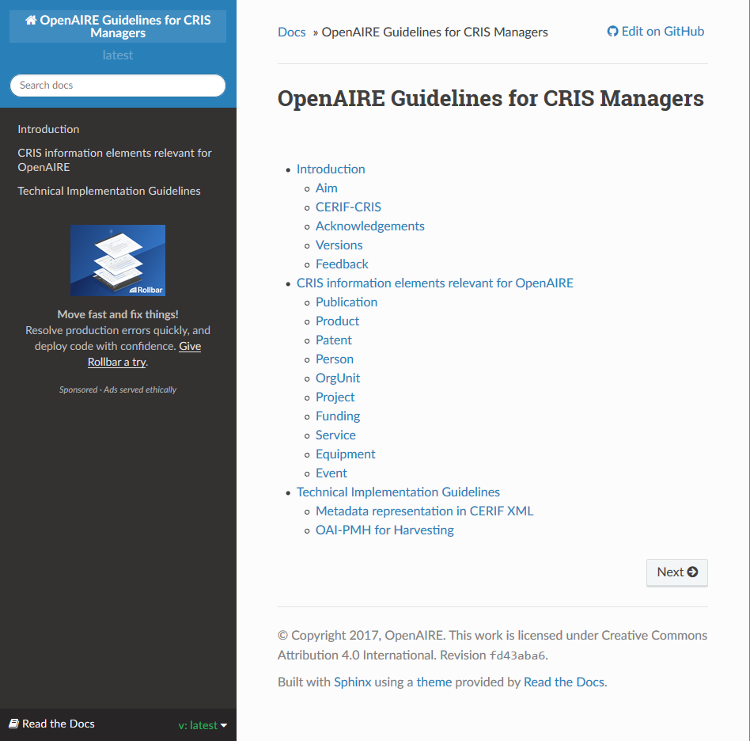
Guidelines for CRIS Managers
“The Guidelines provide orientation for CRIS managers to expose their metadata in a way that is compatible with the OpenAIRE infrastructure. By implementing the Guidelines, CRIS managers support the inclusion and therefore the reuse of metadata in their systems within the OpenAIRE infrastructure.”
OpenAIRE Guidelines for CRIS Managers version 1.1. released in June 2018

Slide 13
Universities
Universities of applied sciences
Vipunen
VIRTA
Statistical data
University hospitals
Research institutions
GET
Juuli
Source systems
GET
Examine metadata
Load XML files to SA (SSIS)
Publication data (CTRIS, DW)
Validate data (SQL procedure)
Research organisations
Organisations transfer data to Publication XML Schema (eg. via CSV-XML tool)
Find Jufo_IDs (C#)
GET
CRIS / master data use
Find co-publications (C#)
GET
JUSTUS
Find duplicates (C#)
Metadata prefill
SFTP Interface
XML files synced
APIs (REST, OAI-PMH)
Publication Data (XML)
Send validation email to organisation
GET/POST
PUT/DELETE
Transfer data to DW (SQL Procedure)
Powershell script
Academy of Finland
Create VIRTA-XML (SQL Procedure)
Applications / reporting
GET
JUSTUS
Database copy via SSH
Create CERIF-XML (SQL Procedure)
OpenAIRE
Publication data (SQL)
Create Dublin Core (SQL Procedure)
Metadata harvesting
Update API tables (SQL Procedure)
Database connection
Research Information Hub
Update reports (SQL Procedure)
Linking to data, projects etc.
Ready
To do

Slide 14
Data models
Many similarities between VIRTA and CERIF data models on publications and what elements are included
Key differences:
Publication type classification
Case of IDs as national aggregator
Open access classification
National classifications (e.g. field of science)
Chosen not to be included in mapping:
Publication forum levels (national scholarly panels)
Artistic publications

Slide 15
Data models
VIRTA - CERIF mapping table available: https://wiki.eduuni.fi/pages/viewpage.action?pageId=80941717
VIRTA data model for reference: https://tietomallit.suomi.fi/model/julkaisu/

Slide 16
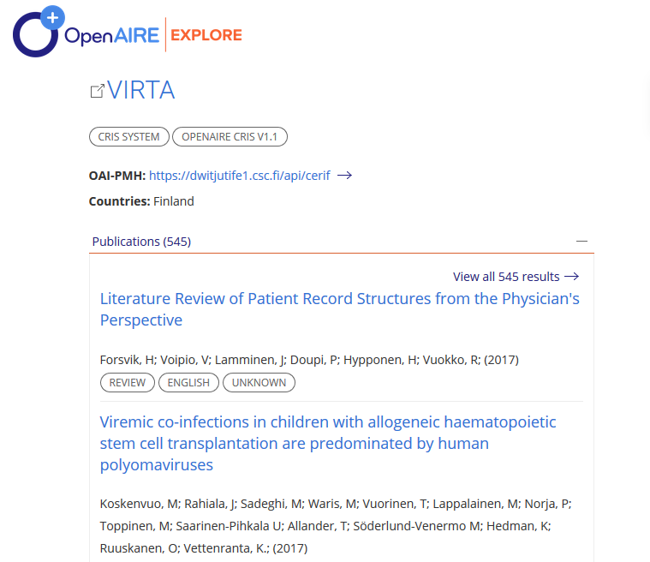
Lessons learned
Implementation process highly dependent on source system architecture / technologies
Following documentation is straightforward, but further support and best practices would be useful for implementers
Aiming for high quality metadata equals more work and more complex mapping (+ upkeep)

Slide 17
Thank you!

Slide 18
Joonas Nikkanen
Project Manager Research Information Management and Interoperability Tel. +358 50 381 80 92
linkedin.com/in/joonas-nikkanen

