Slide 1
Constructing reciprocity with young adults
PhD, Pirjo Korvela
University of Helsinki,
Department of Teacher Education,
Home Economics Art and Science

Slide 2
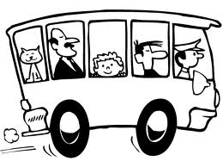
Passenger or driver
of own life?

Slide 3
Drifting daily living of young adults
Daily rhythm upside down
sleeping daytime
awake until early morning
Late from school / work
No motivation and direction of life
Weak social relations or social media related

Slide 4
Going to sleep
Schoolhealth 2007
 |  |  | Whole data
 |  |  | Comprehensive school |  |  |  |  | High school
 |  |  | 8th grade |  | 9th grade |  |  | 1st year |  | 2nd year
 |  |  | Boys | Girls | Boys | Girls | Tot. | Boys | Girls | Boys | Girls | Tot.
Question 88. What time you usually go to sleep on school days? | 21.00 or earlier |  | 2 | 2 | 1 | 1 | 2 | 0 | 1 | 0 | 1 | 1
 | 21.30 |  | 5 | 8 | 3 | 5 | 5 | 2 | 4 | 1 | 3 | 2
 | 22.00 |  | 20 | 24 | 13 | 19 | 19 | 10 | 17 | 7 | 15 | 12
 | 22.30 |  | 26 | 29 | 22 | 28 | 26 | 21 | 29 | 18 | 28 | 24
 | 23.00 |  | 22 | 20 | 24 | 23 | 22 | 26 | 25 | 25 | 27 | 26
 | 23.30 |  | 12 | 9 | 17 | 13 | 13 | 20 | 14 | 21 | 15 | 17
 | 24.00 |  | 6 | 5 | 10 | 6 | 7 | 11 | 6 | 16 | 7 | 10
 | 00.30 |  | 2 | 1 | 3 | 2 | 2 | 4 | 2 | 5 | 2 | 3
 | 01.00 |  | 2 | 1 | 3 | 1 | 2 | 3 | 1 | 4 | 2 | 3
 | 01.30 or later |  | 2 | 1 | 3 | 2 | 2 | 2 | 1 | 3 | 1 | 2
Total % |  |  | 100 | 100 | 100 | 100 | 100 | 100 | 100 | 100 | 100 | 100
N |  |  | 12045 | 12216 | 11773 | 11975 | 48009 | 4940 | 7081 | 4502 | 6361 | 22884

Slide 5
Daily rhythm constructed with six sequences of a day in families with children under school age
Sequence 1: The morning chores for leaving home
Sequence 2: Coming back home and settling down
Sequence 3: Doing something together
Seq. 4: Putting children to bed
Seq. 5: Working, adults’ own time
Seq. 6: Retiring for sleep
Time at work
and in day care
Early morning
Night
Time:
(Ref. Korvela, 2003)

Slide 6
Structure of everyday life (Sekki & Korvela 2012)
Family 1
Family 2
Family 3
Functioning part
Not Functioning:
Topic for the GG project
GG is not an applicable method, or not priored
Working with other
Institutions
Functioning part
Not Functioning:
Topic for the GG project
GG is not an applicable method, or not priored
Working with other institutions
Functioning part
Not Functioning:
Topic for the GG project
GG is not an applicable method, or not priored
Working with other institutions

Slide 7
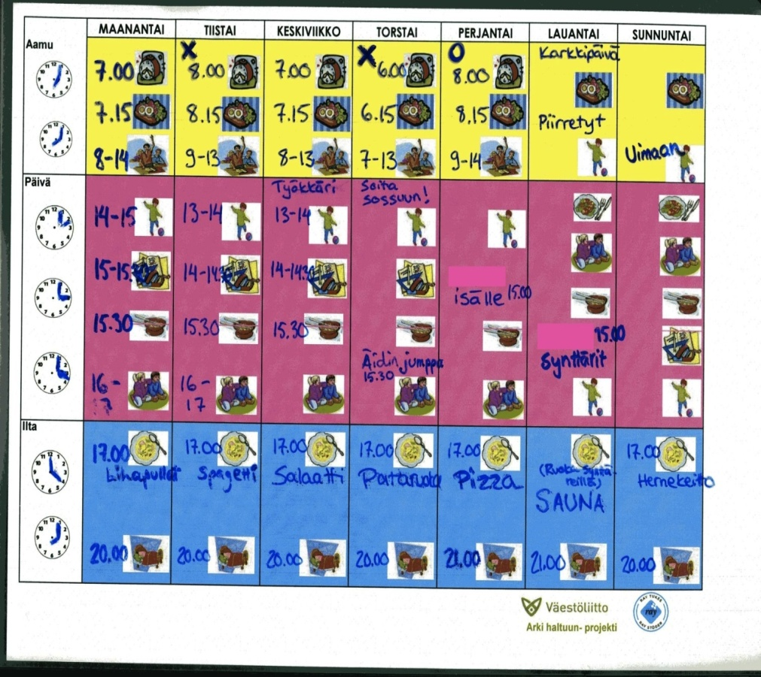
The Sequence Method
Discussions of daily activities (what, when, where, with whom)
Building up the Sq Map, constructing new daily rhythm together
SQ Map

Slide 8
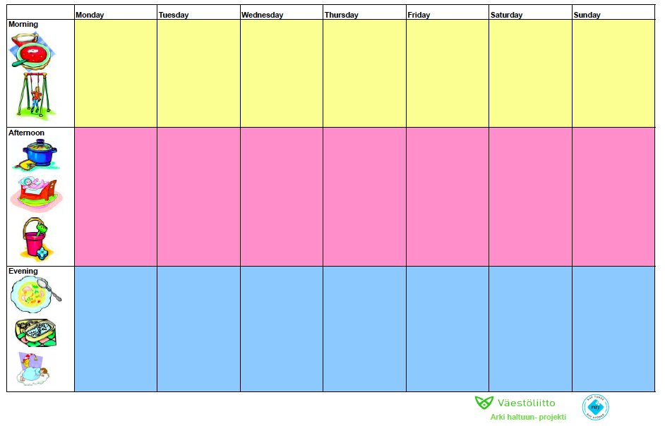
The Sequence method
Discussions of daily activities (what, when, where, with whom)
Building up the Sq Map, constructing new daily rhythm together
Data

Slide 9
Data
Recorded and transcripted discussions
Research Questions
What are the elements of reciprocity that can be recognized in the sequence method process?
What kind of reciprocal and non-reciprocal relations of young adults have with other individuals and communal institutions?

