Slide 1
Challenges of Data Analysis - stage of gaining independence
Maritta Törrönen, Professor of Social Work
University of Helsinki, Department of Social Research, Finland

Slide 2
Research on young people
who have been in public care and are leaving to start independent lives

Slide 3
Action and participatory peer research
EU-funded “Rights of Children in Alternative Care, from Theory to Practice: Filling the Gap through Peer Research” organised by SOS Children’s Village International
Poland, the Czech Republic, Albania and Finland

Slide 4
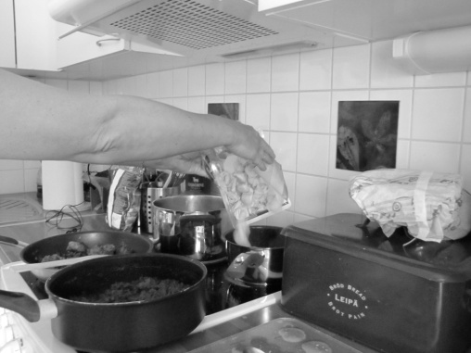
Knowledge about young people’s well-being when leaving care

Slide 5
Young people’s well-being
social, cultural and economic resources
and health
subjectivity

Slide 6
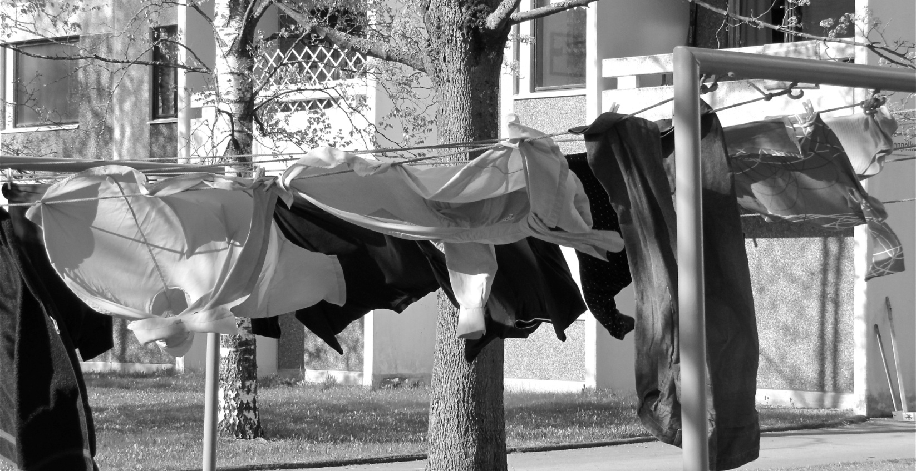
Young people’s participation in research - active participants

Slide 7
Experts by experiences
What can be learned from the other countries about child welfare services and how do these services support young people leaving care
Develop social work with young people so that young people have the possibility to have their own say

Slide 8
Difficulties in comparison
To collect data
To analyse data
To report

Slide 9
The semistructured interview schedule with open and closed answers
-Translations
- Many actors
Interaction
Interpretation

Slide 10
Difficulties in comparison
The systems The concepts used in child welfare

Slide 11
The semistructured interview schedule with open and closed answers
-Translations
- Many actors
- Time limits

Slide 12
but if experiences – understanding and the options for social work practice (Healy 2011)

Slide 13
Those who have it worst?

Slide 14
The interpretation of the replies
EXPRESSIONS OF THEIR OWN REALITY
REFLECTING ”TRUE EXPERIENCES”

Slide 15
vARIETY
young people’s varying experiences of alternative care

Slide 16
Flexibility
with regard to ending alternative care

Slide 17
Economic resources
Support
for schooling, study and work life skills

Slide 18
Mental and physical resources
Support
for psychological and physical well-being

Slide 19
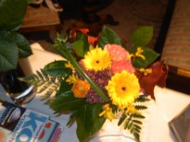
Social resources
Contacts with people who are important

