Slide 1
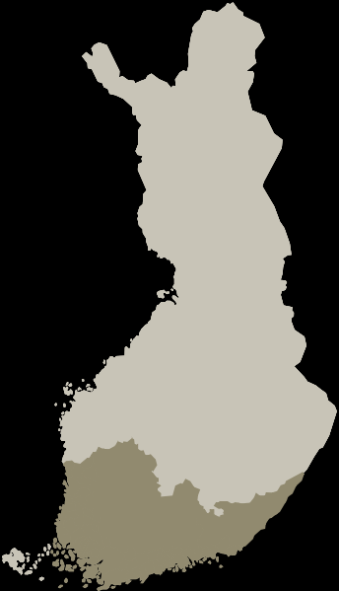
Tervetuloa Suomeen!
9.8.2013

Slide 2
There is an endless list of loan words…
taksi drinkki tee kahvi
bussi posti nörtti turisti
pumppu disko presidentti ministeri
pankki idea suklaa viini

Slide 3
Finnish is not a difficult language!
No articles! (a/the)
No gender! (she/he → hän)
No future!
Mä laitan ruokaa. (I’m cooking.)
Mä laitan ruokaa huomenna. (I will cook tomorrow.)

Slide 4
More easy features
Almost 1:1 relationship between sounds and letters
tuli = fire
tuuli = wind
tulli = customs
(A classic mistake:)
Tapaan sinut illalla = I’ll meet you in the evening.
Tapan sinut illalla. = I’ll KILL you in the evening.

Slide 5
And even more…
The stress is always on the first syllable of the word.
tomaatti
musiikki
The basic word order is S-V-O.
Minä juon maitoa. = I drink milk.
You can make new words with different suffixes
kirja (book)
kirjasto (library)
kirjallisuus (literature)
Japani (Japan)
japanilainen (Japanese, nationality)

Slide 6
Some survival phrases:
Kiitos = Thank you Ole hyvä = You’re welcome
Anteeksi = Sorry /Excuse me
Huomenta! = Good morning
Hei! Moi! Terve! = Hi! Päivää = Good day
Mikä sun nimi on? = What’s your name?
Mitä kuuluu? = How are you?
Hyvää, kiitos. = Fine, thanks.
Ei = no Kyllä / Joo = yes
Anteeksi, missä on…? = Where is..?
Terveisiä Suomesta! = Greetings from Finland!

Slide 7
And now.. Can you fill in the gaps and say something about yourself in Finnish?
___Moi! Hei!____________! (A suitable greeting)
Mun nimi on ____Nuppu_______.
Mä olen ____korealainen__.
Hyvä! ☺
Good!

Slide 8
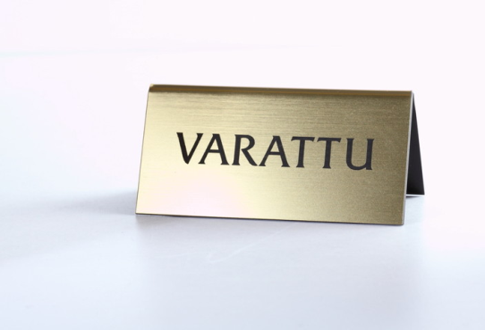
ULOS
EPÄKUNNOSSA

Slide 9
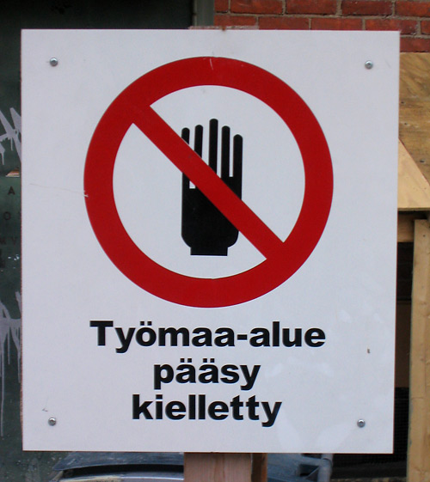
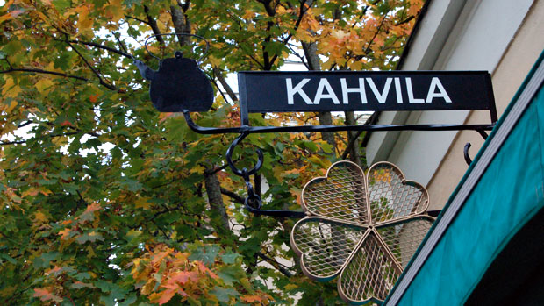
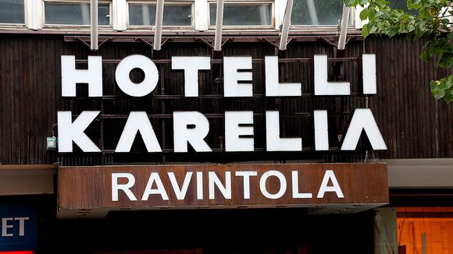
These ones you can see outdoors

Slide 10
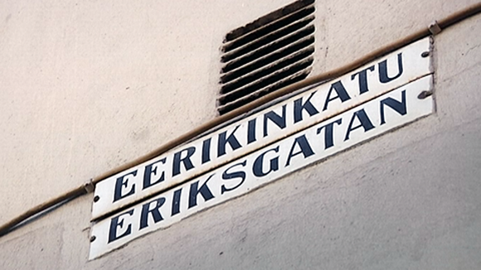
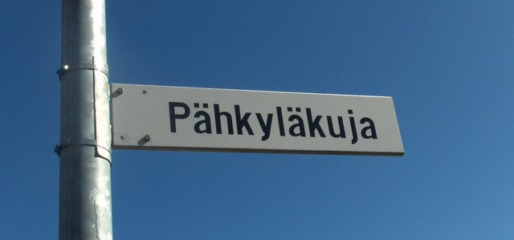
STREET NAMES
If someone yells at you VARO!
What do you think that means?

Slide 11
A few cultural points
Large country at the European scale – large distancies
Rather homogenious population – immigration considerably new phenomen
Helsinki are is the most populated and most diverse area
Appeciated values: honesty, straightforwardness, equality, quietness, intelligence (education)

Slide 12
Cultural DO’s and DON’T’s
DON’T ☹
be surprised people being quiet and serious.
tip, it is not very common.
DO ☺
make an eye contact
shake hands with both men and women
line-up nicely for buses, metros and trams
ask for help if needed, most Finns speak English and are happy to help you
HAVE FUN!

