Slide 1
Socioeconomic Differences in Alcohol use, Disorders and Harm: Exploring the Alcohol Harm Paradox
Sebastián Peña, MD, PhD
Väinö Kannisto Award 2021
Notes:
Seppo Koskinen National Institute for Health and Welfare, Finland
Pia Mäkelä National Institute for Health and Welfare, Finland
Tommi Härkänen National Institute for Health and Welfare, Finland
Markku Helioväärä National Institute for Health and Welfare, Finland
Tiina Laatikainen National Institute for Health and Welfare, Finland
Satu Mänistö National Institute for Health and Welfare, Finland
Erkki Vartiainen National Institute for Health and Welfare, Finland
Teemu Gunnar

Slide 2
Acknowledgements
Supervisors
Seppo Koskinen Finnish Institute for Health and Welfare, Finland
Pia Mäkelä Finnish Institute for Health and Welfare, Finland
Co-authors
Gonzalo Valdivia Jaana Suvisaari Markku Helioväärä Erkki Vartiainen
Satu Helakorpi Tommi Härkänen Teemu Gunnar
Niina Markkula Suoma Saarni Satu Männistö
Paula Margozzini Janne Härkönen Tiina Laatikainen
Funders
Research grant, 2016
Salaried position, 2018-2019
Research grant, 2019

Slide 3
Outline
Background and Aims
Methods
Key results
Conclusions and way forward

Slide 4
Background
Harmful alcohol use is associated with vast health, social and economic harm
In Finland, alcohol-related mortality represent 49% of all deaths in the lowest socioeconomic quintile (35-64 yrs)
Finland has some of the highest socioeconomic differences in alcohol-attributable mortality
Alcohol harm paradox:
Lower socioeconomic groups experience greater alcohol mortality (about 3 times higher than higher socioeconomic counterparts)
This contrasts with the reported small or no differences in alcohol use
Tarkiainen 2016
Mackenbach 2015
Probst 2015
Peña, 2017

Slide 5
Causal framework
Socioeconomic status
Alcohol-attributable morbidity
Alcohol-attributable mortality and harm
Notes:
Contrast between colours!

Slide 6
Causal framework
Differential bias in measurement of alcohol use
Reverse
causality
Socioeconomic status
Alcohol-attributable morbidity
Alcohol-attributable mortality and harm
Differential exposure to risk factors
Differential vulnerability to risk factors
Alcoholic liver disease (K70)
Alcohol use disorder (F10)
Alcohol poisoning (X45)
Alcohol pancreatitis (K852, K860)
Alcohol cardiomyopathy (I426)
Degeneration of nervous system due to alcohol (G312)
Notes:
Contrast between colours!

Slide 7
Aims
To examine the socioeconomic differences in alcohol use and alcohol-related harm and to identify explanatory factors for the alcohol harm paradox in Finland
To investigate the existence and patterns of socioeconomic inequalities in alcohol use in Finland and Chile using nationally representative data
To examine the changes in the prevalence and the socioeconomic correlates of alcohol use disorders between 2000 and 2011 in Finland
To examine whether the systematic differences in alcohol-attributable mortality in Finland are due to underreporting of alcohol use in surveys versus biomarkers (GGT, CDT, ALT, AST)
To quantify the extent to which socioeconomic inequalities in alcohol-attributable mortality in Finland are explained by joint effects between alcohol and behavioural risk factors (smoking and body mass index) and between SES and behavioural risk factors

Slide 8
Methods

Slide 9
I - Socioeconomic inequalities in alcohol use
Design
Cross-sectional analysis of national public health surveys in Finland and Chile
Data
Pooled surveys on Health Behaviour and Health among the Finnish Adult Population (AVTK) in 2008–2011 (n= 9994)
National Health Survey 2009–2010 (ENS09-10) (n=3477)
Exposure
Years of education (continuous variable)
Sex and age
Outcome
Abstinence
Weekly volume of alcohol use
Heavy volume drinking
Heavy episodic drinking
Statistical analysis
Concentration index
Stratified by age and sex

Slide 10
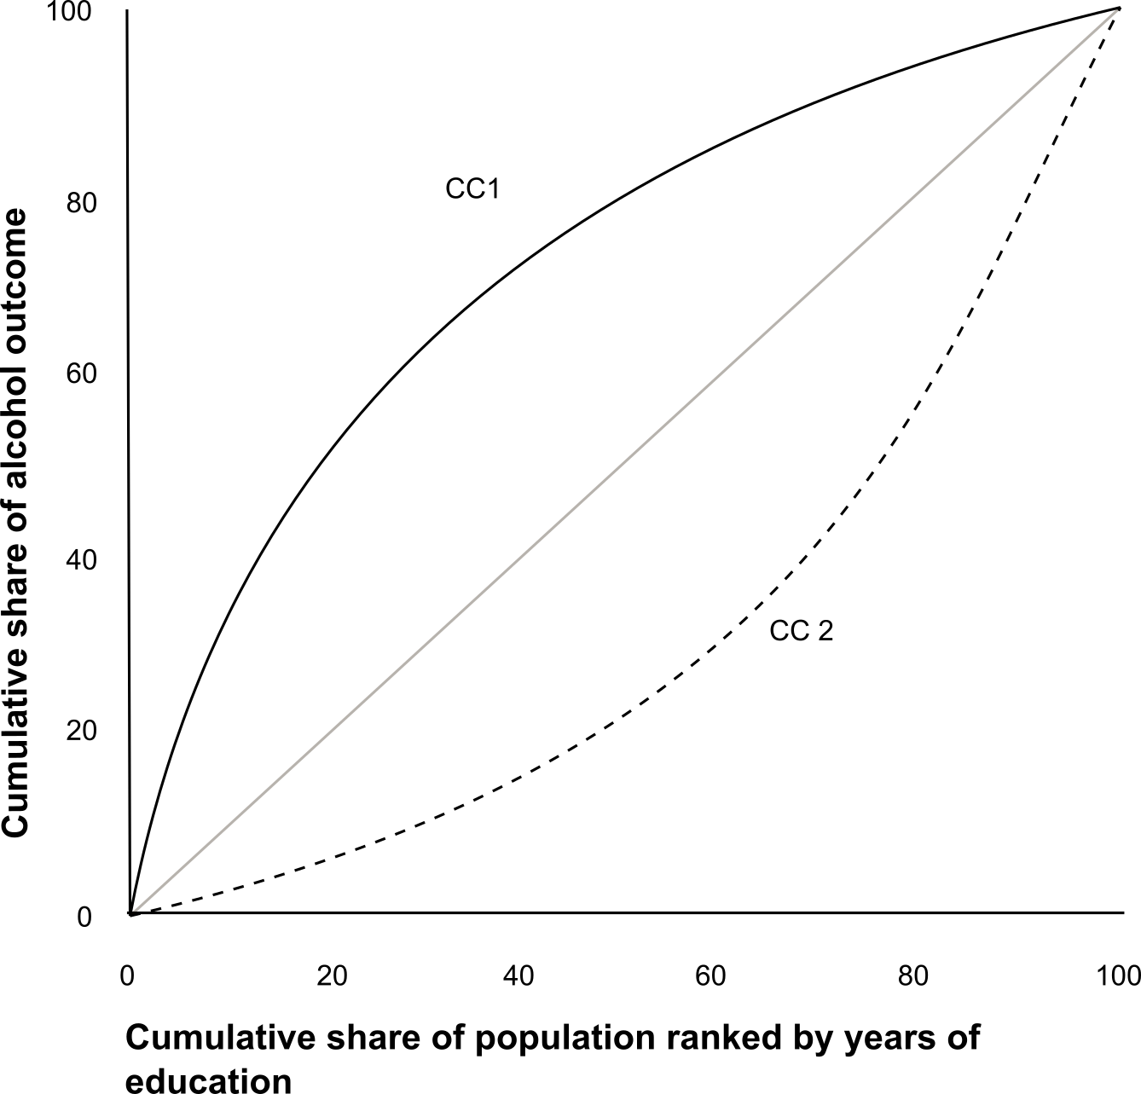
Concentration index
Limits
-1 All the outcome concentrated in
the lowest educational groups
+1 All the outcome concentrated in
the highest educational groups
0 Perfect equality

Slide 11
II – Prevalence and socioeconomic differences in alcohol use disorders
Design
Repeated measures longitudinal analyses
Data
Health 2000 Survey
Health 2011 Survey (follow-up of Health 2000 Survey)
59% participation rate, n = 4381
Exposures
Sex and age
Educational level
Marital status
Outcome
Alcohol use disorders (using the M-CIDI, a structured interview)
Statistical analysis
Model-adjusted prevalence from logistic regressions
Comparison of inverse probability weights and multiple imputation (to account for non-participation)

Slide 12
III – IV Explanations for the alcohol harm paradox
Design
Prospective cohort study of pooled nationally representative health surveys
Data
Eight health examination surveys: Mini-Finland Survey 1978, Health 2000, FINRISK 1982-2007
High response rates (average 78%)
Comparable design and implementation
Analytic sample: ~53,000 participants
Exposures
Sex, age, income and education (SES), marital status
Weekly alcohol use
Smoking and body mass index
Alcohol biomarkers: GGT, CDT, AST, ALT
Outcome
Alcohol-attributable mortality (35 100% attributable causes)
Death certificates (underlying and contributory causes of death)
Follow-up from baseline until December 2016

Slide 13
III - DAG and mediation analysis
‘Confounders
Exposure:
Income
Mediator 1:
Alcohol use
Mediator 2:
Biomarker
Alcohol mortality
Direct effect (unexplained)

Slide 14
III - DAG and mediation analysis
$$\left(1\right) Y=i_{1}+cX+ e_{1}$$
Model 1
Model 2
Sex, age and survey round
+ Alcohol use
$$\left(2\right) Y=i_{2}+c′X+bM+ e_{2}$$
2.20
1.50
$$c −c′$$
Hazard ratio
“Change-in-estimate” i.e. difference method
Survival analysis with frailty Cox proportional hazards models
Age as the timescale
Complex sampling design

Slide 15
Limitations of the difference method
$$\left(1\right) Y=i_{1}+cX+ e_{1}$$
$$\left(2\right) Y=i_{2}+c′X+bM+ e_{2}$$
$$c −c′$$
Simplicity
Does not allow to quantify the indirect effect
Cannot accomodate interactions and nonlinear exposures and mediators
Cannot separate differential exposure from differential vulnerability

Slide 16
IV - DAG and causal mediation analysis
‘Confounders
Mediated pathways decomposed into:
Indirect effects
Mediated interactive effects
Mediator 1:
Alcohol use
Exposure:
Income
Mediator 1:
Smoking
Alcohol mortality
Mediator 1:
Body mass index
Direct effect
Total effect = Direct effect + Indirect effect (M1, M2, M3) +
Mediated interactive effects (M1, M2, M3)
Lange 2014; VanderWeele, 2013, Nordahl, 2014
Notes:
Contrast between colours!

Slide 17
IV - DAG and mediation analysis
$$\left(1\right) Y=i_{1}+cX+b_{1}M_{1}+b_{2}M_{2}+b_{3}M_{3}+e_{1}$$
Marginal Structural Models
Remove known confounding by creating a pseudo-population
Aalen additive hazard models
Age as the timescale
Does not remove ALL confounding
Does not remove mediator-outcome confounder
Cannot accomodate complex sampling design

Slide 18
Original articles
Peña S, Makela P, Valdivia G, et al. Socioeconomic inequalities in alcohol consumption in Chile and Finland. Drug and alcohol dependence 2017; 173: 24-30
Peña S, Suvisaari J, Härkänen T, Markkula N, Saarni S, Härkönen J, Mäkelä P, Koskinen S. Changes in prevalence and correlates of alcohol-use disorders in Finland in an 11-year follow-up. Nord J Psychiatry 2018; 72: 512-520
Peña S, Mäkelä P, Härkänen T, Heliövaara M, Gunnar T, Männistö S, Laatikainen T, Vartiainen E, Koskinen S. Measurement error as an explanation for the alcohol harm paradox: analysis of eight cohort studies. Int J Epidemiol 2020; 49 (6): 1836–1846
Peña S, Mäkelä P, Härkänen T, Heliövaara M, Männistö S, Laatikainen T, Koskinen S. Joint effects of alcohol use, smoking and body mass index as an explanation of the alcohol harm paradox: causal mediation analysis of eight cohort studies. Addiction 2021; 116(8): 2220-2230

Slide 19
Efforts to increase replicability of results
Submitted protocol (to access data) but not preregistration
All code (either Stata or R) available in my Research Gate and GitHub and in Supplementary Appendix
The harmonization protocol is available in the Supplementary Appendix

Slide 20
Results

Slide 21
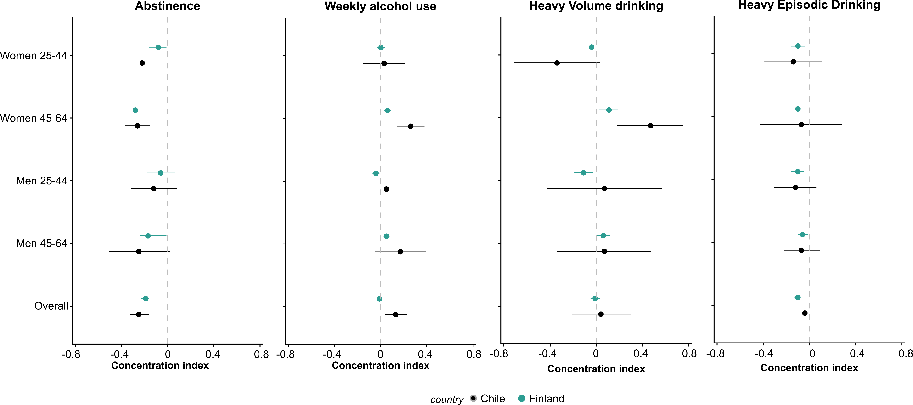
I – Socioeconomic inequalities in alcohol use

Slide 22
II – Prevalence and correlates of alcohol use disorders
 | Prevalence (95% CI)
 | 2000 | 2011
Overall | 4.6 (4.0-5.1) | 2.0 (1.6-2.4)
Educational level
Basic | 3.2 (2.9-4.4) | 2.0 (1.2-2.7)
Intermediate | 5.5 (4.5-6-6) | 2.4 (1.7-3.1)
High | 4.7 (3.7-5.7) | 1.6 (1.7-3.1)
Marital status
Married or cohabiting | 4.0 (3.4-4.6) | 1.5 (1.1-1.9)
Unmarried, widowed or divorced | 5.8 (4.7-6.8) | 3.2 (2.2-4.2)

Slide 23
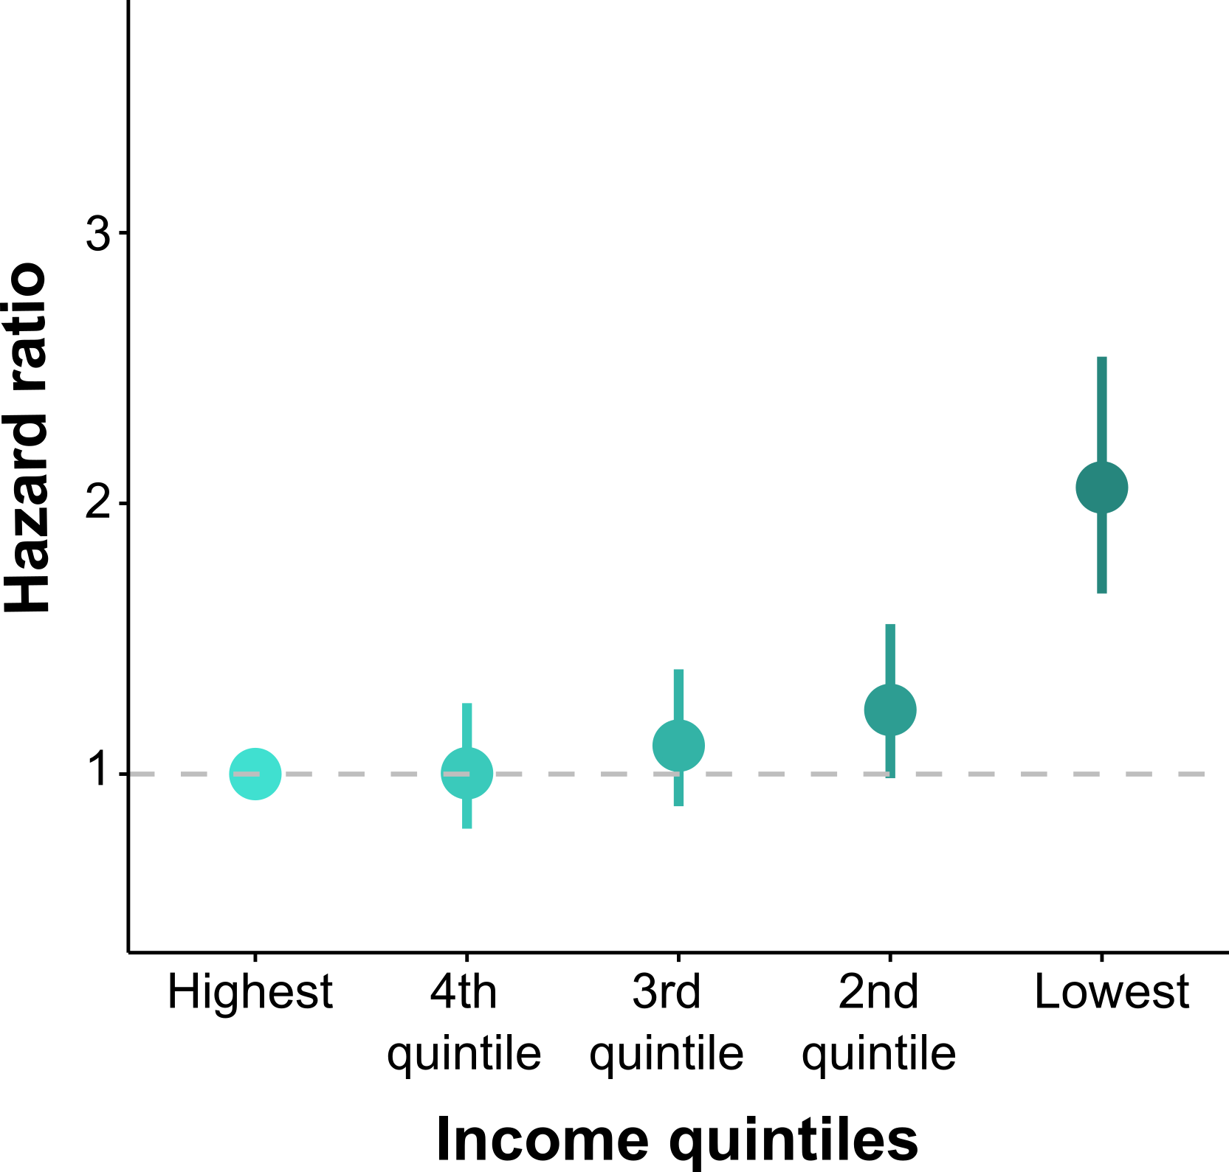
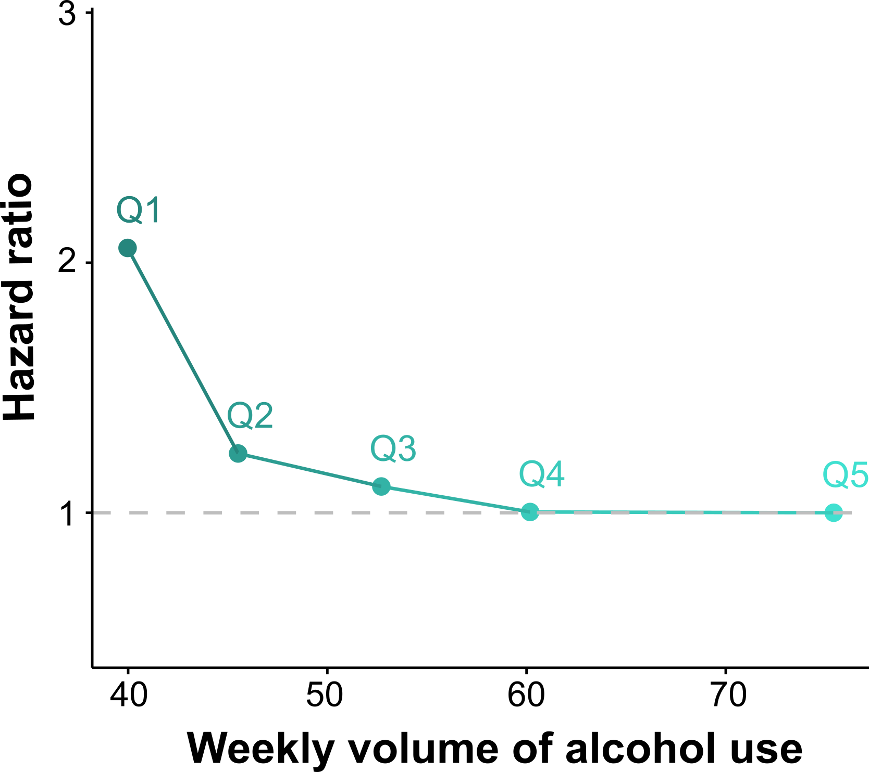
III – IV Clear socioeconomic differences in alcohol use

Slide 24
III – Alcohol biomarkers improved the predicted ability (C-index)
Self-reported alcohol use
Self-reported alcohol use + alcohol biomarker
Alcohol biomarker
All cohorts, GGT
0.823
0.844
0.825
Subsample with GGT and CDT
0.841
0.864
0.856
Subsample with GGT and ALT
0.869
0.897
0.894
Subsample with GGT and AST
0.859
0.871
0.842

Slide 25
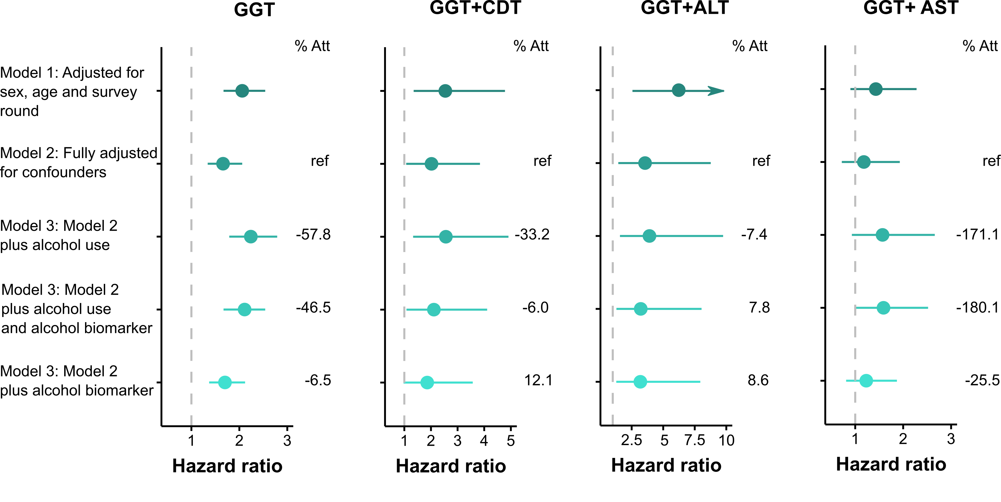
III – Adjusting for self-reported alcohol use vs biomarkers

Slide 26
IV - Evidence of joint effects?
Income*Alcohol
Income*Smoking
Income*BMI
Alcohol*Smoking
Alcohol*BMI
YES!
46.8 (25.8; 68.6)
YES!
11.4 (5.8; 17.0)
NO
-4.2(-9.8; 1.4)
NO
12.3 (-1.3; 25.9)
NO
-0.7 (-18.1; 16.7)
46.8 extra deaths due to the interaction (income*alcohol)
11.4 extra deaths due to the interaction (income*smoking)
Estimate: Number of additional alcohol deaths per 10,000 person years

Slide 27
DAG and causal mediation analysis
‘Confounders
Mediator 1:
Alcohol use
Indirect effects
Mediated interactive effects
Exposure:
Income
Mediator 1:
Smoking
Alcohol mortality
Mediator 1:
Body mass index
Direct effect
Total effect = Direct effect + Indirect effect (M1, M2, M3) +
Mediated interactive effects (M1, M2, M3)
Notes:
Contrast between colours!

Slide 28
IV – Three-way decomposition
 | Additional alcohol deaths per 10,000 person-yrs | 95% CI | Proportion explained (%)
Total effect | 5.5 | 3.7; 7.3 | 100%
Direct effect | 8.3 | 6.0; 10.6 | 151.3
Indirect effect combined | -2.8 | -3.8; -1.8 | -51.3

Slide 29
 | Additional alcohol deaths per 10,000 person-yrs | 95% CI | Proportion explained (%)
Indirect effect, through alcohol use | -1.2 | -2.0; -0.4 | -22.1
Mediated interactive effect, through alcohol use^{c} | -2.6 | -3.8; -1.4 | -47.2
Indirect effect, through smoking | 0.5 | 0.3; 0.7 | 9.2
Mediated interactive effect, through smoking^{d} | 0.5 | 0.1; 0.8 | 8.4
Indirect effect, through BMI | 0.4 | 0.1 0.8 | 7.9
Mediated interactive effect, through BMIe | -0.4 | -0.9; 0.1 | -7.4

Slide 30
Summary
People with lower SES had higher levels of abstinence in Finland and Chile and higher levels of HED in Finland. These differences were small
We did not observe important socioeconomic differences in the prevalence of alcohol use disorder
In the same population, we observed that those with lower SES showed lower levels of alcohol use, but higher alcohol mortality
Alcohol biomarkers explained a small proportion of the socioeconomic differences in alcohol mortality in our data
We observed joint effects for income and alcohol and income and smoking
Smoking and BMI (both indirect effect and mediated interactive effects) explained 18.1% of income differences in alcohol mortality

Slide 31
The way forward
Research
Other mediators: Cumulative disadvantage, psychological stress, access to health care
Methods that improve our identification strategy: Mendelian randomization, natural experiments
Policy changes (i.e. price, marketing, availability) have had a differential impact on alcohol-related harm
Policy
Universal alcohol policies that benefit more those with lower SES (i.e. tax structure)
Targeted alcohol policies
Differential vulnerability: structural determinants of health (social, environmental, commercial, political)

Slide 32
References
Tarkiainen L, Martikainen P, Laaksonen M. The contribution of education, social class and economic activity to the income-mortality association in alcohol-related and other mortality in Finland in 1988-2012. Addiction (Abingdon, England) 2016; 111: 456-64
Probst C, Roerecke M, Behrendt S, Rehm J. Socioeconomic differences in alcohol-attributable mortality compared with all-cause mortality: a systematic review and meta-analysis. International journal of epidemiology 2014; 43: 1314-27
Peña S, Makela P, Valdivia G, et al. Socioeconomic inequalities in alcohol consumption in Chile and Finland. Drug and alcohol dependence 2017; 173: 24-30.
Syden L, Sidorchuk A, Makela P, Landberg J. The contribution of alcohol use and other behavioural, material and social factors to socio-economic differences in alcohol-related disorders in a Swedish cohort. Addiction (Abingdon, England) 2017; 112: 1920-30
Katikireddi SV, Whitley E, Lewsey J, Gray L, Leyland AH. Socioeconomic status as an effect modifier of alcohol consumption and harm: analysis of linked cohort data. The Lancet Public health 2017; 2: e267-e76
Lange T, Rasmussen M, Thygesen LC. Assessing Natural Direct and Indirect Effects Through Multiple Pathways. American journal of epidemiology 2013; 179: 513-8
VanderWeele TJ. A Three-way Decomposition of a Total Effect into Direct, Indirect, and Interactive Effects. Epidemiology (Cambridge, Mass) 2013; 24: 224-32
Nordahl H, Lange T, Osler M, et al. Education and Cause-specific Mortality: The Mediating Role of Differential Exposure and Vulnerability to Behavioral Risk Factors. Epidemiology (Cambridge, Mass) 2014; 25: 389-96

Slide 33
Thank you!!
Sebastián Peña
National Institute for Health and Welfare, Finland
Email: sebastian.penafajuri@thl.fi
Twitter: @spenafajuri

Slide 34
Causal mediation analysis
Fit multinomial logistic regressions with mediators as an outcome
Create auxiliary variables, one for each mediator, and expanded the dataset to allow all posible combinations of the original exposure
Calculate predicted probabilities for the auxiliary variable and the original exposure and divided them to create three weights (one fo each mediator)
Fit a marginal structural model using Aalen hazard model

