Slide 1
Re-imagining online learning
at Global Campus
Viikki 24.11.2023
Ulla Hemminki-Reijonen
Director, MOOC Center
Project Lead, Global campus
University of Helsinki

Slide 2
”Start-up inside the university”
2022-2024
Team of 9, including 4 students
Creating a platform for bold EdTech experiments (XR&AI)
Helping faculties to open education in English, in an innovative way
9.11.2023

Slide 3
What we do at global campus?
EdTech experiments
AI
Course development
Own product development
XR

Slide 4
MOOC Center
Knowledge and Learning are for Everyone.
www.mooc.fi
Create your MOOC now and get help!

Slide 5
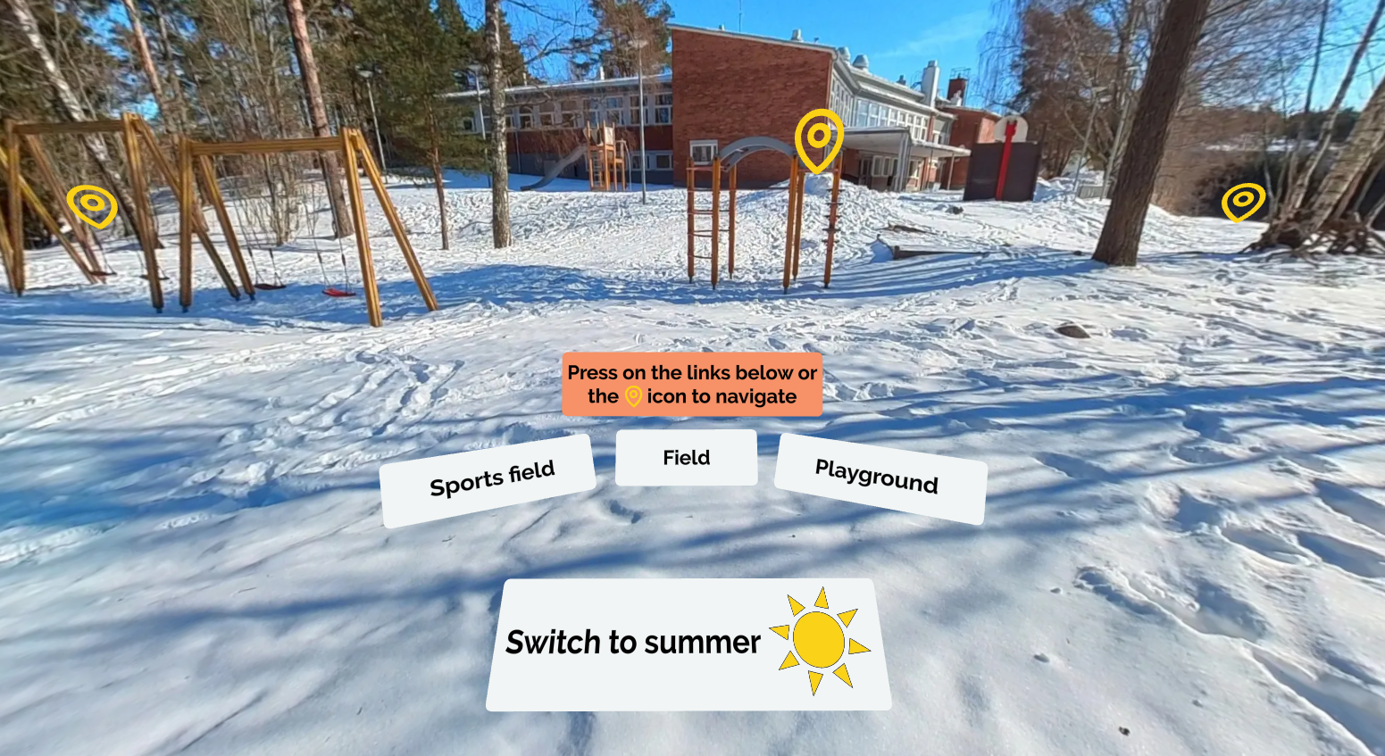
Uncover Finnish Education MOOC → launched in August with VR simulations and AI videos at mooc.fi

Slide 7
The pedagogical framework combines
Sustainability competencies
Learner-centered pedagogies
The best of VR and AI in multimodal environment
Systems-thinking
Values-thinking
Futures-thinking
Interpersonal/Intrapersonal skills
Implementation skills
Strategic-thinking
Making impossible possible
Traveling in time&place
AI companions
Changing perspectives
Serendipitous Learning: discovering interesting aspects and recognizing new relations and gaining new insights
Developing empathy
Personalized learning
Problem-based learning

Slide 8
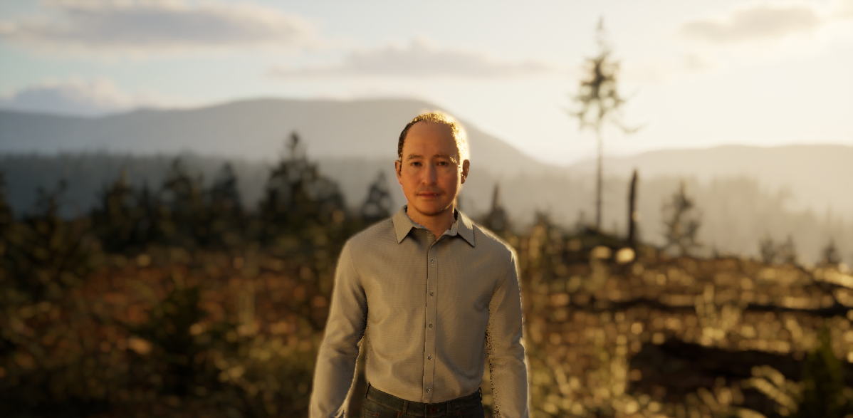
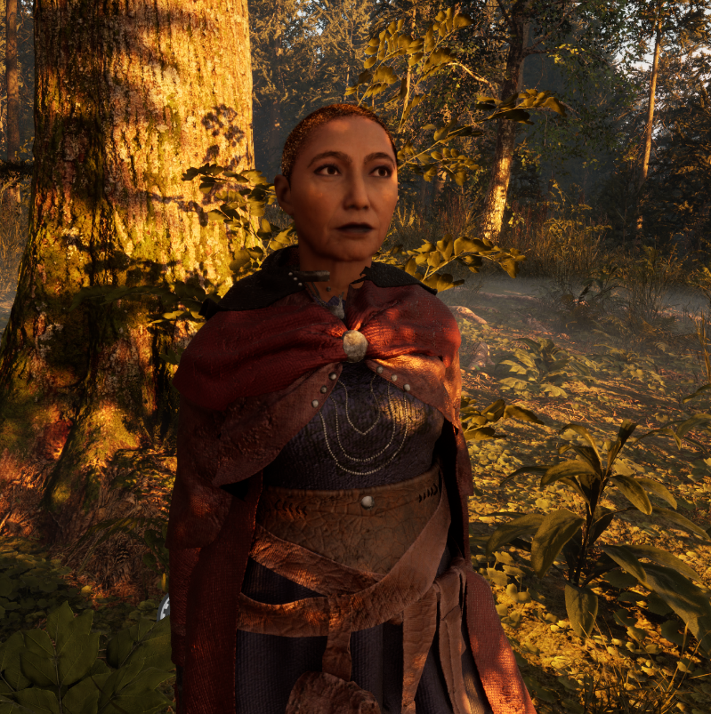
Discuss with AI-powered characters
AI characters are designed to fulfill different pedagogical purposes and learning content such as:
Playing local people, enabling perspective-taking with different cultures and stakeholders
Helping students in doing tasks, such as creating their future vision

Slide 9
Four episodes
Based on the tipping elements of the earth´s climate system.
Each has its own virtual environment, people, content, challenges, final task. In each episode, different disciplines are covered and different sustainability competencies are being developed.
The four episodes will form a university course with credits.
More information: www.serendip.fi

Slide 10
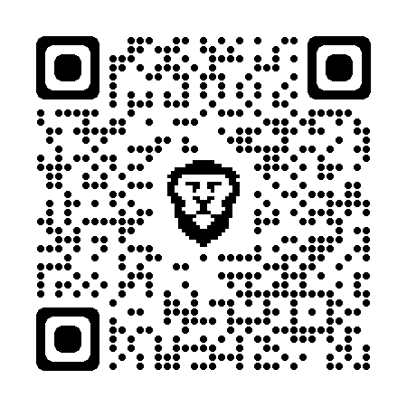
For more information, please follow our blog:
https://blogs.helsinki.fi/globalcampus/
Global Campus

